Slide 1
Systems Evaluation Workshop
AEA 2019
Renger & Renger

Slide 2
Agenda
8:00 Welcome & introductions
8:10 Rise of systems thinking in evaluation: limitations with program evaluation approaches
9:00 Defining systems, systems thinking, and system concepts
9:30 Coffee Break
9:45 Evaluating systems using System Evaluation Theory (SET)
11:00 Leave conference for Mall of America
14:00 Leave Mall of America for conference opening plenary

Slide 3
What is your understanding of systems thinking?

Slide 4
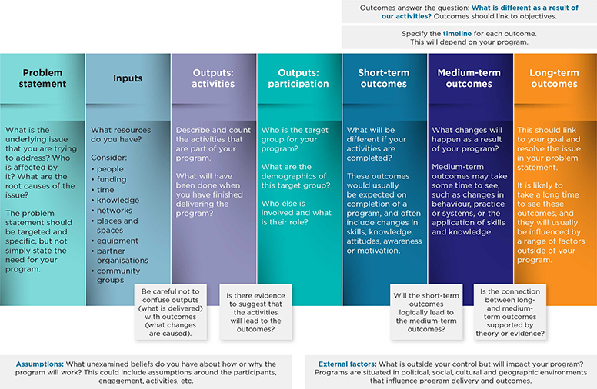
Rise of systems thinking in evaluation
Why is systems thinking garnering so much attention in evaluation?

Slide 5
Did not set alarm
No back-up generator
Power failure
Alarm didn’t go off on time
Daylight savings time switch
Did not change time
Forgot
Delayed because had to change outfits
Don’t get out the door on time for work/school
No smart Phone
No weather app
Didn’t check weather
Didn’t think it would snow
Never learned smart phone functions
Don’t know how to use weather app
Other family members using shower first
No schedule
No one took charge
Had to wait for shower
Only 1 shower
Poor family planning
Too many family members
No hot water

Slide 6
Did not set alarm
No back-up generator
Power failure
Alarm didn’t go off on time
Daylight savings time switch
Did not change time
Forgot
Delayed because had to change outfits
Don’t get out the door on time for work/school
No smart Phone
No weather app
Didn’t check weather
Didn’t think it would snow
Never learned smart phone functions
Don’t know how to use weather app
Other family members using shower first
No schedule
No one took charge
Had to wait for shower
Only 1 shower
Poor family planning
Too many family members
No hot water

Slide 7
Building a Theory Driven Logic Model
Immediate Outcomes
Intermediate Outcomes
Long term Outcome
Program Theory (Assumptions)
Everyone attempts to take shower at the same time
Don’t get out the door on time for work
No one took charge
No Sequencing
Members wait for shower
Intervention:
Family meeting to create process flow

Slide 8
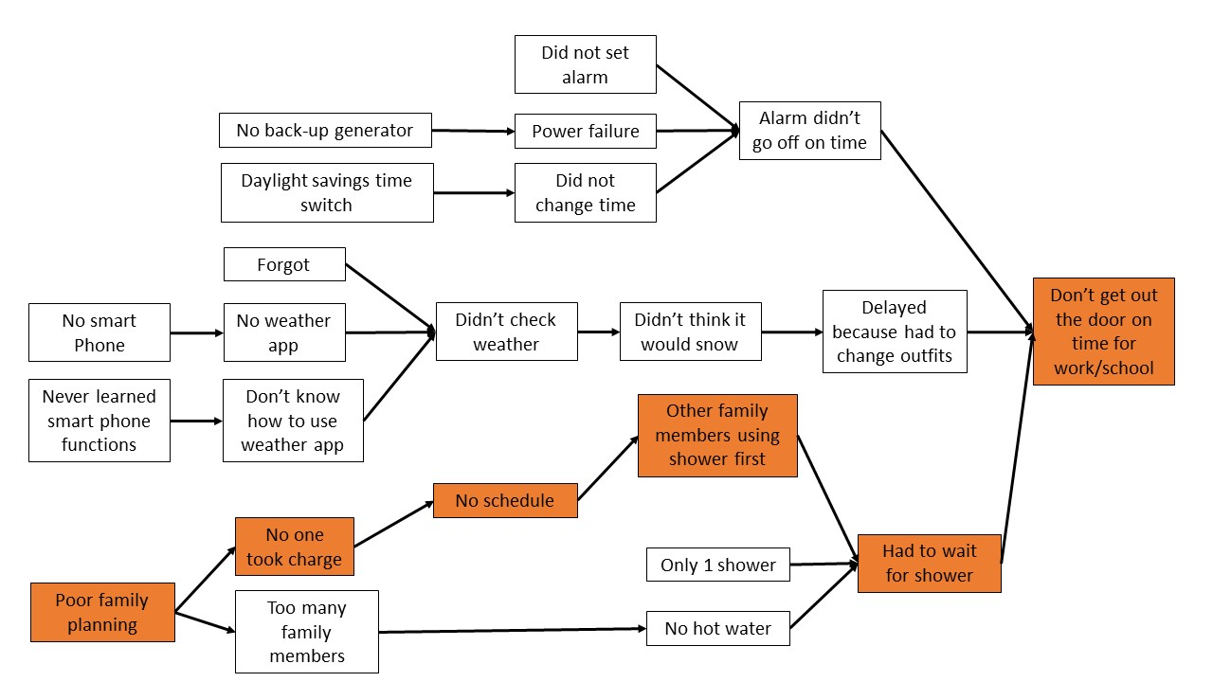
So what are the limitations of the logic model?

Slide 9
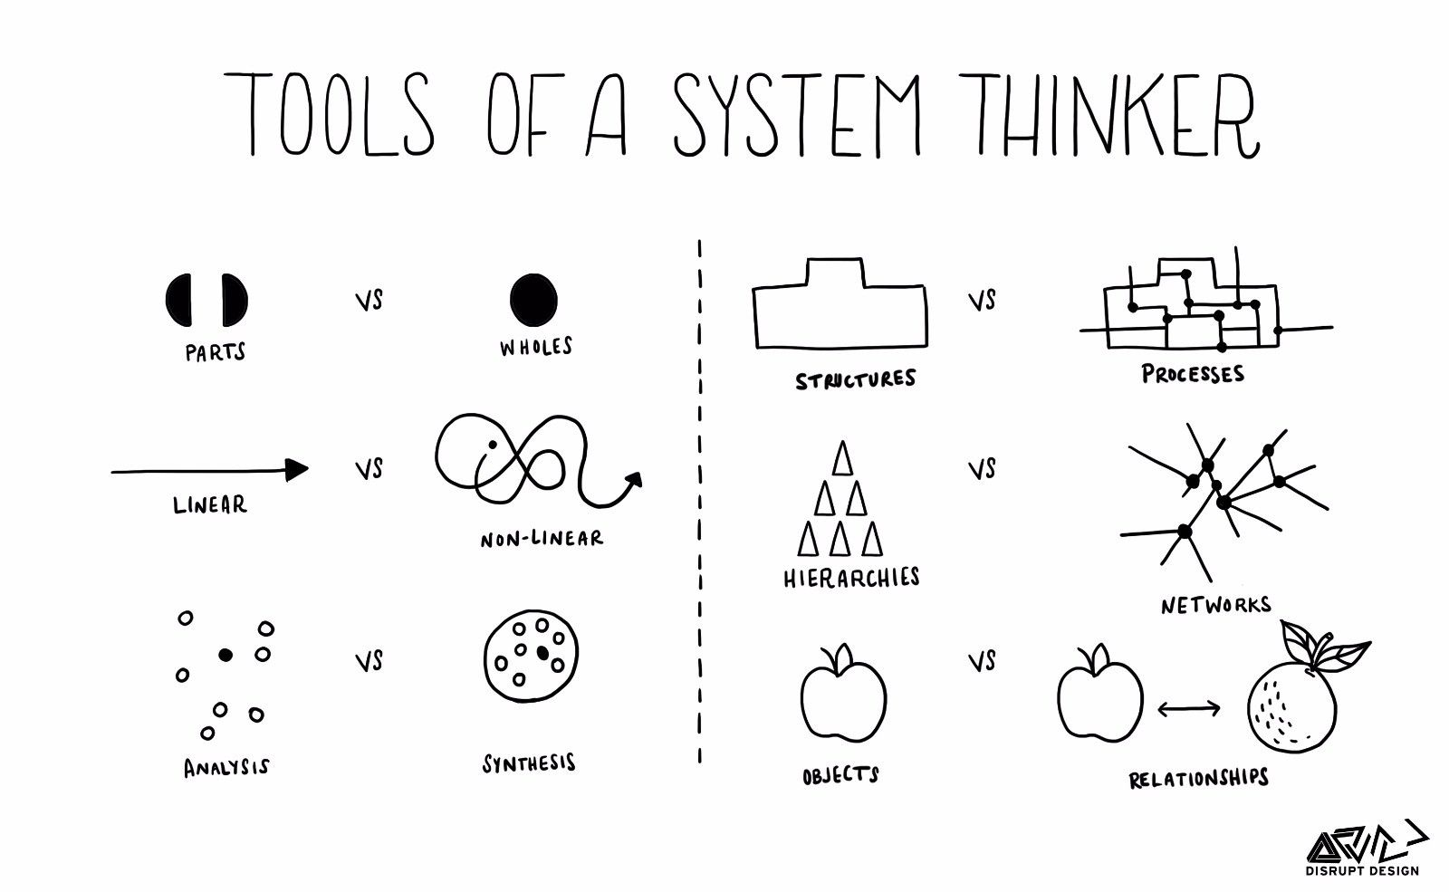
Logic models only focus on conditions targeted by the program
Other contextual factors impacting program success not weighed in the evaluation.
Makes outcome evaluation difficult to explain.
Renger, Bartel & Foltysova, (2013)
Contextual factors that are being targeted by program are depicted linearly.
Artificial representation of reality = meaningless recommendations
Renger, Foltysova, Becker & Souvannasacd (2015)
Renger, Renger, Donaldson, Renger, Hart & Hawkins (in press)

Slide 10
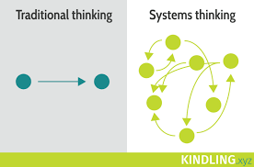
Systems thinking and system concepts
A way of thinking based on core system concepts (AEA, 2018).
System concepts have come to define the systems field (AEA, 2018).
System concepts focus on interconnectedness between elements.

Slide 11
Do you know any system concepts?

Slide 12
The big four system concepts….but so much more!
Boundaries
Elements
Relationships
Perspectives

Slide 13
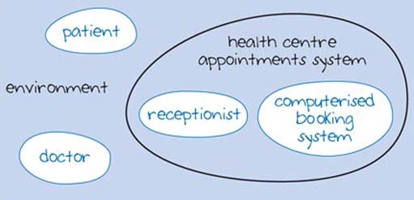
Boundaries
Determines where the system starts and finishes.
Why is this important for evaluation?

Slide 14
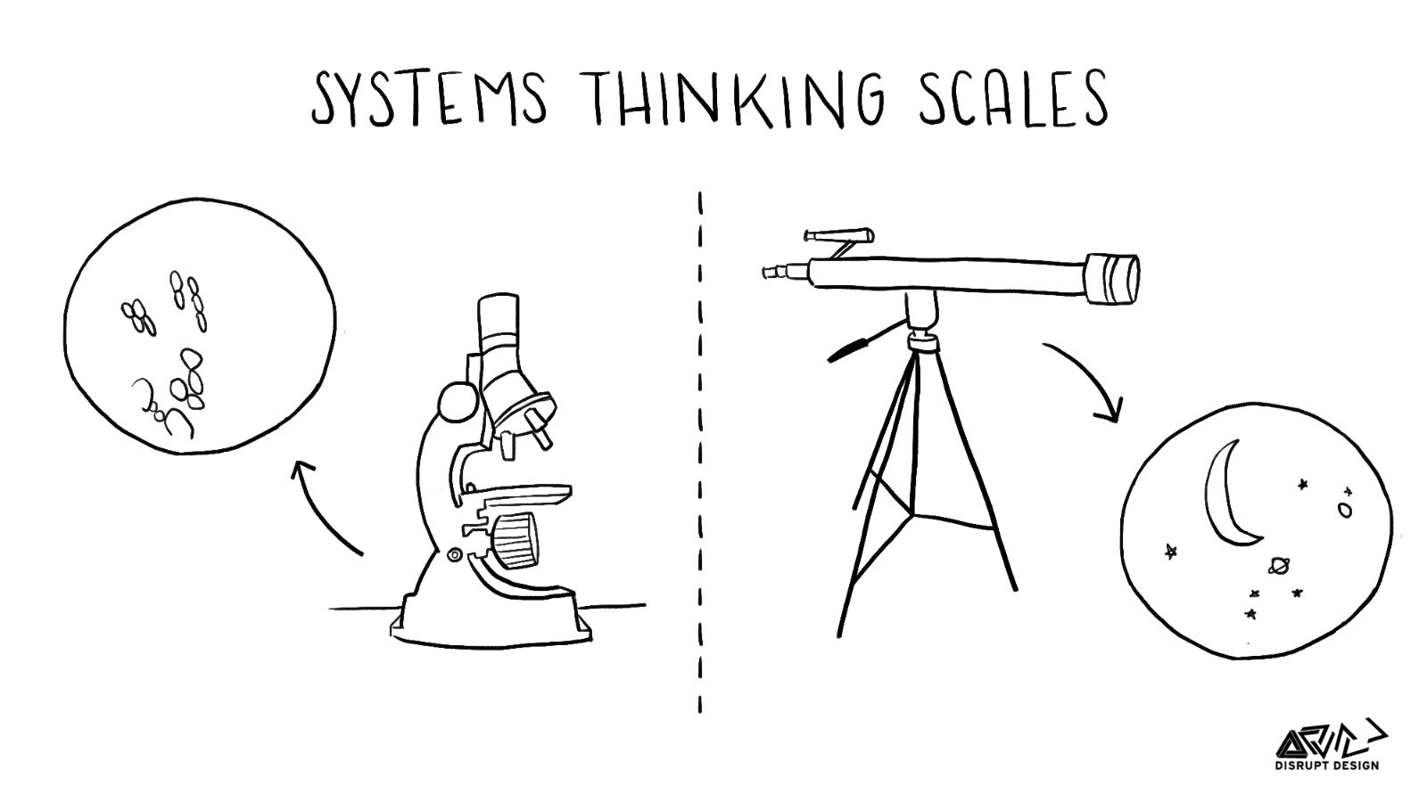
System Scale

Slide 15
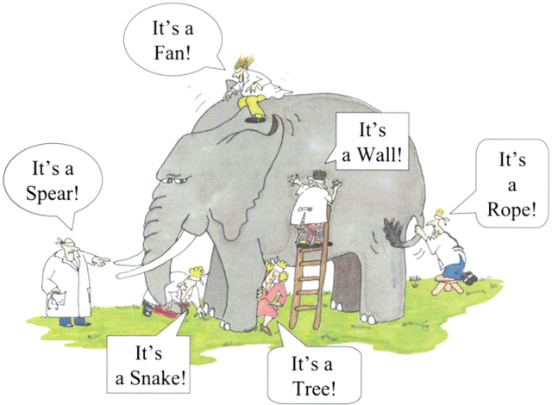
Understanding the scale helps with……

Slide 17
Elements
Components of the system working together toward the common goal.
What are the system elements?

Slide 18
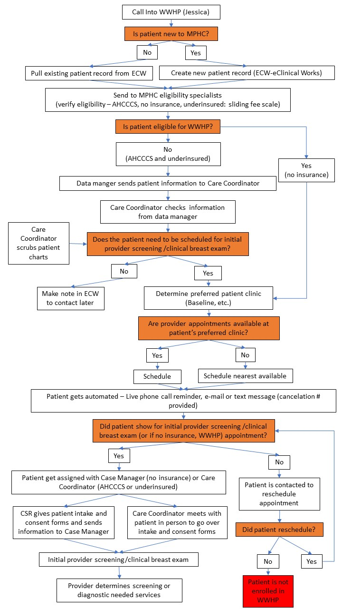
Relationships
What are the processes by which the system elements interact with each other?

Slide 19
Beyond the big four: Other systems concepts to evaluate interconnectivity

Slide 20
Feedback Loops
What are essential features of a healthy feedback loop?
Closed
Specific
Credible
Relevant
Timely
Sufficiently Frequent
Renger (2016)

Slide 21
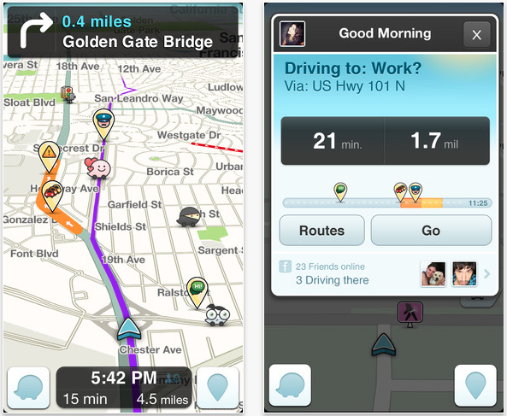
Applying feedback criteria: the traffic app
Credible: Department of Transportation or similar.
Relevant: Provides data on issues impacting traffic flow and nothing else.
Specific: Where is the traffic problem?
Timely: Available at anytime one is driving.
Sufficiently Frequent: in real time or every few minutes to reflect dynamic changing conditions.

Slide 22
Cascading Failures
A problem noted in one part of the system is caused by something upstream.
The problem could be a surge or it could be nothing is happening. There is a disruption in the normal flow.
Renger, Foltysova, Ienuso, Renger & Booze (2017).

Slide 23
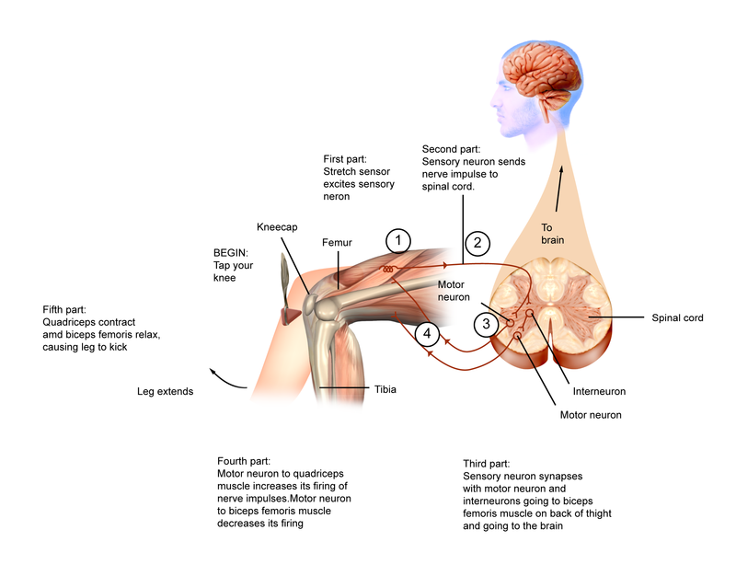
Reflex Arc
To what extent can processes be handled at the lowest level as opposed to being passed up the system for processing; which causes delays.

Slide 24
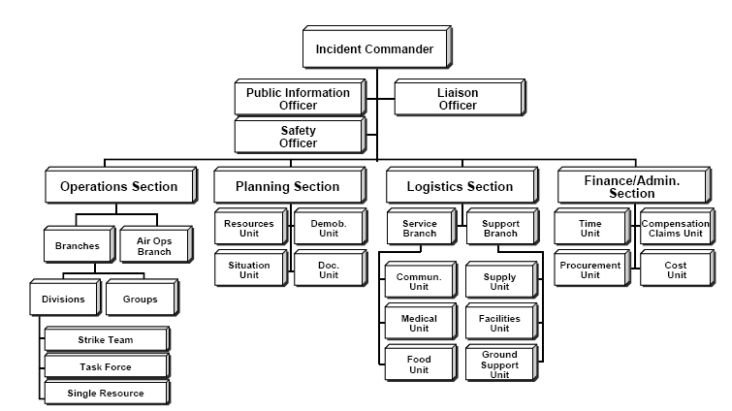

Slide 25
Do you know of other system concepts?
System waste (important but not necessarily related to interconnectivity).
Wholeness, synergy: important in evaluating effectiveness; can’t partition success.

Slide 26
System concepts are embedded in some tools that evaluators are using to help with a program evaluation

Slide 27
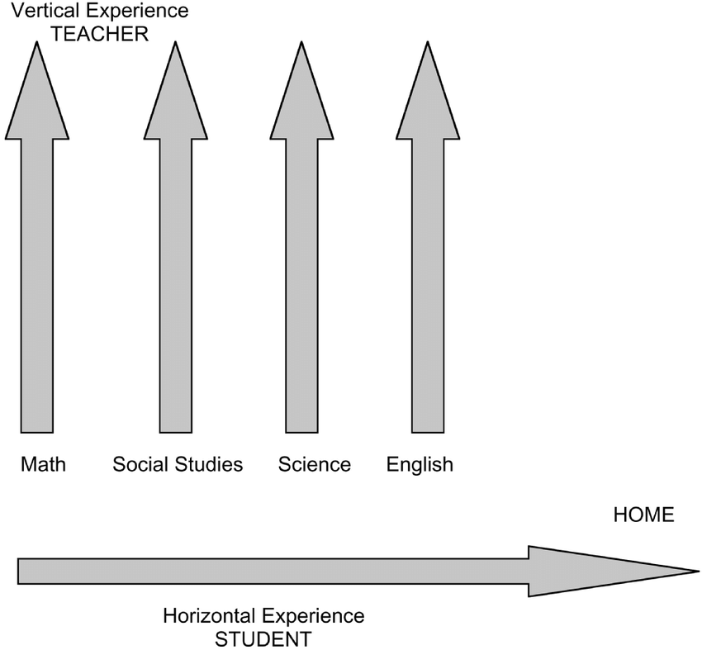
Our focus: Evaluating systems, not programs
What is the difference between a program and a system?
Programs are usually finite.
Can operate independently.
Can be a subset of a system.
System: a set of interrelated elements that interact to achieve an ascribed purpose (AEA, 2018).

Slide 28
Framework for systematically applying systems thinking concepts to evaluate systems: Systems Evaluation Theory (SET)
Emergency response
Water management
Research centers
Breast Cancer Screenings

Slide 29
SET: 3 steps
Step 1: Define the system
Step 2: Evaluate system efficiency
Step 3: Evaluate system effectiveness

Slide 30
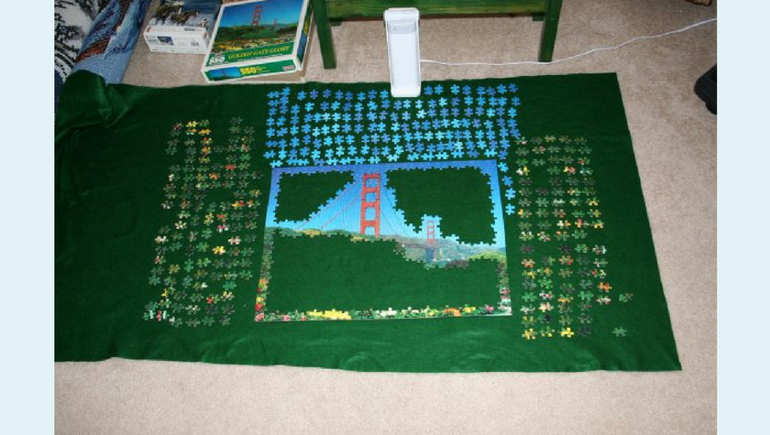
Step 1: Define the system
Use common system goal to establish boundaries
Then fill in elements
Then define relationships between elements
Renger, Foltysova, Renger & Booze (2017)

Slide 31
Defining boundaries and elements: The importance of defining the system goal
If a family reunion was your goal, who would you invite?
If you are trying to get out the door on time for work in the morning who would you include?
The common system goal is how you can define the system boundaries and elements.

Slide 32
Define the relationships
Map out your morning process
Renger, McPherson, Kontz-Bartels, & Becker (2016)

Slide 33
Parent
Alarm
Get Phone
Wake?
Check Weather App
No
Yes
No
Sunny?
Yes
Snooze
Select Shorts
Select Pants
Alarm
Make Coffee
Wake?
Shower
Dress
No
Child Ready?
Yes
Time for Coffee?
No
Yes
Remind Child
Drink Coffee
Leave house

Slide 34
SET step 1 summary
SET applies big four system concepts used to define the system.
Need to define system first so we understand what we are trying to evaluate.
SET applies other system concepts to evaluate system efficiency and effectiveness.

Slide 35
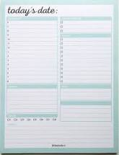
Step 2: Evaluate efficiency
How might we track everyone in the morning and see how much time each step takes?

Slide 36
What did we observe?
Parent 2
7:00 AM
7:10 AM
7:20 AM
7:30 AM
7:40 AM
7:50 AM
8:00 AM
8:10 AM
Alarm goes off
Wakes
Checks weather app
Goal = leave the house by 8:10 AM
Choose appropriate outfit
Make coffee
Shower
Get dressed
Drink Coffee
Warm-up Car
Check Traffic app
Ready to leave

Slide 37
What did we observe?
Parent 2
7:00 AM
7:10 AM
7:20 AM
7:30 AM
7:40 AM
7:50 AM
8:00 AM
8:10 AM
Alarm goes off
Wakes
Checks weather app
Goal = leave the house by 8:10 AM
Choose appropriate outfit
Make coffee
Shower
Get dressed
Drink Coffee
Warm-up Car
Check Traffic app
Ready to leave

Slide 38
What did we observe?
Parent 2
7:00 AM
7:10 AM
7:20 AM
7:30 AM
7:40 AM
7:50 AM
8:00 AM
8:10 AM
Alarm goes off
7:00 AM
7:10 AM
7:20 AM
7:50 AM
8:00 AM
8:10 AM
8:20 AM
8:30 AM
Wakes
Checks weather app
Goal = leave the house by 8:10 AM
Choose appropriate outfit
Make coffee
Shower
Get dressed
Drink Coffee
Warm-up Car
Check Traffic app
Ready to leave

Slide 39
Step 2: Evaluate efficiency
Challenge is we can’t just look at an individual family member SOP because they are interconnected!
Need to consider the interactions with other family member SOPs to get out the door.
Start applying system concepts!

Slide 40
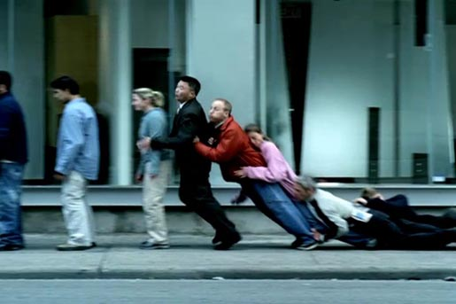
Looking for a cascading failure

Slide 41
Parent 1
Parent 2
Child
7:00 AM
7:10 AM
7:20 AM
7:30 AM
7:40 AM
7:50 AM
8:00 AM
8:10 AM
Alarm goes off
Alarm goes off
Alarm doesn’t work
Wakes
Wakes + wakes Child
Parent2 wakes child
Checks weather app
Checks weather app
Watches TV
Choose appropriate outfit
Choose appropriate outfit
Parent : reminds to “get ready”
Make coffee
Remind child to get ready
Choose wrong outfit
Shower
Shower*
Shower*
Get dressed
Shower
Shower
Drink Coffee
Get dressed
Get dressed
Warm-up Car
Parent: tells child select new outfit
Makes sure child is dressed & ready for school
Check Traffic app
Don’t know how to select outfit
Parent: helps child get dressed
Ready to leave
Drink Coffee
Use restroom
8:20 AM
Ready to leave
8:30 AM
Ready to leave

Slide 42
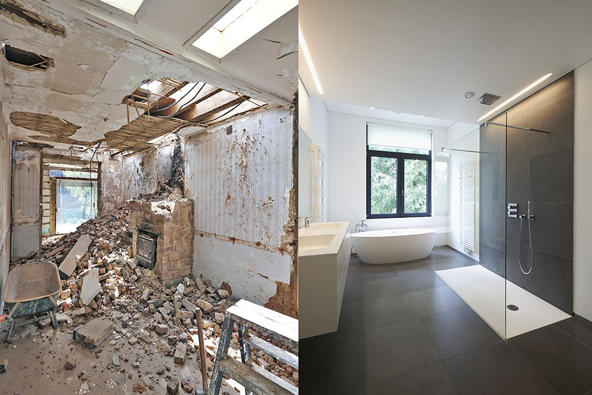
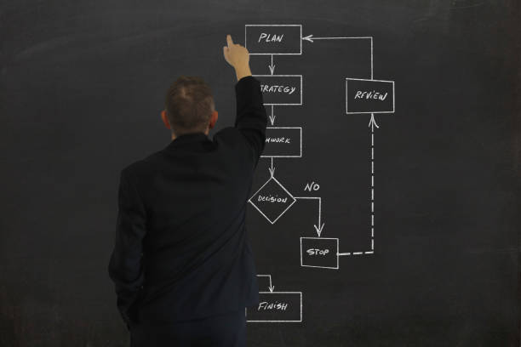
Solutions?
Get another shower.
Change process flows (SOPs).
What is critical in implementing any change strategy?
Leadership: parents know what resources they can bring to the situation.

Slide 43
Feedback loop

Slide 44
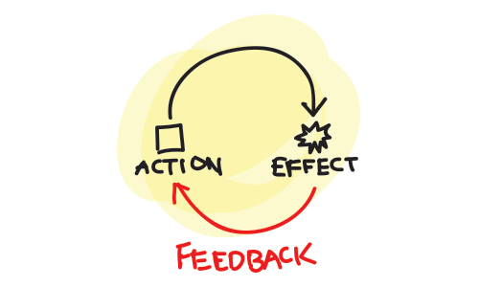
Goal = leave the house by 8:10 AM
Parent 2
Child
7:00 AM
7:10 AM
7:20 AM
7:30 AM
7:40 AM
7:50 AM
8:00 AM
8:10 AM
Alarm goes off
Alarm doesn’t work
7:00 AM
7:10 AM
7:20 AM
7:30 AM
7:40 AM
8:00 AM
8:20 AM
8:30 AM
Wakes + wakes Child
Parent2 wakes child
Checks weather app
Watches TV
Choose appropriate outfit
Parent : reminds to “get ready”
Remind child to get ready
Shower
Shower
Get dressed
Get dressed
Choose wrong outfit
Parent: tells child select new outfit
Makes sure child is dressed & ready for school
Don’t know how to select outfit
Parent: helps child get dressed
Drink Coffee
Use restroom

Slide 45
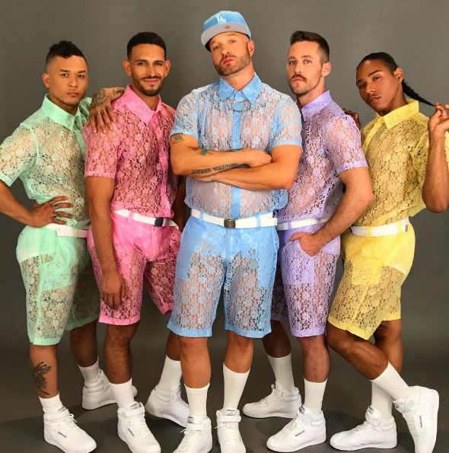
What might be some feedback issues at play?
Feedback not specific: e.g. “not good enough, get changed”
Credibility issue: child does not trust parent’s fashion sense.

Slide 46
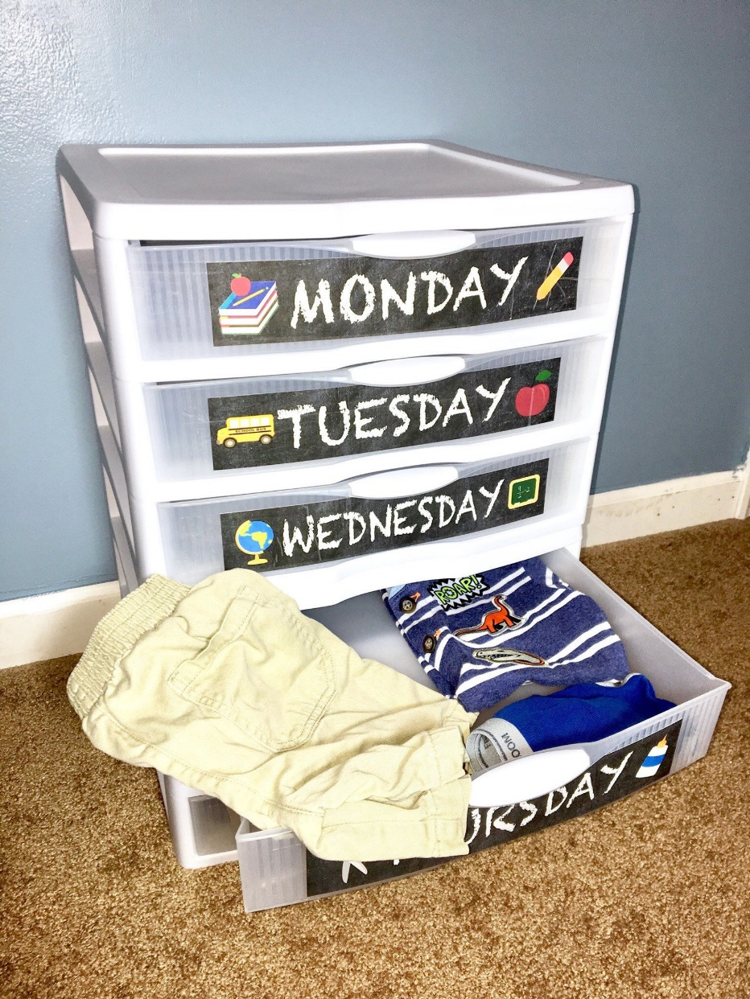
Solutions?
Get rid of feedback loop: implement a reflex arc!
E.g. Have outfit schedule in place; no need to go up the chain of command to parent.

Slide 47
Goal = leave the house by 8:10 AM
Parent 2
Child
7:00 AM
7:10 AM
7:20 AM
7:30 AM
7:40 AM
7:50 AM
8:00 AM
8:10 AM
Alarm goes off
Alarm doesn’t work
7:00 AM
7:10 AM
7:20 AM
7:30 AM
7:40 AM
8:00 AM
8:20 AM
8:30 AM
Wakes + wakes Child
Parent2 wakes child
Checks weather app
Watches TV
Choose appropriate outfit
Parent : reminds to “get ready”
Remind child to get ready
Shower
Shower
Get dressed
Get dressed
Choose wrong outfit
Parent: tells child select new outfit
Makes sure child is dressed & ready for school
Don’t know how to select outfit
Parent: helps child get dressed
Drink Coffee
Use restroom

Slide 48
Goal = leave the house by 8:10 AM
Parent 2
Child
7:00 AM
7:10 AM
7:20 AM
7:30 AM
7:40 AM
7:50 AM
8:00 AM
8:10 AM
Alarm goes off
Alarm doesn’t work
Wakes + wakes Child
Parent2 wakes child
Checks weather app
Watches TV
Choose appropriate outfit
Parent : reminds to “get ready”
Remind child to get ready
Shower
Shower
Get dressed
Child consults schedule
Get dressed
Drink Coffee
Use restroom

Slide 49
System waste: Reworks

Slide 50
Goal = leave the house by 8:10 AM
Parent 1
Parent 2
7:00 AM
7:10 AM
7:20 AM
7:30 AM
7:40 AM
7:50 AM
8:00 AM
8:10 AM
Alarm goes off
Alarm goes off
Wakes
Wakes + wakes Child
Checks weather app
Checks weather app
Choose appropriate outfit
Choose appropriate outfit
Make coffee
Remind child to get ready
Shower
Pack kid’s lunch
Get dressed
Shower
Drink Coffee
Get dressed
Pack kid’s lunch
Warm-up Car
Makes sure child is dressed & ready for school
Check Traffic app
Ready to leave
Drink Coffee

Slide 51
Goal = leave the house by 8:10 AM
Parent 1
Parent 2
7:00 AM
7:10 AM
7:20 AM
7:30 AM
7:40 AM
7:50 AM
8:00 AM
8:10 AM
Alarm goes off
Alarm goes off
Wakes
Wakes + wakes Child
Checks weather app
Checks weather app
Choose appropriate outfit
Choose appropriate outfit
Make coffee
Remind child to get ready
Shower
Pack kid’s lunch
Get dressed
Shower
Drink Coffee
Get dressed
Pack kid’s lunch
Warm-up Car
Makes sure child is dressed & ready for school
Check Traffic app
Ready to leave
Drink Coffee

Slide 52
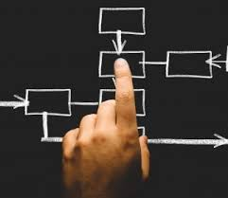
Solutions?

Slide 53
Reasons for inefficiencies: Toward recommendations
Training
Leadership
Parent 2
Parent 1
Child 1
Child 2
Information
Technology
Culture

Slide 54
Goal = leave the house by 8:10 AM
Parent 1
7:00 AM
7:10 AM
7:20 AM
7:30 AM
7:40 AM
7:50 AM
8:00 AM
8:10 AM
Alarm goes off
Wakes
Checks weather app
Choose appropriate outfit
Make coffee
Shower
Get dressed
Drink Coffee
Pack kid’s lunch
Warm-up Car
Check Traffic app
Ready to leave

Slide 55
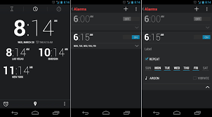
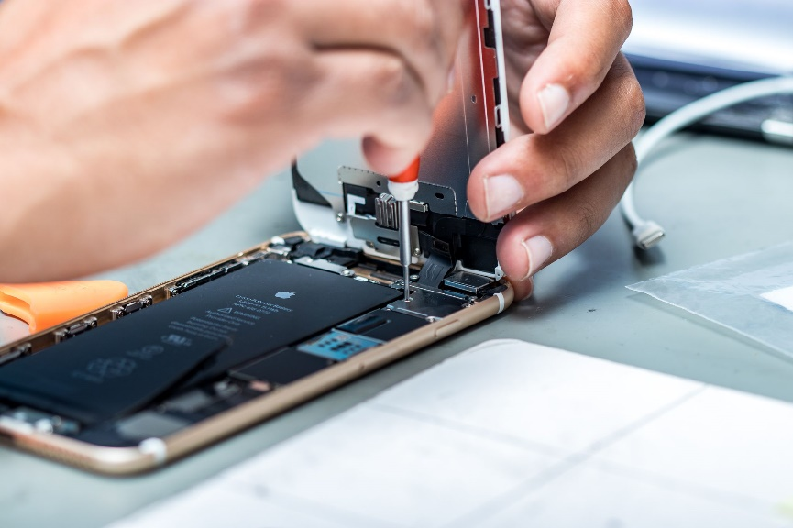
Goal = leave the house by 8:10 AM
Parent 1
7:00 AM
9:00 AM
9:20 AM
9:30 AM
9:40 AM
9:50 AM
10:00 AM
10:10 AM
Alarm goes off
Training Issue
Wakes
Checks weather app
Choose appropriate outfit
Make coffee
Shower
Information Technology Issue
Get dressed
Drink Coffee
Pack kid’s lunch
Warm-up Car
Check Traffic app
Ready to leave

Slide 56
Goal = leave the house by 8:10 AM
Parent 2
Child
7:00 AM
7:10 AM
7:20 AM
7:30 AM
7:40 AM
7:50 AM
8:00 AM
8:10 AM
Alarm goes off
Alarm doesn’t work
7:00 AM
7:10 AM
7:20 AM
7:30 AM
7:40 AM
8:00 AM
8:20 AM
8:30 AM
Wakes + wakes Child
Parent2 wakes child
Checks weather app
Watches TV
Choose appropriate outfit
Parent : reminds to “get ready”
Remind child to get ready
Shower
Shower
Get dressed
Get dressed
Choose wrong outfit
Parent: tells child select new outfit
Makes sure child is dressed & ready for school
Don’t know how to select outfit
Parent: helps child get dressed
Drink Coffee
Use restroom

Slide 57
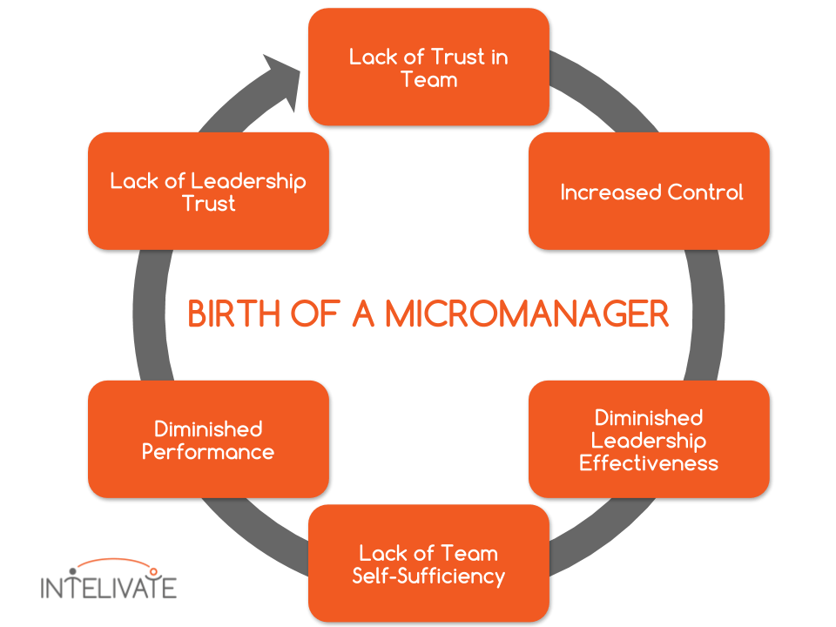
Culture

Slide 58
Goal = leave the house by 8:10 AM
Child
7:00 AM
7:10 AM
7:20 AM
7:30 AM
7:40 AM
7:50 AM
8:00 AM
8:10 AM
Alarm goes off
Parent wakes child
Watches TV
Parent : reminds to “get ready”
Choose wrong outfit
Shower
Get dressed
Parent: tells child select new outfit
Don’t know how to select outfit
Parent: helps child get dressed
Use restroom
Ready to leave

Slide 59
Goal = leave the house by 8:10 AM
Child
7:00 AM
7:10 AM
7:20 AM
7:30 AM
7:40 AM
7:50 AM
8:00 AM
8:10 AM
Alarm goes off
Parent wakes child
Watches TV
Parent : reminds to “get ready”
Choose wrong outfit
Shower
Get dressed
Parent: tells child select new outfit
Don’t know how to select outfit
Parent: helps child get dressed
Use restroom
Ready to leave

Slide 60
Goal = leave the house by 8:10 AM
Child
7:00 AM
7:10 AM
7:30 AM
7:50 AM
8:00 AM
8:10 AM
8:30 AM
8:40 AM
Alarm goes off
Parent wakes child
Watches TV
Culture
Parent : reminds to “get ready”
Choose wrong outfit
Shower
Get dressed
Parent: tells child select new outfit
Don’t know how to select outfit
Parent: helps child get dressed
Use restroom
Ready to leave

Slide 61
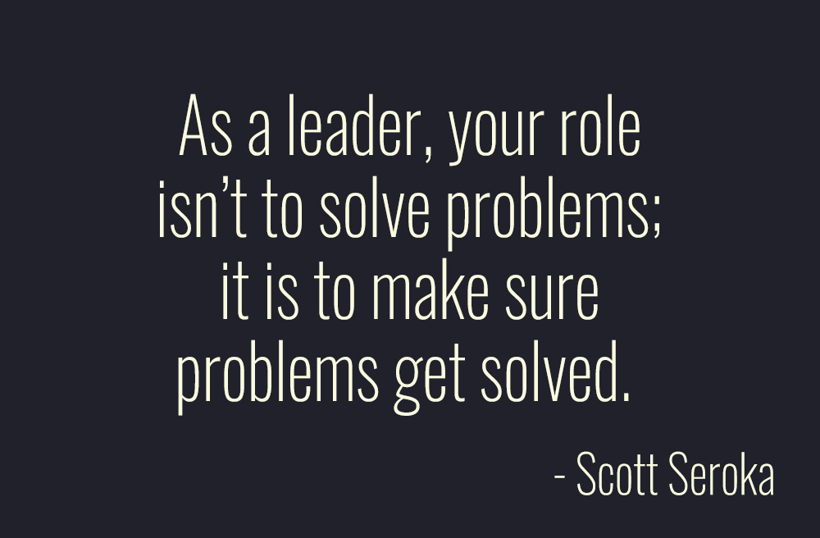
The biggest key to system change?

Slide 62
Step 3: Evaluate effectiveness

Slide 63
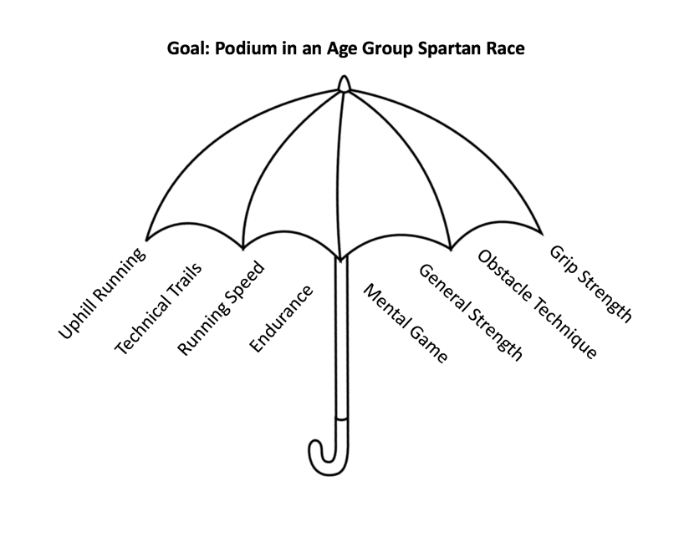
How would you select system effectiveness measures?

Slide 64
jessica@justevaluation.com
ralph@justevaluation.com
www.justevaluation.com
Special thanks to Eric Souvannasacd

