Slide 1

Welcome!

Slide 2
ACKNOWLEDGEMENT OF COUNTRY
“Barrambin” (Windy place)
We take the time to recognise and acknowledge the traditional people of the lands and water where we meet today the Yugara and Turubul people of this area. We acknowledge these traditional custodians who cared for these lands and waters for thousands of years, (and) their decendants who maintain their spiritual connections and traditions.
We recognise that these have always been places of teaching and learning. We strongly encourage justice to promote understanding and pay respect to our elders past, present and those emerging. Before you continue your journey please take a moment to honour millions of footprints that have travelled these dreaming pathways.
By Aunty Nicole Williams

Slide 3
Housekeeping
Event: | Workshop - Systems Evaluation Theory: Practice & Implementation
Date: | Thursday 2nd March AND Thursday 9th March 2023
Venue: | Via Zoom: AES account: learning3@aes.asn.au
Time (AEDT) | Registration: 9:45am Start: 10:00am Break: 11:30 – 11.45am Close: 1:00pm
AES Rep: | Sarah Renals Merlo Consulting M: 0406 554 866 E: sarah.merloconsulting@gmail.com
Facilitators: | Lewê Atkinson | Ralph Renger M: 0419 240 979 | E: ralph@justevaluation.com E: lewis@hainescentreaustralia.com.au
AES Contact: | Bill Wallace M: 0447 955 514 E: aes@aes.asn.au

Slide 4
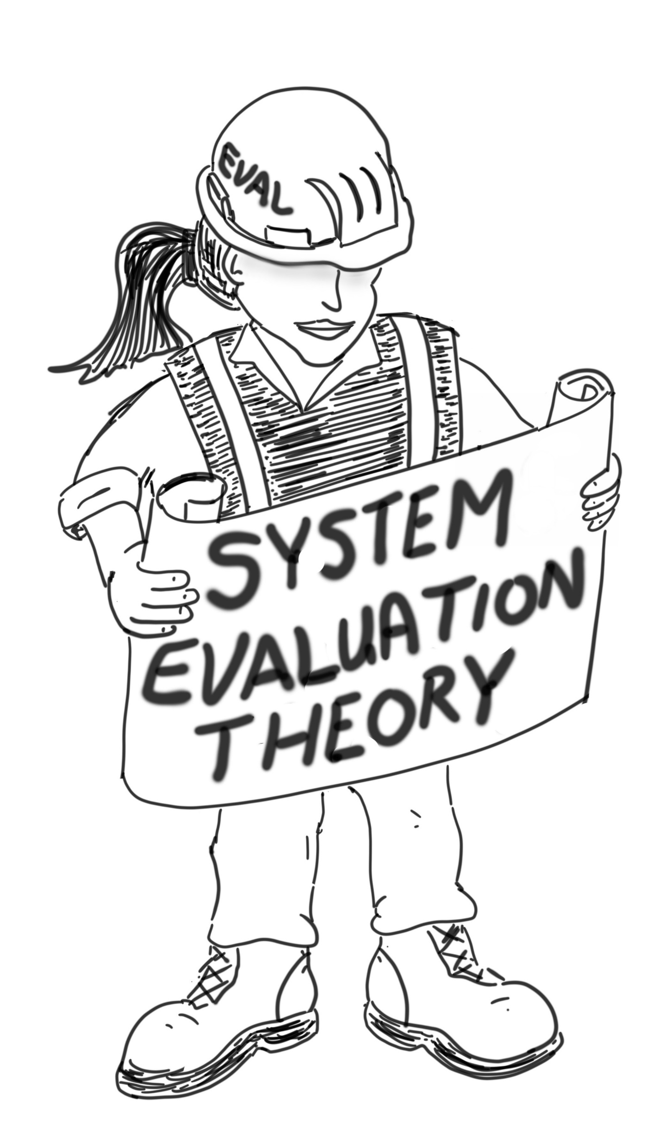
Workshop Objectives
  Objective 1: To understand the challenges in evaluating complex interventions.
  Objective 2: To understand why an approach grounded in systems is a path forward for evaluating complex interventions.
  Objective 3: To learn the basics in Systems Evaluation Theory (SET) to define and evaluate complex interventions operating and functioning as a system.

Slide 5

What are some characteristics of a simple intervention?
“ a simple linear pathway linking the intervention and its outcome” (Petticrew, 2011).
Examples?
Notes:
B: Multiple choice
Linear program theory
If>then logic
logic model can covey the essence of the intervention and ouctomes
Outcomes are in the control of the intervention to change
All but d
All of the above

Slide 6

A simple intervention

Slide 7
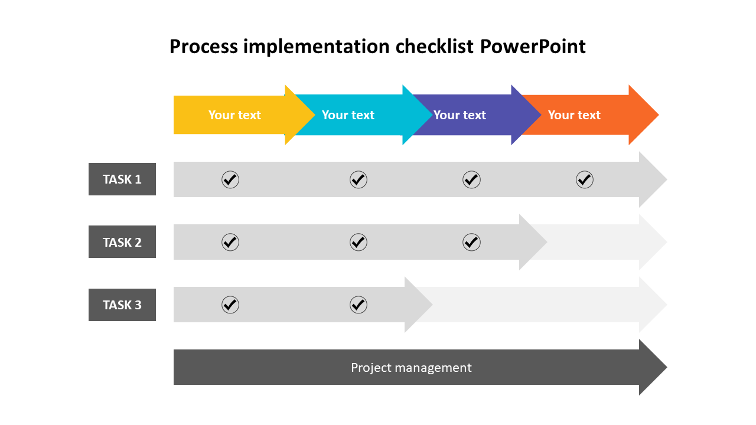
What might be some of the process evaluation questions for this simple intervention?
Was all the course content covered?
Did students complete all the assignments?
Notes:
B: Word cloud

Slide 8
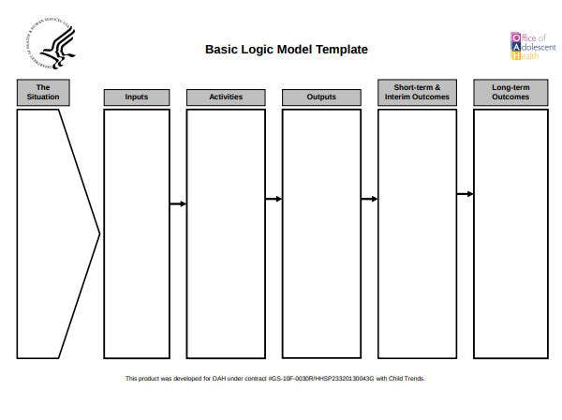
What might be some of the outcomes for this simple intervention?
# of enrollees
Courses developed
Obtain High School Diploma
Teachers
Classrooms
IT
Progression in courses
High schoolers dropout
GED Classes
Notes:
B: word cloud

Slide 9

What are some characteristics of a complex intervention?
A complex intervention “involves at minimum multiple components and a complex pathway…” (Guise et al., 2017).
Many components working together nonlinearly.
Examples?
Notes:
B: Multiple choice
Linear pathways
Non linear pathways
Multiple components
All of the above
b and c

Slide 10
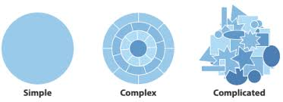
What is the difference between complex and complicated?
Our field is very inconsistent and careless in using the terms complex and complicated.
We will use the term complex to mean many parts working together.
We will use the term complicated to mean difficult.
Notes:
B: Multiple choice
Complicated means many pathways; complex means hard
Complex means many pathways; complicated means hard
There is no difference

Slide 11
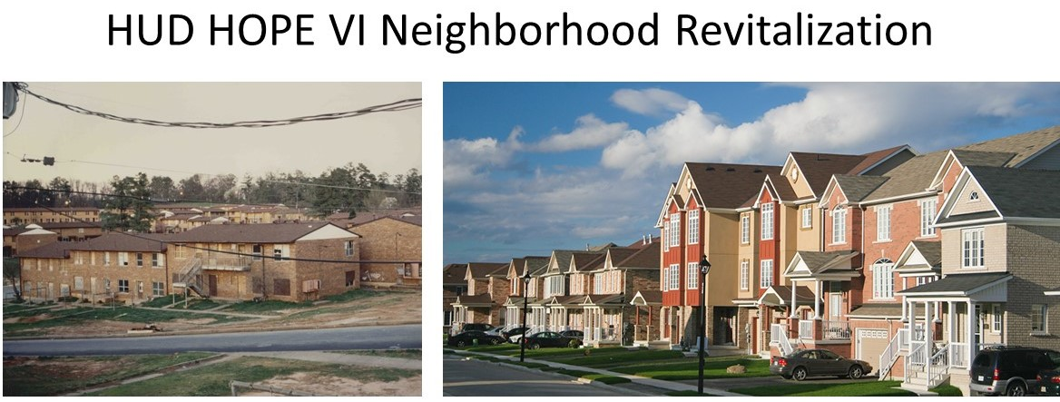
A complex intervention

Slide 12






Housing Density
Job Skills
Safe Parks
Neighborhood
Businesses
Tax Incentives
Education
Childcare

Slide 13
Housing Density
Job Skills
Safe Parks
Neighborhood
Businesses
Tax Incentives
Education
Childcare

Slide 14
is a complex intervention.

Slide 15


Slide 16
Safe Parks
Job Skills
Neighborhood
Businesses
Housing Density
Tax Incentive
Education
Childcare

Slide 17
Safe Parks
Job Skills
Neighborhood
Businesses
Housing Density
Tax Incentive
Residents Remaining in Neighborhood
Retrained and employed
New locally owned businesses
Park Utilization
Reduced Housing
Density
Spouses at Work
High School Diploma
Education
Childcare

Slide 18

What does this strategy miss from an outcomes evaluation perspective?
Notes:
B: lets just ask them to respond in the chat for this one

Slide 19


Housing Density
Job Skills
Safe Parks
Neighborhood
Businesses
Tax Incentive
Childcare
Finish High School

Slide 20
What does this strategy miss from a process evaluation perspective?
Notes:
B: lets just ask them to respond in the chat for this one

Slide 21
Housing Density
Job Skills
Safe Parks
Neighborhood
Businesses
Tax Incentives
Education
Childcare

Slide 22
Safe Parks
Job Skills
Neighborhood
Businesses
Housing Density
Tax Incentive
Finish High School
Childcare

Slide 23
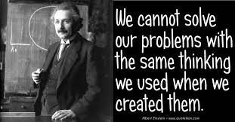
If more logic models are not the solution, then…

Slide 24
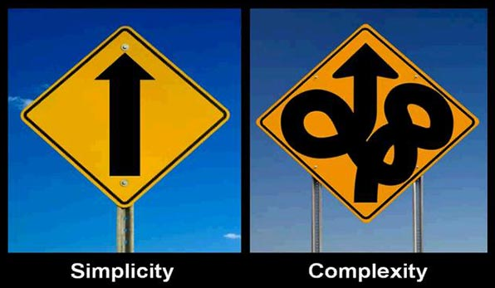

…..what is the solution?

Slide 25

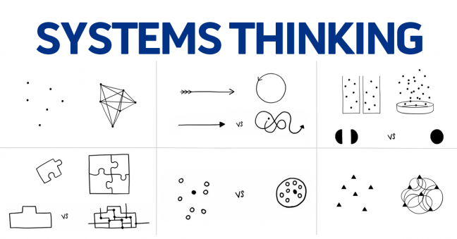

Slide 26

Systems thinking is literally thinking like a system.
So how would you define a system?
An integrated whole whose essential properties emerge from the interdependence between its parts (Ison, 2008).
Notes:
B: word cloud

Slide 27
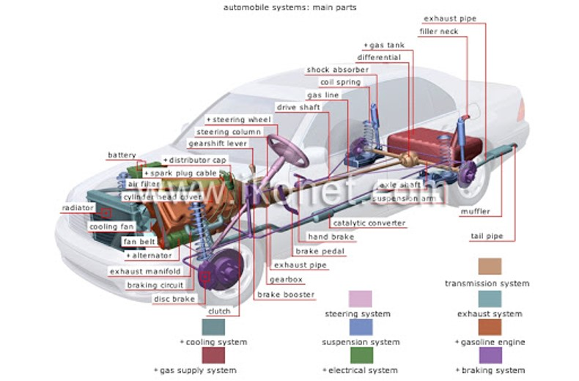
Illustrating parts, interdependence and emergence

Slide 28

Meet the system test?
All parts are needed for the essential system property (i.e., moving you from point A to point B) to emerge.
If a single part is missing, then the car won’t run as well or at all, so the essential system property may not emerge.

Slide 29
System thinking and theory is a good fit for evaluating complex interventions because….
Systems, by definition, have many moving parts that must work together to achieve something they cannot do independently.

Slide 30
But, don’t judge a book (intervention) by its cover (label) Press | Justevaluation
A program might be operating and functioning as a system. A system might be operating and functioning as a program.
Does the complex intervention pass the system test?
  Operating as a system? (interdependencies)
  Functioning as a system? (emergence)

Slide 31
Housing Density
Job Skills
Safe Parks
Neighborhood
Businesses
Tax Incentives
Education
Childcare

Slide 32
Housing Density
Job Skills
Safe Parks
Neighborhood
Businesses
Tax Incentives
Education
Childcare

Slide 33
Meet the system test?
All the HUD HOPE VI components are needed for improved quality of life to emerge.
No single component can achieve quality of life on its own but missing just one part likely means the intervention will not lead to improvements in quality of life.

Slide 34

So what is the value added of applying an understanding of system properties in evaluating complex interventions?
Complexity in and of itself is just “a bunch of stuff” (Meadows).
  There are no standards to evaluate a bunch of stuff.
Property of interdependence gives the “bunch of stuff” (i.e., complexity) an operational purpose that can now be evaluated.
Property of emergence gives the “bunch of stuff” (i.e., complexity) a functional purpose that can now be evaluated.
Notes:
Note to B: I will pose this question to myself and answer

Slide 35

Break

Slide 36

Let’s be honest
Many interventions are not designed with the complexity necessary to match the problem they are intended to solve.
This explains why most interventions fail (GAO2021; Suchman, 1967; Friedman, 2009)
Even though the logic model isn’t fit for purpose (evaluating complexity), even a perfect evaluation can’t make up for a poor program design.

Slide 37

However, for complex interventions that are well designed…
Need an evaluation approach tailored to evaluate complexity.
An approach grounded in systems provides a possible way forward for evaluating complex interventions.

Slide 38
System Evaluation Theory (SET)
A blueprint for how to do apply an understanding of systems to evaluate complex interventions.
  Step 1. Define the system.
  Step 2: Evaluate interdependencies.
  Step 3: Evaluate emergence.

Slide 39
Rationale of System Evaluation Theory (SET)
Cascading events
Parts
Reworks
Step 1: Define the System
Levels
Step 2: Evaluate System Efficiency
Interdependencies
Reflex Arcs
Scale
Evaluate interdependencies
Feedback loops
Boundaries
Others
Emergence
Step 3: Evaluate System Effectiveness
Note: System refers to the complex intervention that is acting as a system.
Evaluate emergence
Holism

Slide 40

The Challenge

Slide 41
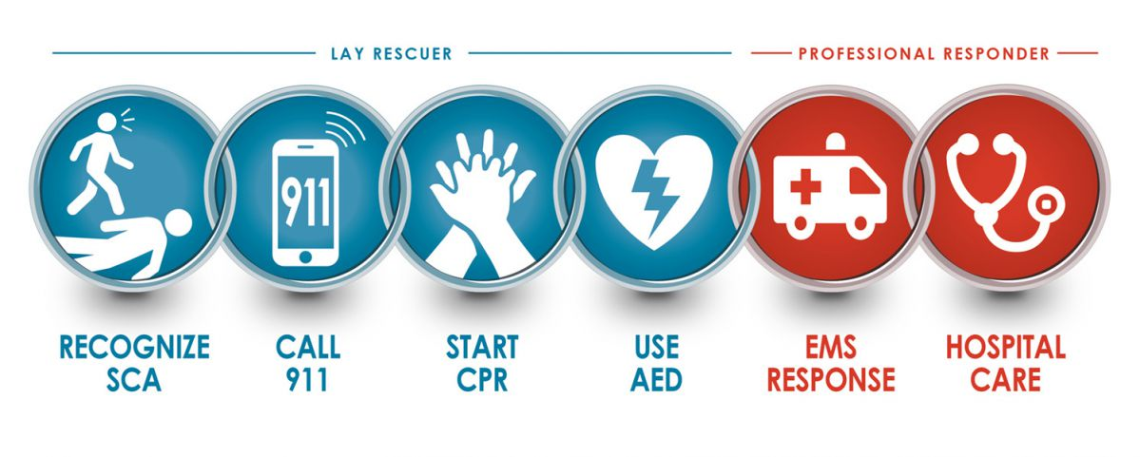
But the reality is…

Slide 42
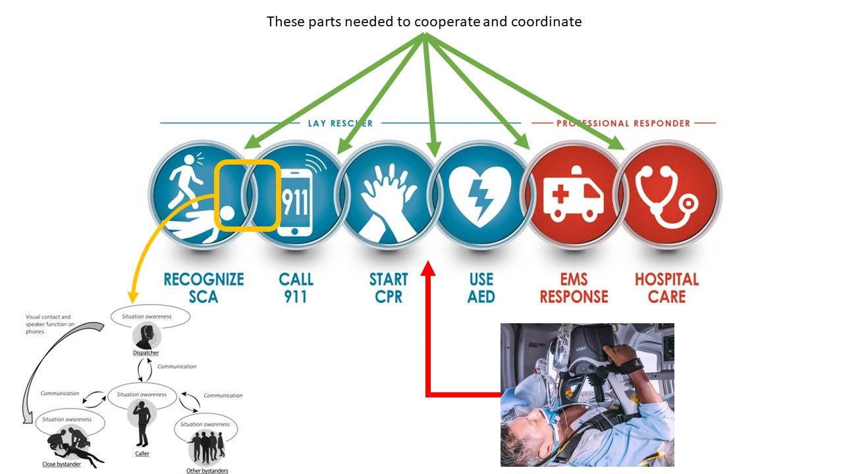
The LUCAS device is one of many interdependent components.

Slide 43

The LUCAS device by itself cannot save a life.

Slide 44




We are evaluating a complex intervention operating and functioning as a system.
The LUCAS device is one interdependent component of the cardiac system of care.

Slide 45
Applying System Evaluation Theory (SET)
Cascading events
Parts
Reworks
Step 1: Define the System
Levels
Step 2: Evaluate System Efficiency
Interdependence
Reflex Arcs
Scale
Evaluate interdependencies
Feedback loops
Boundaries
Others
Emergence
Step 3: Evaluate System Effectiveness
Note: System refers to the complex intervention that is acting as a system.
Evaluate emergence
Holism

Slide 46
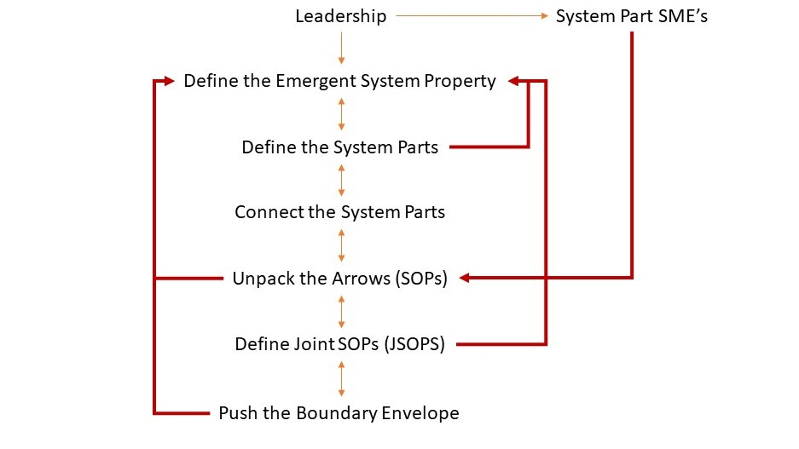
Step 1: Define the System

Slide 47
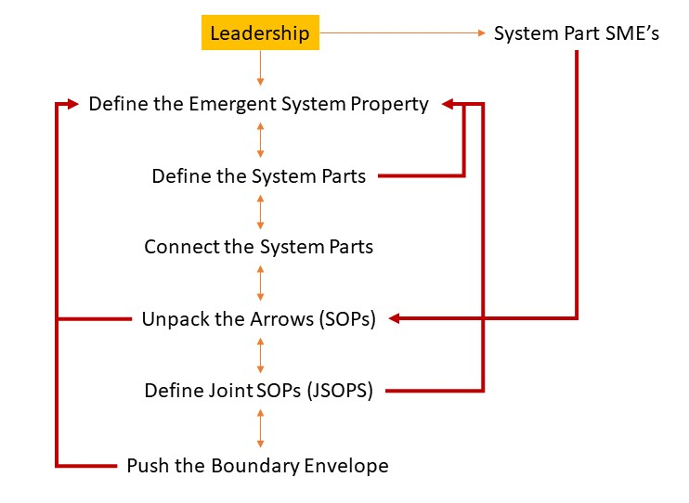

Cardiac System of Care Case Study

Slide 48
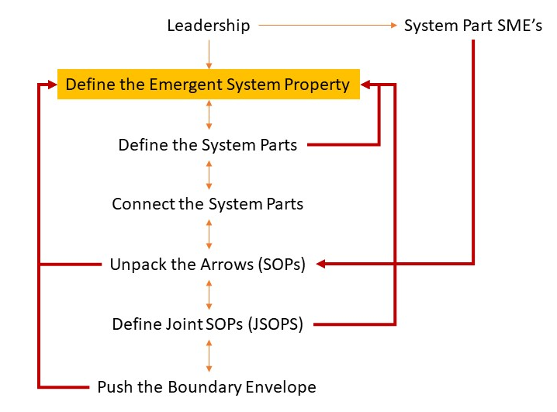

Notes:
Lewe’s reference to the law

Slide 49


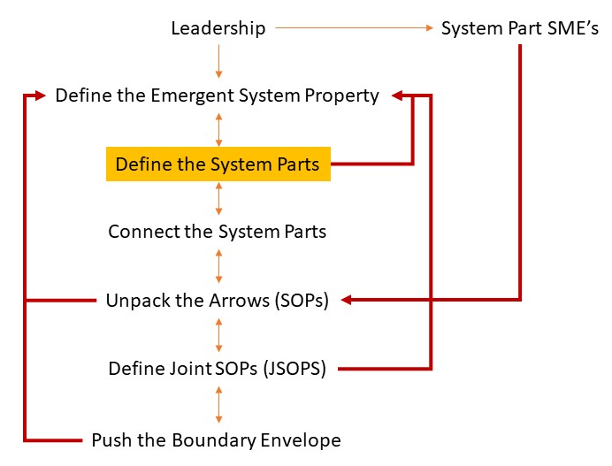
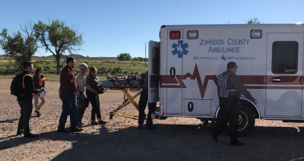

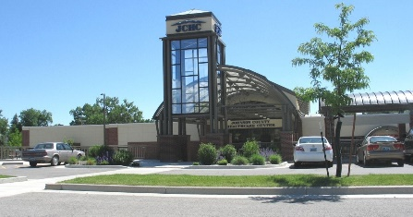
Emergency Dispatch
Volunteer Emergency Medical Services
EMS with Paramedic
Heart Hospital
(definitive care)
Critical Access Hospital

Slide 50
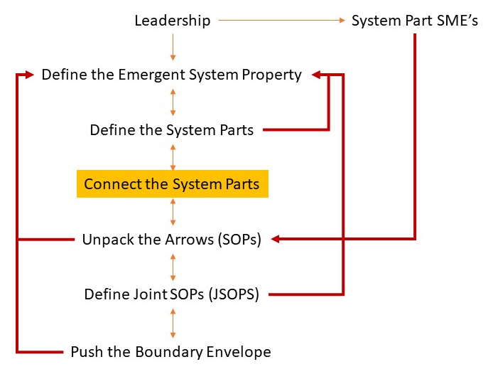

Volunteer Emergency Medical Services
Emergency Dispatch
EMS with Paramedic
Heart Hospital
(definitive care)
Critical Access Hospital

Slide 51
Volunteer Emergency Medical Services
Emergency Dispatch
EMS with Paramedic
Heart Hospital
(definitive care)
Critical Access Hospital

Slide 52
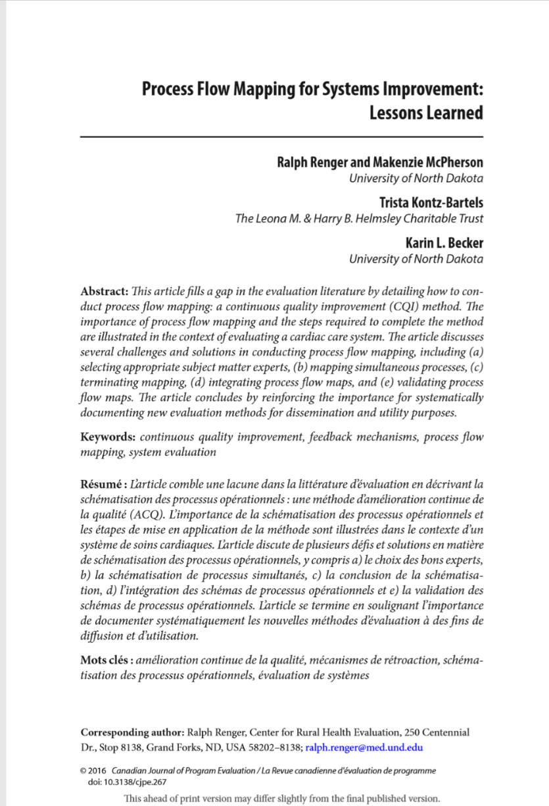
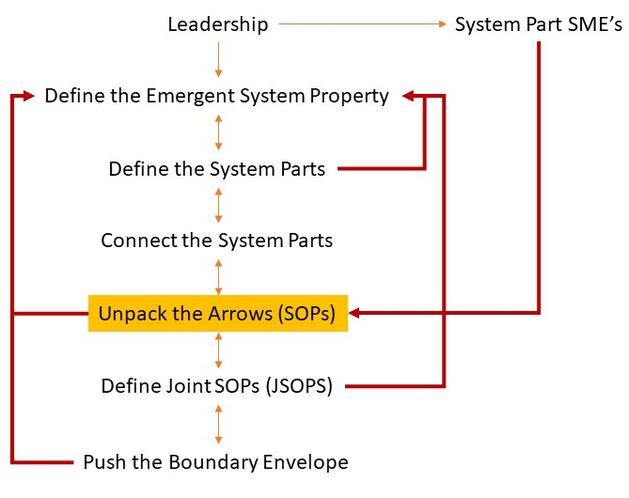
Using Process Flow Mapping to “unpack” the arrows

Slide 53



Slide 54
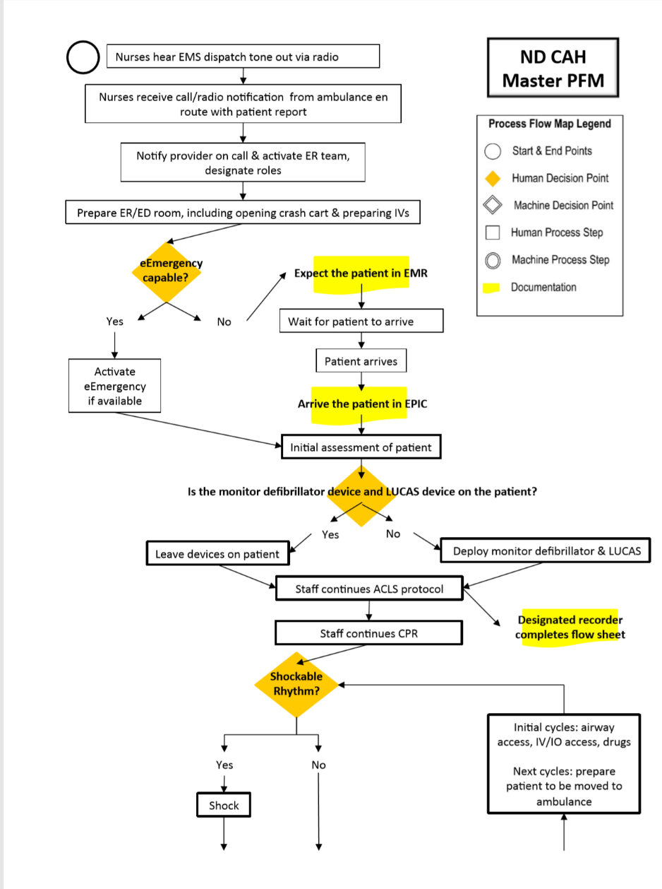
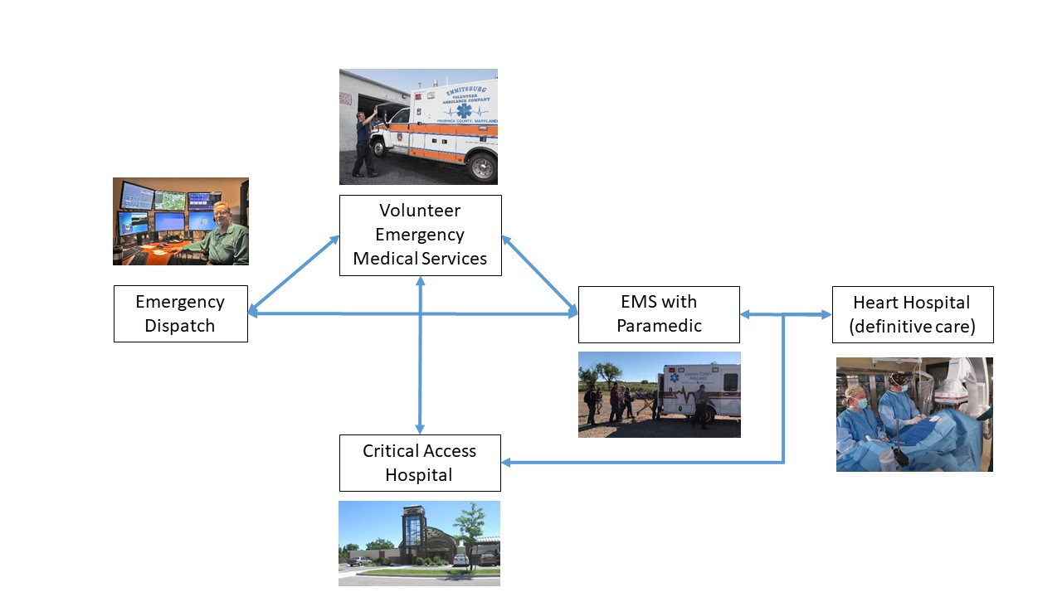

Slide 55

How do SOPs help with the evaluation?
The SOPs are the standard of acceptability against which we make evaluative judgements!

Slide 56
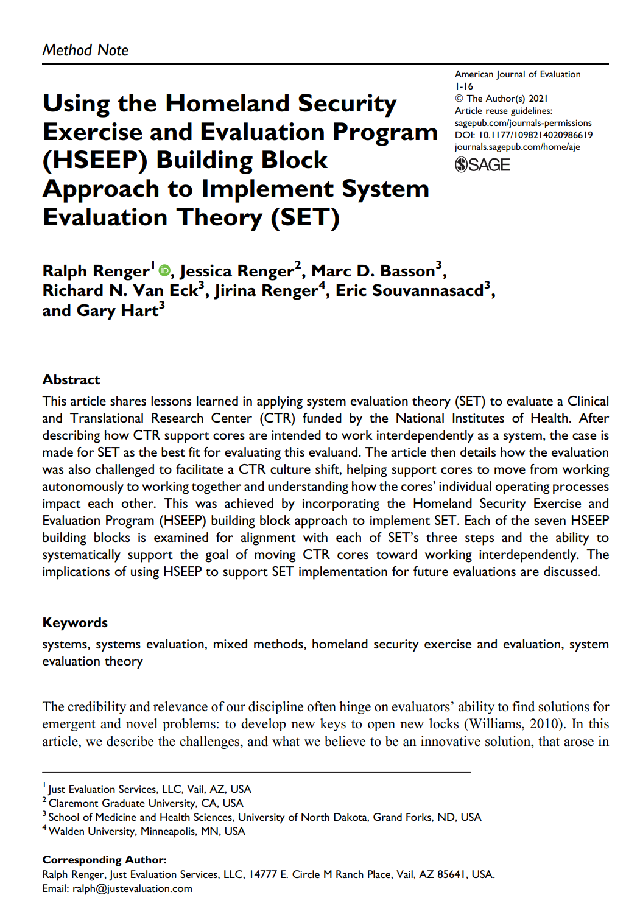
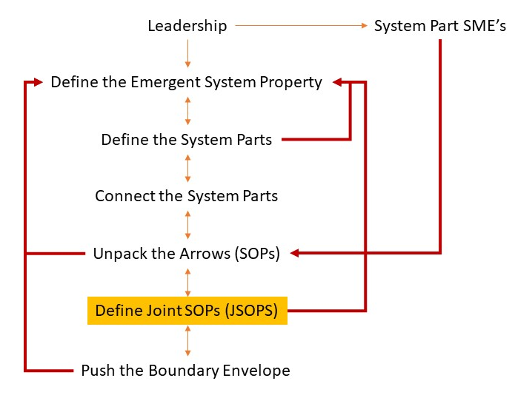

Slide 57


Slide 58
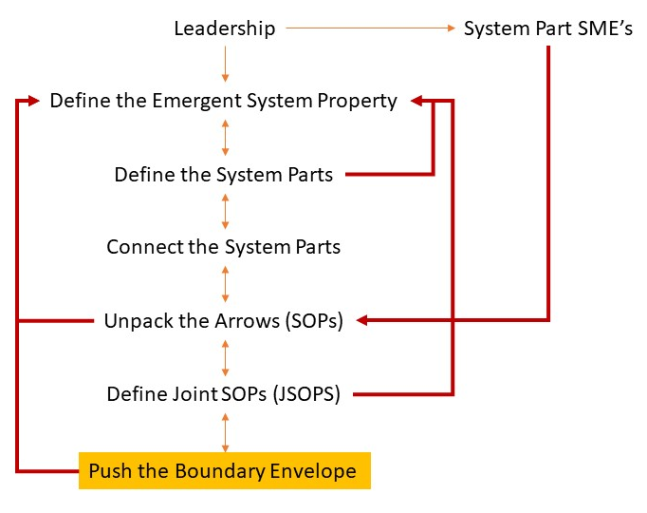
The parts included in our system form an initial system boundary

Slide 60


Long Term Care
(Rehabilitation)
Bystander CPR

Slide 61
Long Term Care
(Rehabilitation)
Bystander CPR

Slide 62
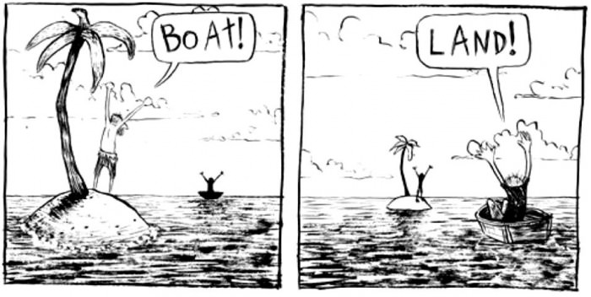
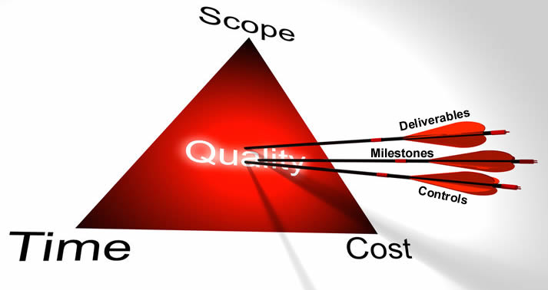
Why is knowing the boundary of the complex intervention important?
Helps you understand which perspectives are needed in defining the system.
Gives you an idea of the scope and therefore cost of the evaluation.
Notes:
B: Multiple choice
Can you help you with an evaluation budget.
The concept of boundaries is theoretical and has no practical application
Gives you an idea of the system actors with whom you need to work.
A & C

Slide 63
Summary: Defining the System

Slide 64

What are some benefits of step 1 beyond evaluation?
Yarbrough et. al = we want our evaluation products and processes to be useful.
  Products.
    Defined SOPs = helps with standardizing training.
  Processes.
    Builds culture of cooperation; improved SOPs by just talking through; cheaper alternative.
Notes:
B: use Word cloud

Slide 65

Break

Slide 66
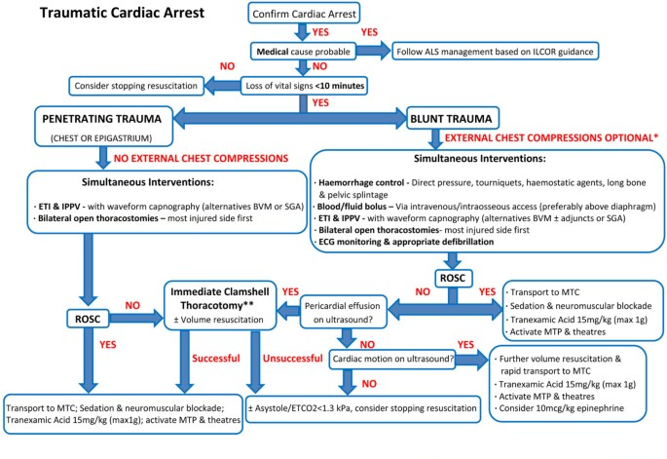
What is the product of step 1?
Now what?
Notes:
B: Multiple choice
Defined parts
Defined interdependencies
Established boundaries for evaluation purpose
SOPs
JSOPs
A standard from which an evaluation can proceed
All of the above
A & B

Slide 67
Rationale of System Evaluation Theory (SET)
Cascading events
Parts
Step 1: Define the Intervention Operating as a System
Reworks
Levels
Step 2: Evaluate System Efficiency
Interdependence
Reflex Arcs
Scale
Evaluate interdependencies
Feedback loops
Boundaries
Others
Emergence
Step 3: Evaluate System Effectiveness
Note: System refers to the complex intervention that is acting as a system.
Evaluate emergence
Holism
Notes:
Moved Mentimeter question (why is it important to evaluate system efficiency before effectiveness?) to this slide.

Slide 68




What might be some methods for evaluating JSOPs (interdependencies)?
Notes:
Note to B: word cloud.
Note to self: The types of questions asked are informed by the system principles.
Questions will pertain to feedback loops, cascading events, reflex arcs, etc
Analyses of source documents (e.g. themes) informed by systems principles.
Where you focus your observation is informed by systems principles.

Slide 69





Evaluating the Cardiac Care System JSOPs using direct observation
Volunteer Emergency Medical Services
Emergency Dispatch
EMS with Paramedic
Heart Hospital
(definitive care)
Critical Access Hospital

Slide 70
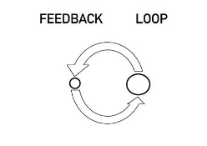
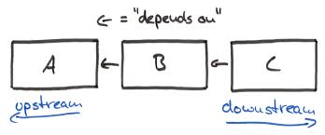
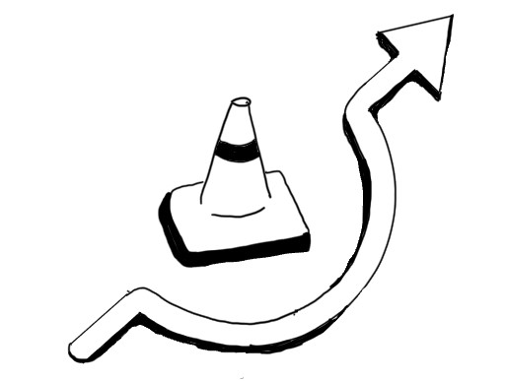
Applying system principles to evaluate interdependencies.
Feedback loops
Cascading events
Reflex arcs

Slide 71

Feedback Loops
The return of information about the status of a process.

Slide 72
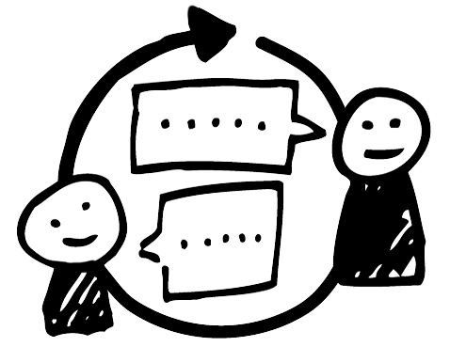
First evaluation decision point: Is the feedback loop being closed?

Slide 73
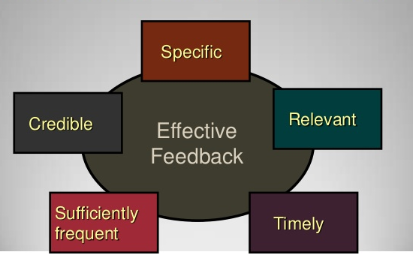
Second evaluation decision point: Quality of the feedback?
Notes:
Add close the loop

Slide 74

Feedback loop problem
Patient and run report data collected by EMS
Hospital adds data on patient outcome
State EMS combines run data and hospital data.

Slide 75
Feedback loop problem
Patient and run report data collected by EMS
Annually
Hospital adds data on patient outcome
State EMS combines run data and hospital data.

Slide 76

Consequences
Notes:
B: Multiple choice
What problem with feedback loops does this example illustrate?
Not closing a loop
Feedback timeliness
Feedback specificity
Feedback frequency
Feedback credibility
Feedback relevance

Slide 77
Recommendation: Increase feedback loop frequency
Patient and run report data collected by EMS
Annually
Hospital adds data on patient outcome
State EMS combines run data and hospital data.

Slide 78
Recommendation: Increase feedback loop frequency
Patient and run report data collected by EMS
Monthly
Hospital adds data on patient outcome
State EMS combines run data and hospital data.

Slide 79


Feedback loop problem
Caller
911 Dispatch Center

Slide 80
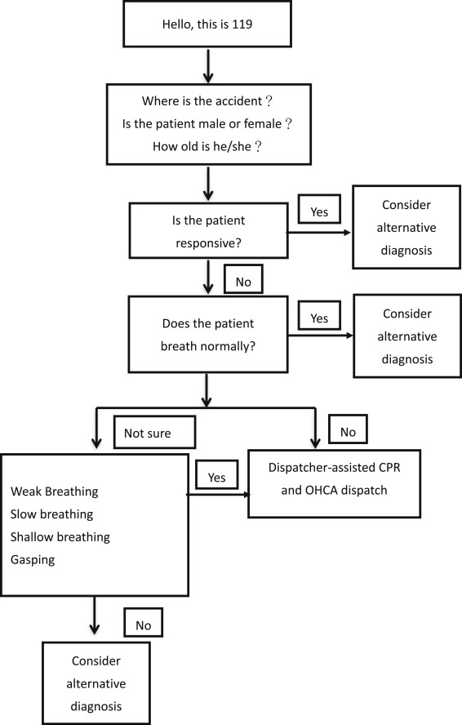
What is your emergency?
Locate the feedback loops
Notes:
specificty

Slide 81
What is your emergency?
Goal is to get to this part of the algorithm as quickly as possible.

Slide 82
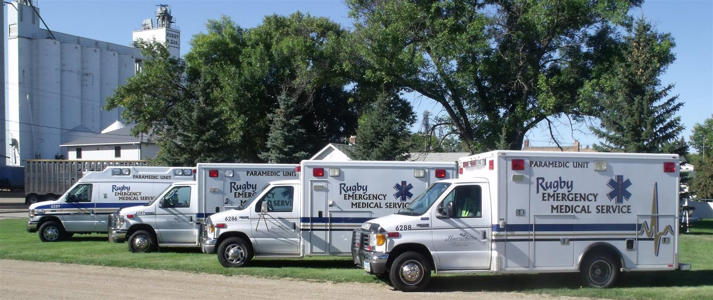
The consequence
Notes:
B: Multiple choice
What problem with feedback loops does this example illustrate?
Not closing a loop
Feedback timeliness
Feedback specificity
Feedback frequency
Feedback credibility
Feedback relevance

Slide 83
Feedback Specificity
What is your emergency?
Goal is to get to this part of the algorithm as quickly as possible.

Slide 84
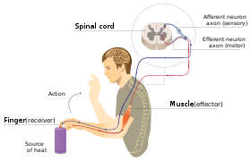
Reflex Arc
In practice: To what extent can processes be handled at the lowest operational level as opposed to being passed up the system for processing; which causes delays.

Slide 85






Reflex Arcs

Slide 86
Reflex Arcs

Slide 87

Cascading Failures

Slide 88


Looking upstream for solutions
Cascading Failures
Volunteer Emergency Medical Services
Emergency Dispatch
EMS with Paramedic
Heart Hospital
(definitive care)
Critical Access Hospital

Slide 89

Recommendation

Slide 90
Rationale of System Evaluation Theory (SET)
Cascading events
Parts
Step 1: Define the Intervention Operating as a System
Reworks
Levels
Step 2: Evaluate System Efficiency
Interdependence
Reflex Arcs
Scale
Evaluate interdependencies
Feedback loops
Boundaries
Others
Emergence
Step 3: Evaluate System Effectiveness
Note: System refers to the complex intervention that is acting as a system.
Evaluate emergence
Holism

Slide 91
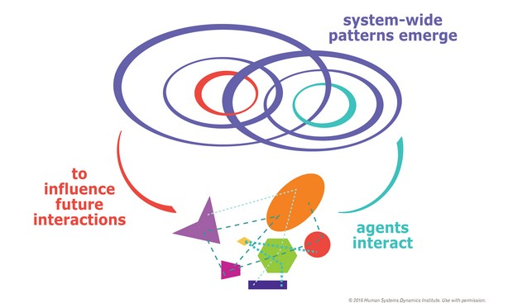
Step 3: Evaluating System Emergence (i.e., effectiveness)
To evaluate a system’s effectiveness is to ask whether the interdependent parts were successful in allowing the essential system property to emerge.

Slide 92
Volunteer Emergency Medical Services
Heart Hospital
(definitive care)
Cardiac Care System
Emergency Dispatch
Critical Access Hospital
EMS with Paramedic

Slide 93
Volunteer Emergency Medical Services
Heart Hospital
(definitive care)
Emergency Dispatch
Critical Access Hospital
EMS with Paramedic

Slide 94
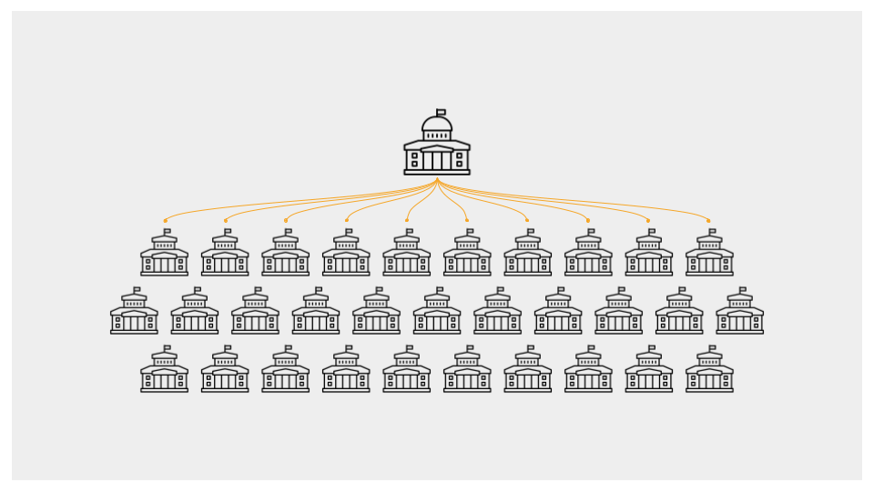
Who should be responsible for collecting data on the emergent property?
Those overseeing the system (complex intervention).
Friedman (RBA): community level indicators.
Not individual system parts.
Notes:
B: Multiple choice
Someone overseeing the system.
The responsibility is passed down to intervention components.
Needs to be decided jointly with leadership.

Slide 95
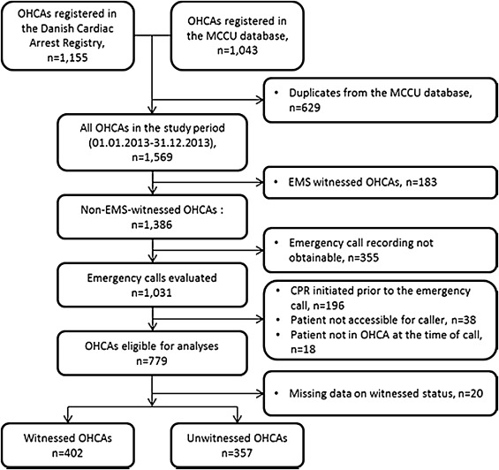

Cardiac Care System
Survival rate data compiled at the state level.

Slide 96
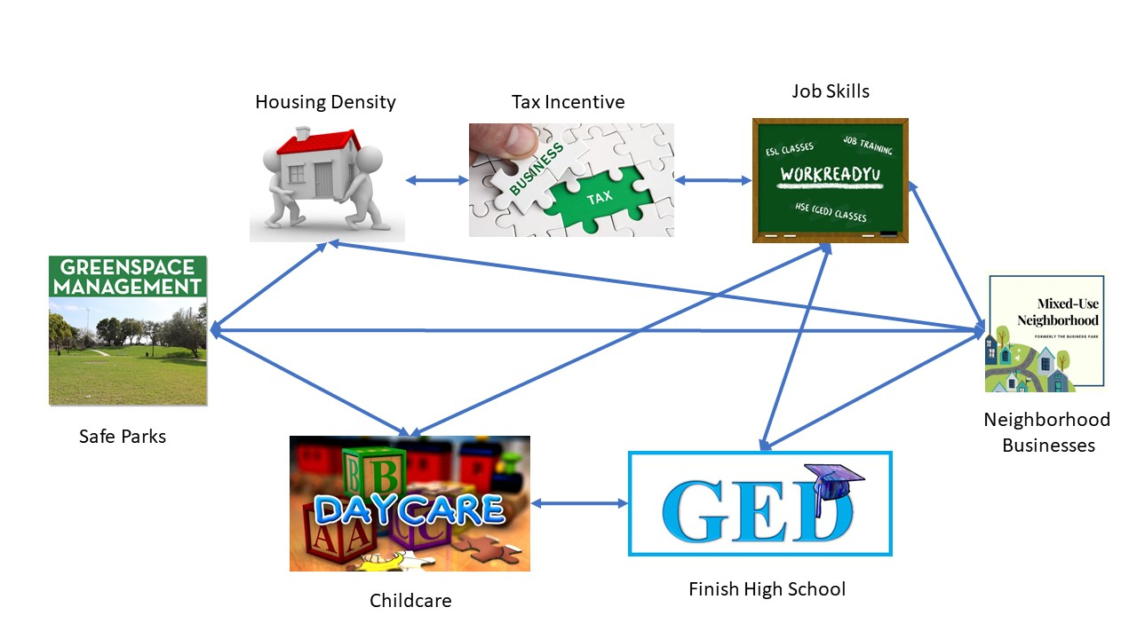

HUD HOPE VI
Survey of all participants by external evaluator.

Slide 97
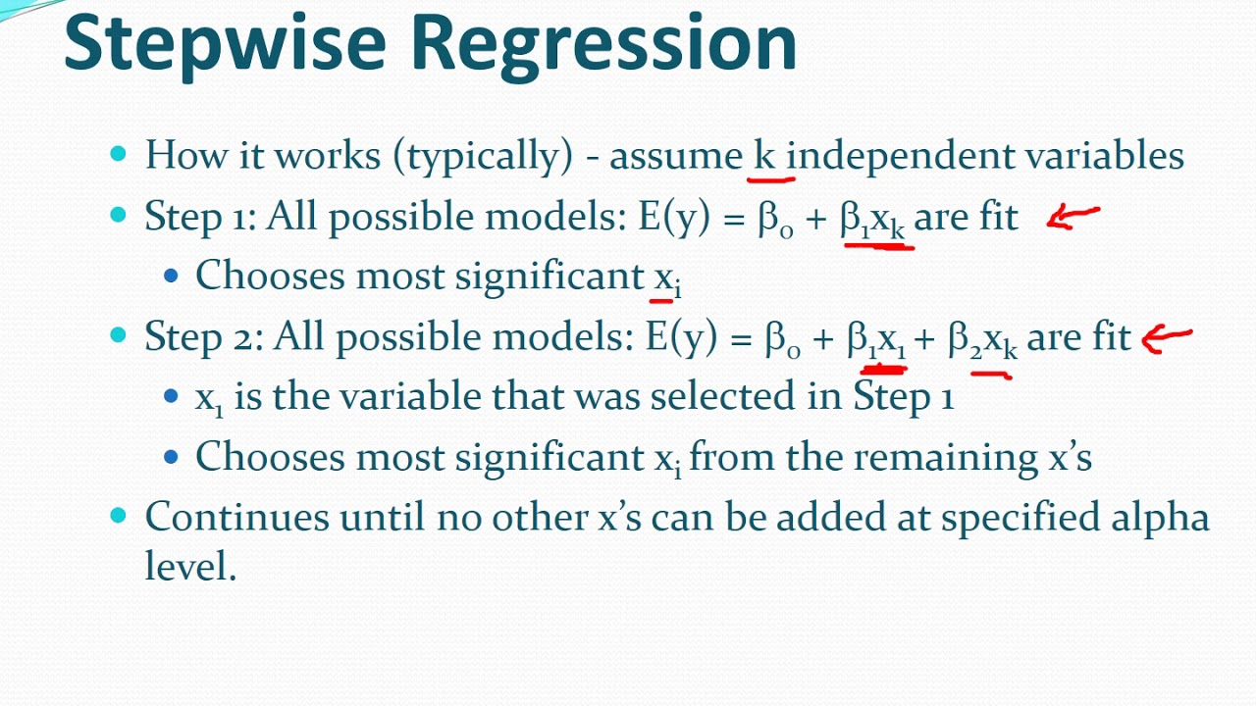
A pitfall of evaluating emergence
If you are evaluating emergence then it not make sense to evaluate the effectiveness of individual system parts because they are “interdependent”.
But assuming interdependence is good if property isn’t emerging then you might need to:
look at whether the system parts are indeed correct…that is, is it what a system part contributing necessary and correct or are we missing a part??
Or whether you have the correct emergent property
The emergent property is a “product” of the interaction of parts. (Ackoff). It’s not summative!

Slide 98

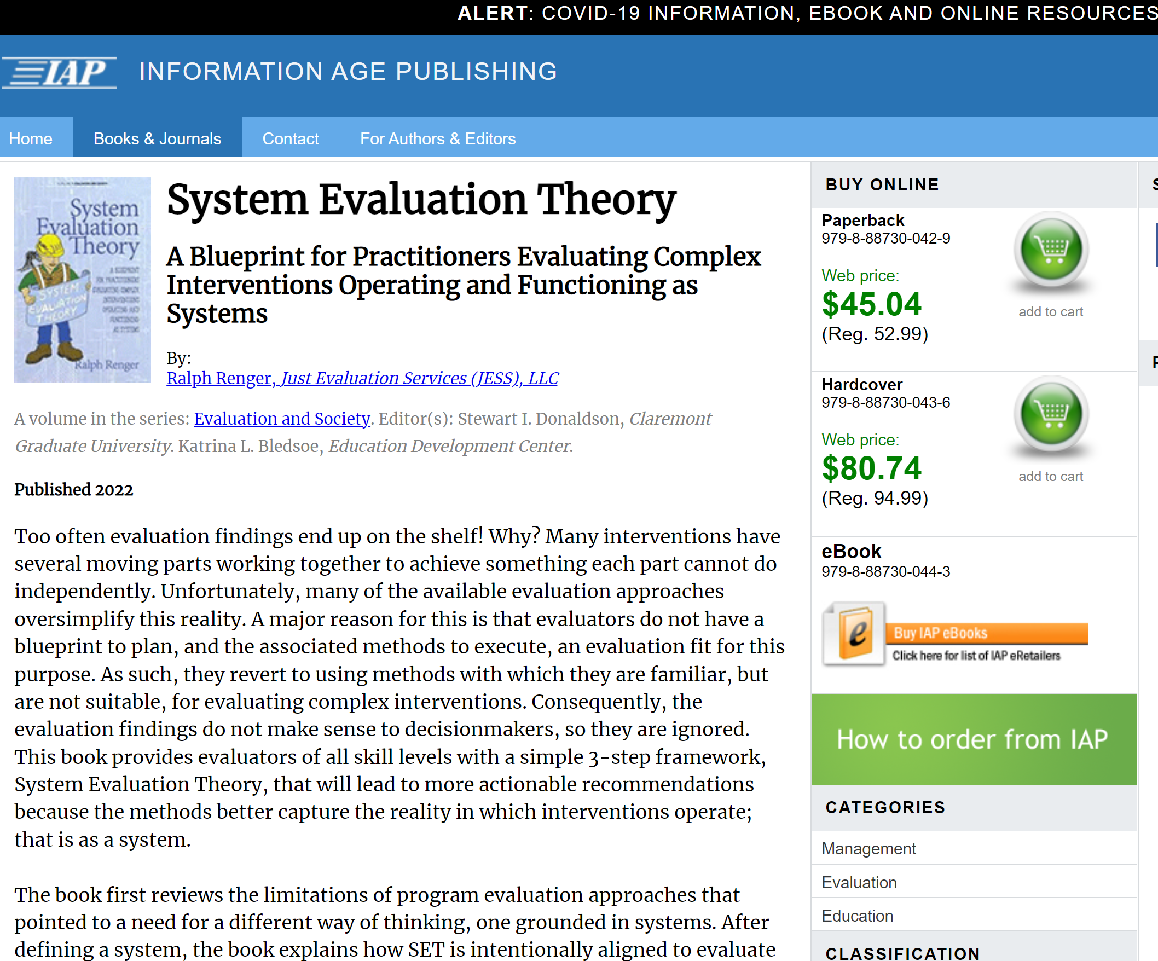
Contact Information:
  email ralph@justevaluation.com
  Website: justevaluation.com
  Cell: 520-203-1038
IAP || Book || System Evaluation Theory (infoagepub.com)

