Slide 1
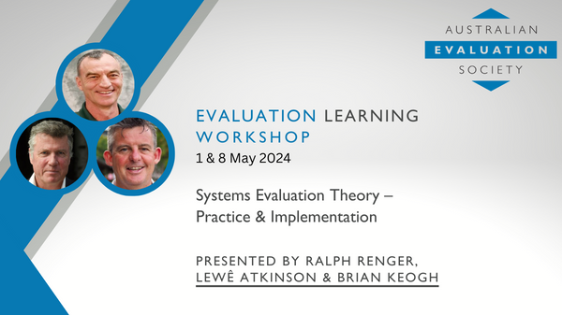
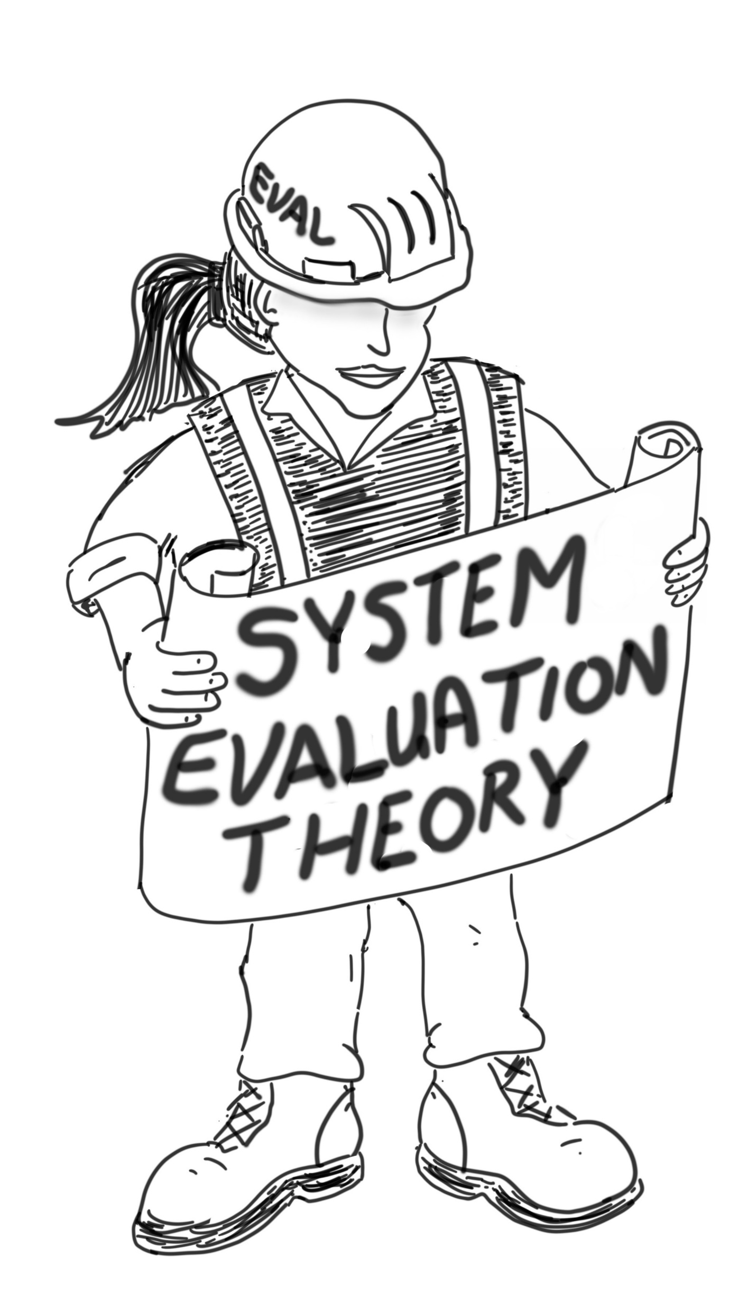

Slide 2
Housekeeping
Event: | Workshop - Systems Evaluation Theory: Practice & Implementation
Date: | Wednesday 1st May AND Wednesday 8th May 2024
Venue: | Via Zoom: https://aes-asn-au.zoom.us/j/85697128507?pwd=UzNUTlVGUkZHQURzQWkzNGQyUWxuUT09
Time (AEST) | Registration: 9:45am Start: 10:00am Break: 11:30 – 11.45am Close: 1:00pm
AES Host: | Dr Laura Baker M: 0410 281 036 E: l.baker@acilallen.com.au
Facilitators: | Lewê Atkinson | Brian Keogh | Ralph Renger M: 0419 240 979 | M: 0408 028 269 | E: ralph@justevaluation.com E: lewis@hainescentreaustralia.com.au E: briankeogh@icloud.com
AES Contact: | Fiona Zlotnik M: 0447 955 514 E: aes@aes.asn.au

Slide 3
Please see the note from the facilitators
Encouraged pre-reading – We know that participants are all busy. But if they have not read the content it will not detract from their workshop experience.
The readings are more of a value add and supporting getting participants into the right frame of mind such that each individual can have their best possible personal takeaways from the workshop process.
EJA Paper 2023 by Michael Cole on Evaluative Thinking
EJA Paper 2019 by Ralph, Lewe, et al on Connection between logic models and systems thinking.
A case study on application of SET by Inspector General of Emergency Management Victoria

Slide 4



https://www.justevaluation.com/system-evaluation

Slide 5

First seven
The lucky winners!
Also see www.systemsthinkingpress.com
AMAZON - https://www.amazon.com/System-Evaluation-Theory-Practitioners-Interventions/dp/B0BDCYFS5C
Lothar Wahl
Alexandra Henderson
Tracey Leonard
Joanne Ross
Lisa Coker
Maryellen Moore
Marwan El Hassan

Slide 6
ACKNOWLEDGEMENT OF COUNTRY
“Barrambin” (Windy place)
We take the time to recognise and acknowledge the traditional people of the lands and water where we meet today the Yugara and Turubul people of this area. We acknowledge these traditional custodians who cared for these lands and waters for thousands of years, (and) their decendants who maintain their spiritual connections and traditions.
We recognise that these have always been places of teaching and learning. We strongly encourage justice to promote understanding and pay respect to our elders past, present and those emerging. Before you continue your journey please take a moment to honour millions of footprints that have travelled these dreaming pathways.
By Aunty Nicole Williams

Slide 7



CHAT
ACTIVITY
In the CHAT function introduce yourself by sharing:
Your name and country on which you are based
Where are you working? (ie. office, couch, patio)
Hover your mouse over the Zoom window until you see the tool bar appear.
Click on the ‘Chat’ icon in the tool bar.
A chat window will then open. Select ‘Everyone’ and type in your answer.
Notes:
POLL
Commercialisation: designing products & pathways that suit your business
Intellectual Property: creating and protecting your ideas
Pathways to Market: options to consider
MVP Prototyping: Market validation and testing techniques
Business Models: Increasing the value of your business

Slide 8
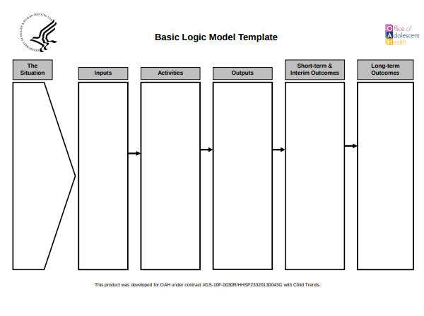

Background

Slide 9


Slide 10
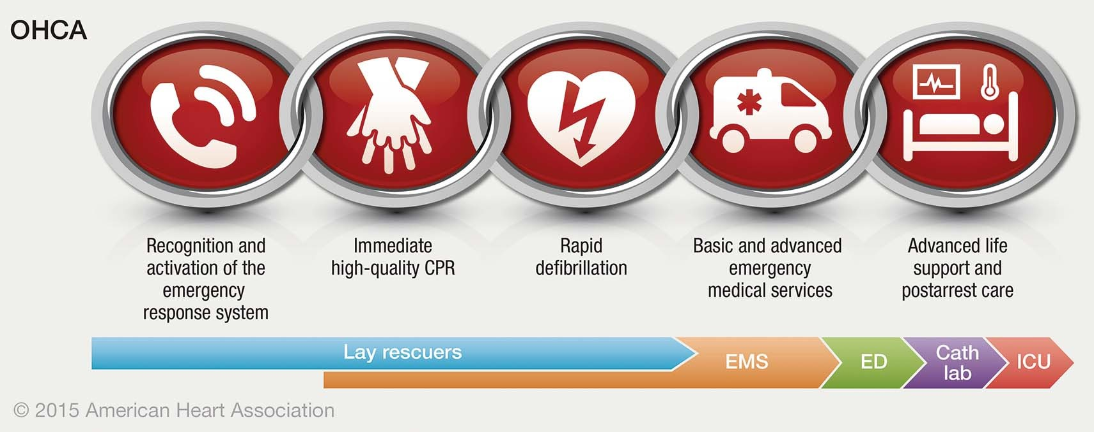

Slide 13
Something was bugging me.
The design of the cardiac care response intervention was different than what I had previously evaluated.
Key design features
  multiple components
  components were dependent on each other for success.
My use of logic models implied that the components were operating independently.

Slide 14

My Search for a Solution
Why were logic models not a good fit?
Why were they developed in the first place?
I gained a much better understanding of what was meant by “fit for purpose”.
  the logic model
  was developed for a certain type of intervention.
  The intervention design is based on research guided by a specific worldview.
Research Worldview
Intervention
Design
Logic Model

Slide 15
My Reasoning
Research Worldview
If I could understand the research worldview underpinning the cardiac care response, then perhaps I could develop an evaluation approach fit for purpose.
Lewe- Cole – Evaluative Thinking
New Evaluation Approach Fit for Purpose
Notes:
Cole 2023. Aussie.
“Evaluations can be designed, implemented and reported without evaluative thinking.
However, without evaluative thinking, evaluators may not make important connections,
miss their biases, lose the context and meaning of their findings, or, in many other ways,
inadvertently compromise the quality and utility of their evaluation.”

Slide 16

  Objective 1: To be able to explain the relationship between the worldview underpinning research, intervention design, and evaluation approaches fit for purpose.
  Objective 2: To be able to explain why systems thinking is a better path forward for evaluating complex interventions grounded in holistic thinking.
  Objective 3: To provide an overview of SET and explain why its “fit for purpose” for evaluating complex interventions.
Purchase the Book | Justevaluation

Slide 17
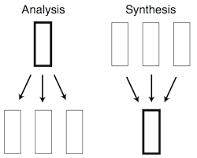
Research Worldviews Influencing Intervention Design
Reductionist thinking.
Holistic thinking.

Slide 18
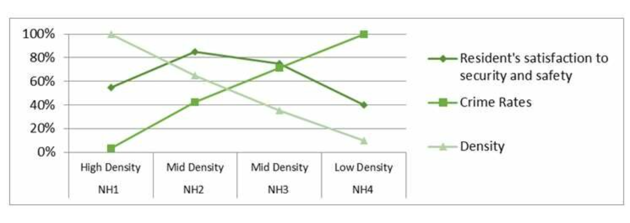
Reductionist Research
E.g., High density housing is a root cause of crime.
Crime
High Density
Housing

Slide 19
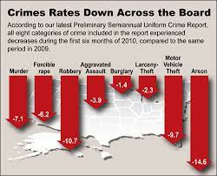

The intervention design then mirrors the reductionist research.
  If we replace high density housing with low density housing, then crime rates will drop.
  The result is a simple intervention.
    one component with linear logic
=
If
Then

Slide 20

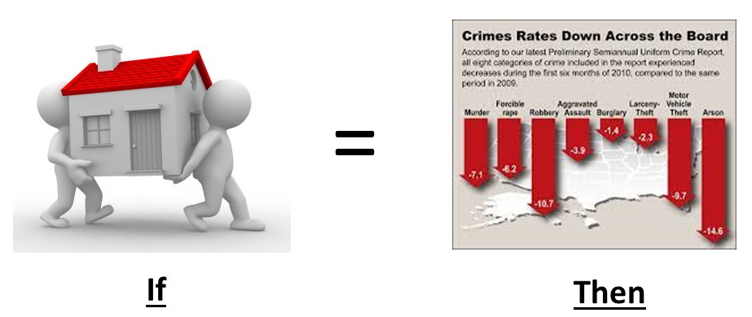
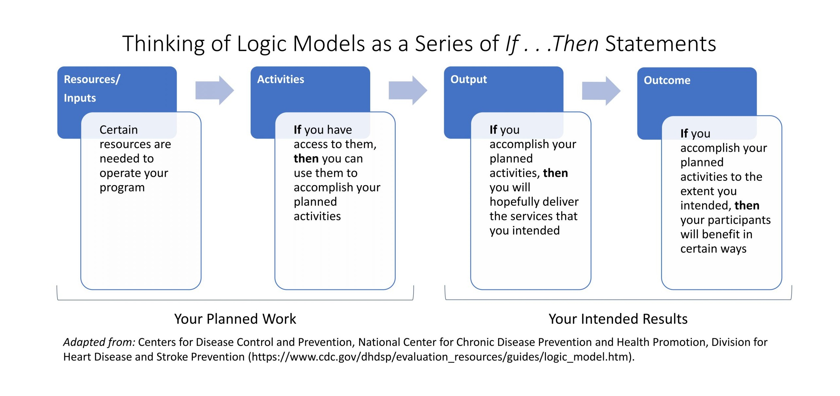
  If we replace high density housing with low density housing, then crime rates will drop.
The logic model was developed to evaluate simple, linear interventions.

Slide 21
Section 8
Relocate & Integrate
Build low density housing
If we decrease housing density then crime rates will drop
Number of homes built
Number of families relocated
Low density housing
Less crime
Funding

Slide 22
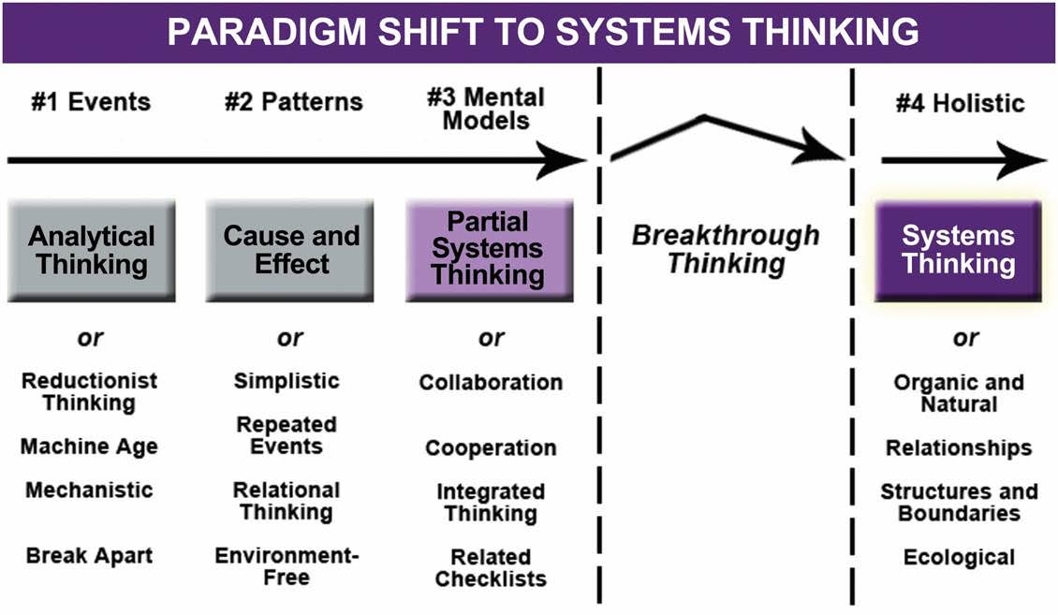
Summary
Research Worldview
Intervention Design
Simple Interventions
Evaluation Approach
Logic Model

Slide 23
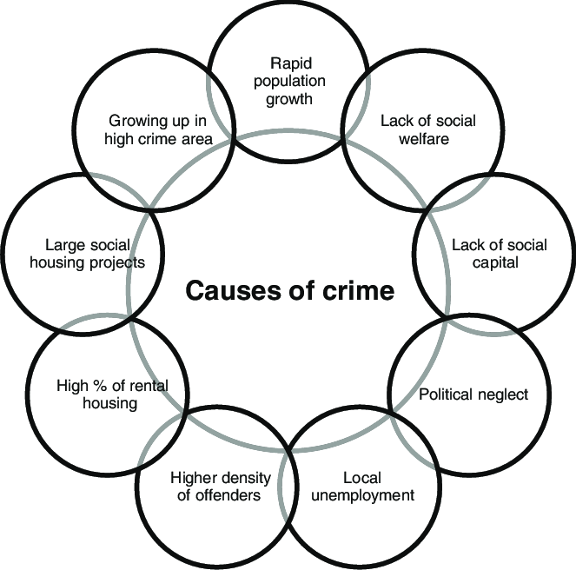
Holistic Research is Increasingly Driving Intervention Design
Unemployment
High Density
Rental Units
Crime

Slide 24


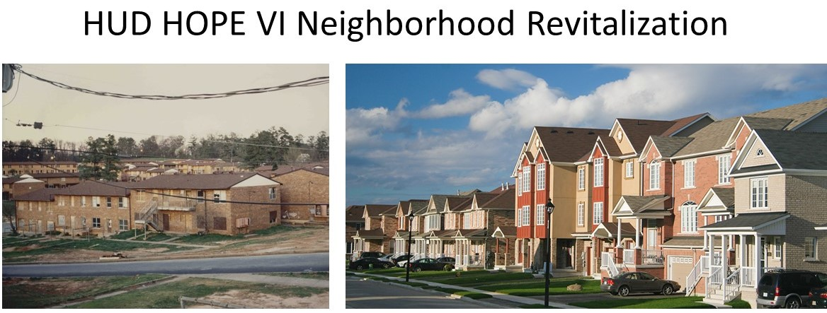




Housing Density
Job Skills
Safe Parks
Neighborhood
Businesses
Tax Incentives
Education
Childcare

Slide 25
Housing Density
Job Skills
Safe Parks
Neighborhood
Businesses
Tax Incentives
Education
Childcare

Slide 26

The HUD HOPE VI intervention is holistically-designed.
Has many interdependent components operating in non-linear ways.
It is a complex intervention.

Slide 27
Safe Parks
Housing Density
Tax Incentive
Job Skills
Neighborhood
Businesses
Education
Childcare

Slide 28
Safe Parks
Housing Density
Tax Incentive
Job Skills
Neighborhood
Businesses
New locally owned businesses
Retrained and employed
Home Ownership
No Gentrification
Park Utilization
Spouses at Work
High School Diploma
Education
Childcare

Slide 29

Breakout Room Discussion Questions – 10 minutes
Have you tried to couple/stack multiple logic models in evaluating a complex intervention?
If yes, did coupling/stacking models serve you well in evaluating complex interventions or did you encounter any limitations with this approach?
Lewe - Cole
Notes:
Cole: Each program logic component must be justifiable and valid and provide the necessary
pre-conditions for achieving the next step or result. One must also identify, make
explicit, test and, where possible account for the underlying assumptions upon which
the program is built. This is clearly the domain of vertical thinking using logic, logical
inference and critical thinking to produce reliable inferences about a projected desirable
future state. But to get there, one must use lateral thinking elements – examine the
context to map the boundaries of the policy problem and program solution; spontaneously
generate untested ideas; make creative inferential leaps and non-judgementally
synthesise different points of views, some of which may initially seem incompatible;
and above all else be prepared to be intellectually playful.

Slide 30
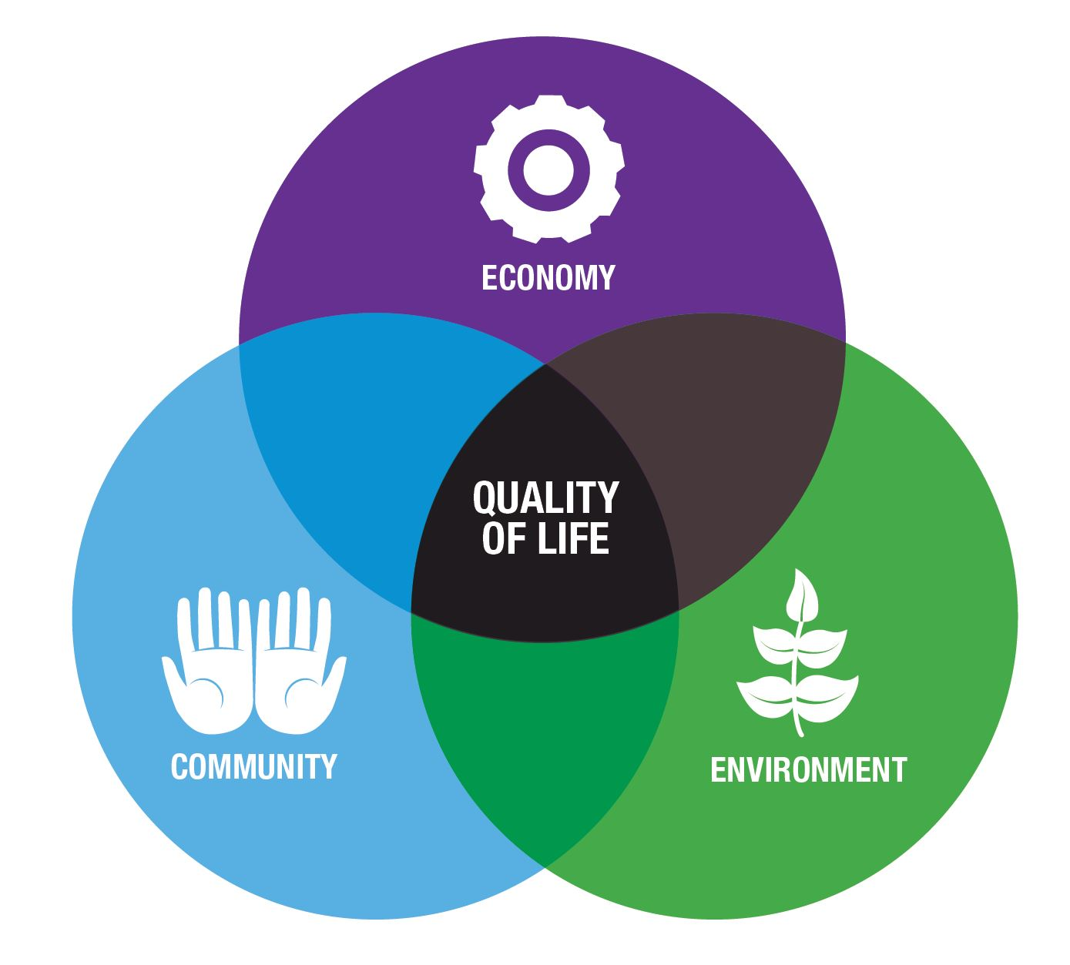

Housing Density
Job Skills
Retrained and employed
Home Ownership
Safe Parks
Neighborhood
Businesses
New locally owned businesses
Park Utilization
No Gentrification
High School Diploma
Spouses at Work
Tax Incentive
Childcare

Slide 31
Safe Parks
Job Skills
Neighborhood
Businesses
Housing Density
Tax Incentive
Finish High School
Childcare

Slide 32
Summary
Research Worldview
Intervention Design
Simple Interventions
Complex Interventions
Evaluation Approach
Logic Model
Stacking Logic Models

Slide 33
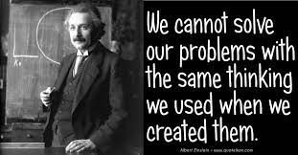
If more logic models are not the solution for evaluating complex interventions, then what is a better approach?

Slide 34
Simple Interventions
Complex Interventions
Complex Interventions
Logic Model
Stacking Logic Models
??????
Notes:
Lewe to add “cross the rubicon”

Slide 35
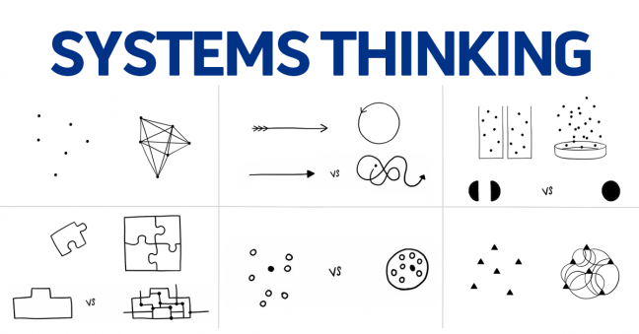
System thinking is holistic thinking.
Systems thinking is literally to think like a system.
It seemed reasonable to think that perhaps our understanding of systems could be used to develop an approach for evaluating complex interventions like a cardiac care response.

Slide 36
System defined: An integrated whole whose essential properties emerge from the interdependence between its parts (Ison, 2008).

Slide 37
System defined: An integrated whole whose essential properties emerge from the interdependence between its parts (Ison, 2008).

Slide 38
System defined: An integrated whole whose essential properties emerge from the interdependence between its parts (Ison, 2008).

Slide 39

System defined: An integrated whole whose essential properties emerge from the interdependence between its parts (Ison, 2008).

Slide 40

Research Worldview
Reductionist Research
Holistic
Research
Intervention Design
Simple Interventions
Complex Interventions Designed to Operate and Function as a System
Evaluation Approach
Logic Model
?????
A blueprint for evaluators to evaluate complex interventions designed to operate and function as systems

Slide 41
Rationale of System Evaluation Theory (SET)
Cascading events
Parts
Reworks
Step 1: Define the Complex Intervention
Levels
Step 2: Evaluate Interdependencies
Reflex Arcs
Scale
Feedback loops
Boundaries
Others
Step 3: Evaluate Emergence
Holism

Slide 42
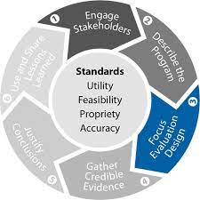
Summary
The best evaluation approach is one aligned with the research worldview giving rise to the intervention design.
Logic models are good for evaluating simple interventions based on reductionist research.
System approaches like SET are needed for evaluating holistically-driven interventions designed to operate and function as a system.

Slide 43


Slide 44
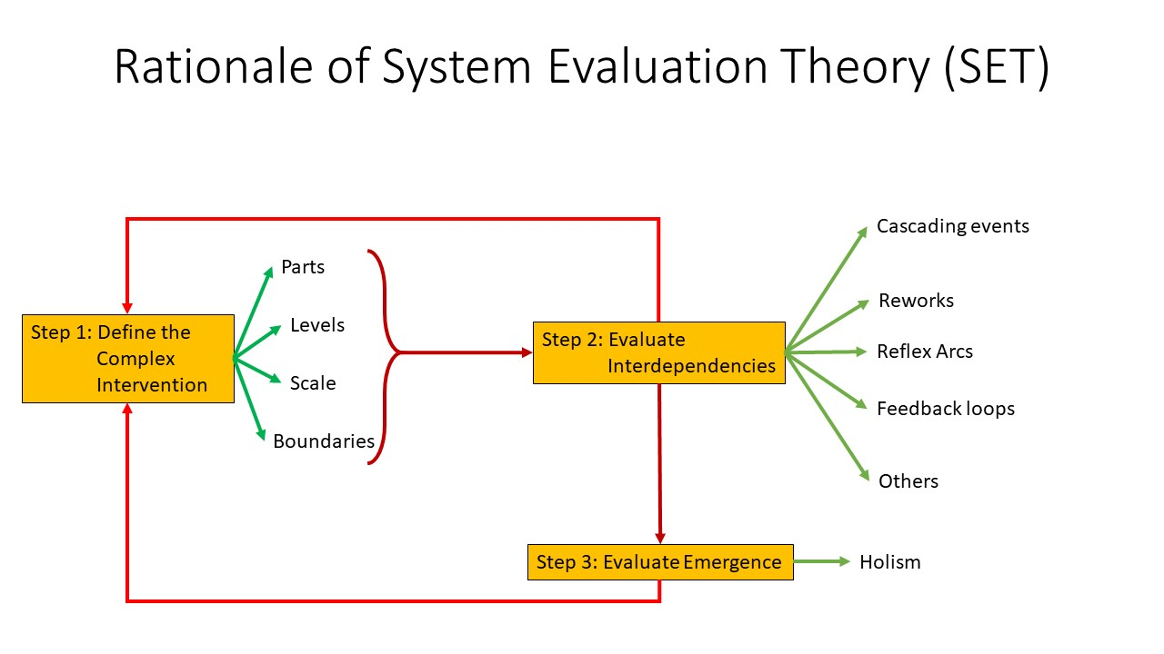
Applying SET – Step 1

Slide 45

Applying SET – Step 1
Goal is to define the evaluand
  i.e., the complex intervention meeting the system test
Need to define the intervention components and how they are intended to operate together.
  the standard of acceptability.

Slide 46
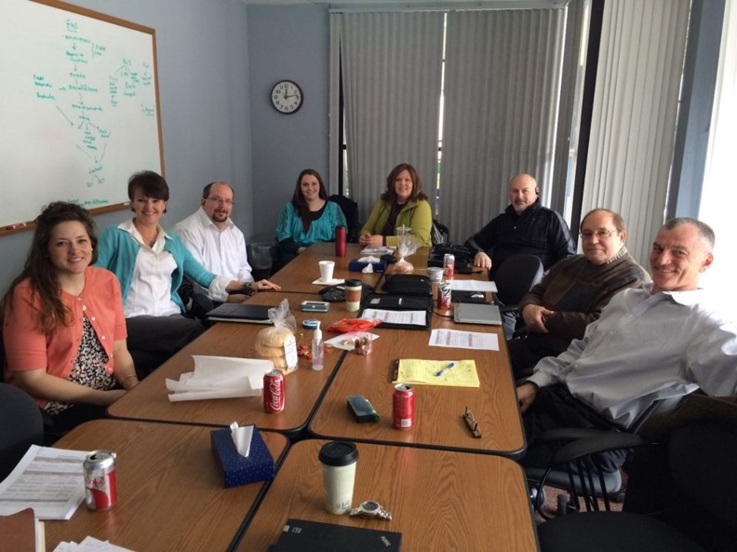
Pull together leaders

Slide 47

Define Emergent Property

Slide 48
Storyboarding

Slide 49
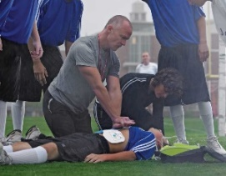
Bystander CPR

Slide 50

Bystander CPR
Original Emergency Dispatch

Slide 51

Bystander CPR
Original Emergency Dispatch
Volunteer Emergency Medical Services

Slide 52
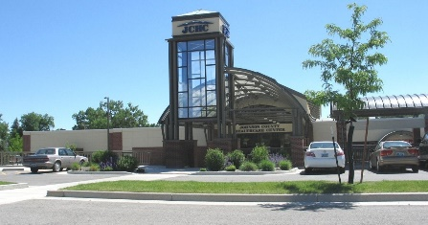
Bystander CPR
Original Emergency Dispatch
Volunteer Emergency Medical Services
Kitimat Critical Access Hospital

Slide 53
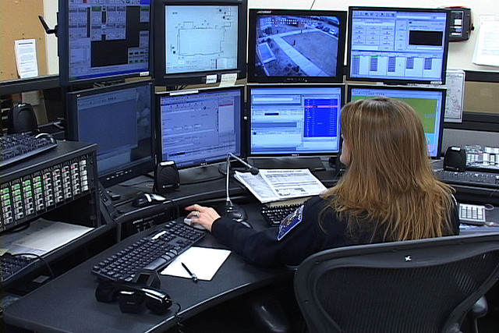
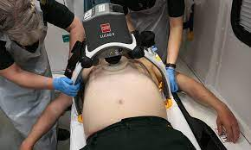
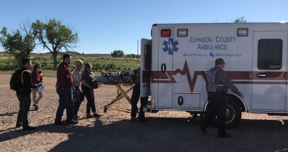


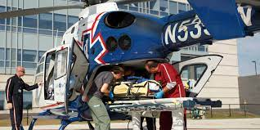
Bystander CPR
Original Emergency Dispatch
Paramedic 911 dispatch
Intercept
LUCAS device
EMS with Paramedic
Volunteer Emergency Medical Services
Medical Transport
Kitimat Critical Access Hospital
Prince Rupert Hospital
Vancouver Heart Hospital

Slide 54
Test the Evaluation Boundary

Slide 55
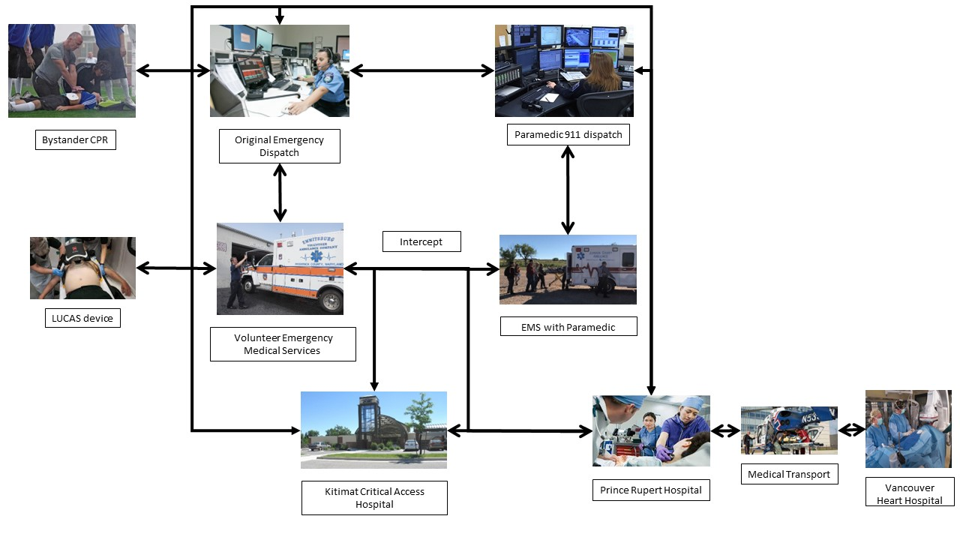

Slide 56
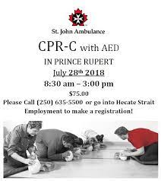
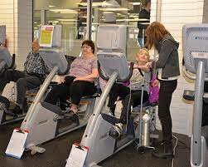
Public CPR
Rehabilitation

Slide 57
Public CPR
Rehabilitation

Slide 58
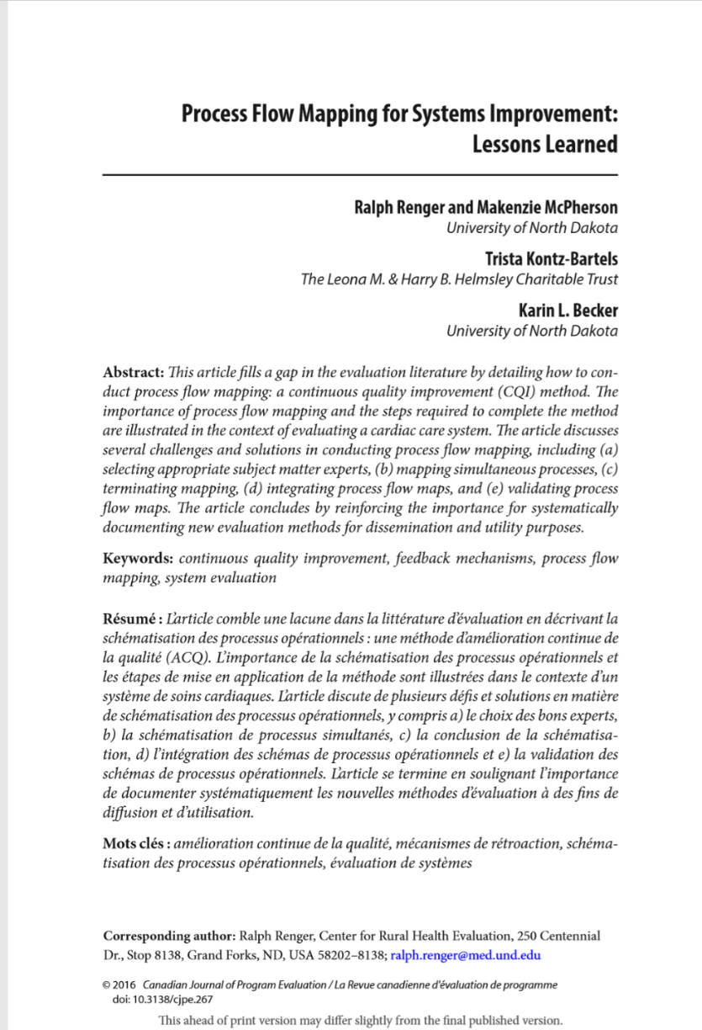
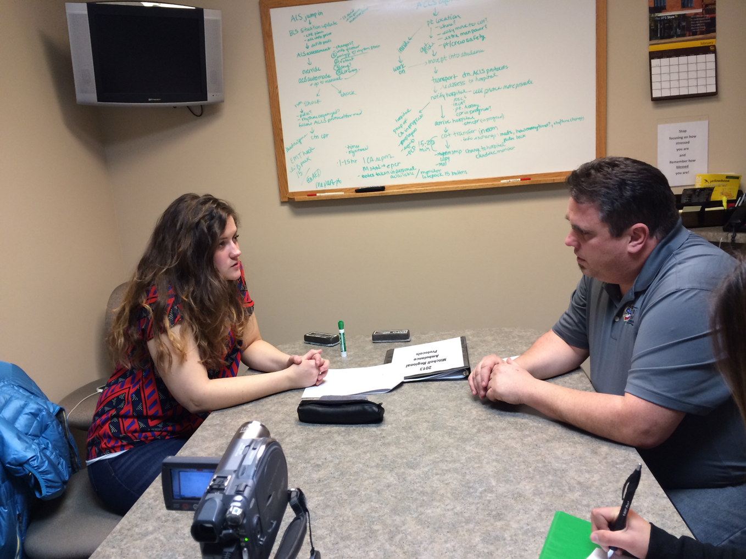
Process Flow Map (PFM) with Operational level SMEs

Slide 59
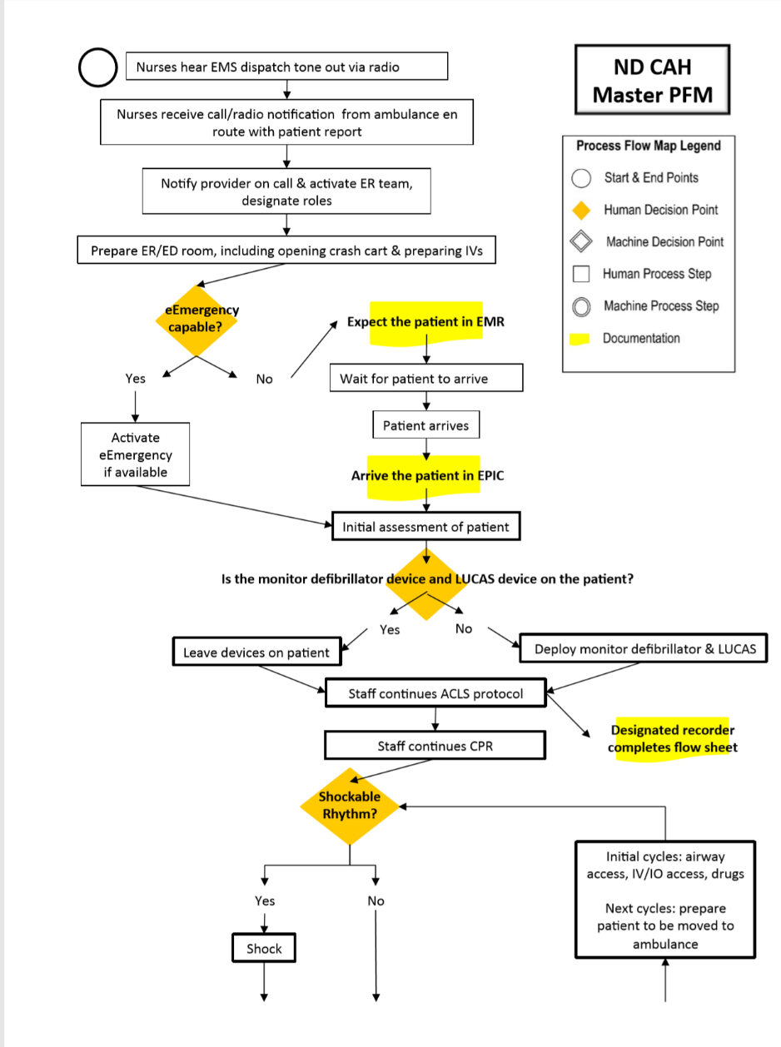

Slide 60

Pull everyone together

Slide 61
Breakout Room Discussion Questions – 10 minutes
Why pull together leaders first?
Why define the emergent property first?
Why complete process flow mapping with individual intervention parts first, why not just pull everyone together immediately to define interdependencies?
Why not use leaders to define the SOPs?
What are the benefits of establishing the evaluation boundary?
Notes:
Leaders- need them to pave way for evaluation cooperation (SMEs)- negotiate recommendation adoption - will help increase likelihood of considering recommendations and acting on them,
Emergence first because you need to be able to ask along the way whether each part is needed to contribute to the outcome: tests the design
Shows as an evaluator you view every part of the system as important. Leaders don’t know operational details?
Need to come to the table with SOPs so they can understand where and when their processes intersect with others and how to then alter their processes
Understand context; help drive recommendations later.
Mention utility is also defined by process and products.

Slide 62
SET Step 1 - Products
Emergent property defined.
Evaluation boundary established.
Standard of acceptability for (JSOPs) interdependencies.
Leadership buy-in.

Slide 63
Applying SET – Step 2

Slide 64

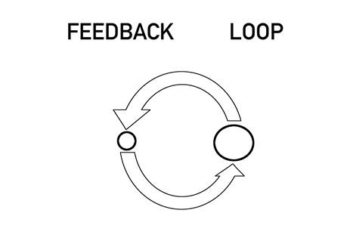
Feedback Loops
The return of information about the status of a process.
Notes:
Add close the loop

Slide 65
Bystander CPR
Original Emergency Dispatch
Paramedic 911 dispatch
Intercept
LUCAS device
EMS with Paramedic
Volunteer Emergency Medical Services
Kitimat Critical Access Hospital
Prince Rupert Hospital

Slide 66

Bystander CPR
Original Emergency Dispatch
Paramedic 911 dispatch
Intercept
LUCAS device
EMS with Paramedic
Volunteer Emergency Medical Services
Kitimat Critical Access Hospital
Prince Rupert Hospital

Slide 67
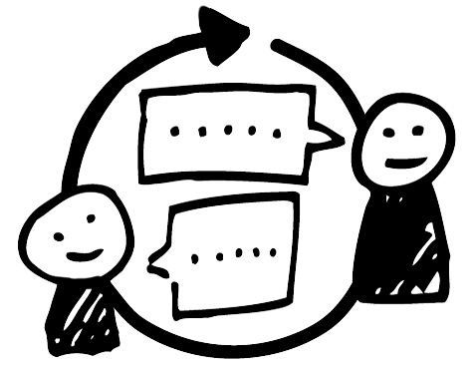
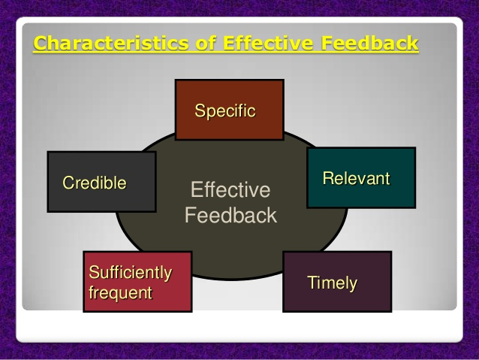
Criteria for evaluating effective feedback.
Close the loop!
Notes:
Add close the loop

Slide 68

Feedback loop frequency
Patient and run report data collected by EMS
Hospital adds data on patient outcome
State EMS combines run data and hospital data.
Notes:
Cardiac arrest data entered into a system by EMTs after every run
Information wasn’t being provided back to EMTs to improve their performance: EMTs stopped filling out reports

Slide 69
Feedback loop frequency
Patient and run report data collected by EMS
Annually
Hospital adds data on patient outcome
State EMS combines run data and hospital data.
Notes:
Cardiac arrest data entered into a system by EMTs after every run
Information wasn’t being provided back to EMTs to improve their performance: EMTs stopped filling out reports

Slide 70

Consequences

Slide 71
Recommendation: Increase feedback loop frequency
Patient and run report data collected by EMS
Annually
Hospital adds data on patient outcome
State EMS combines run data and hospital data.
Notes:
Cardiac arrest data entered into a system by EMTs after every run
Information wasn’t being provided back to EMTs to improve their performance: EMTs stopped filling out reports

Slide 72
Recommendation: Increase feedback loop frequency
Patient and run report data collected by EMS
Monthly
Hospital adds data on patient outcome
State EMS combines run data and hospital data.
Notes:
Cardiac arrest data entered into a system by EMTs after every run
Information wasn’t being provided back to EMTs to improve their performance: EMTs stopped filling out reports

Slide 73


Feedback Specificity
Caller
911 Dispatch Center

Slide 74
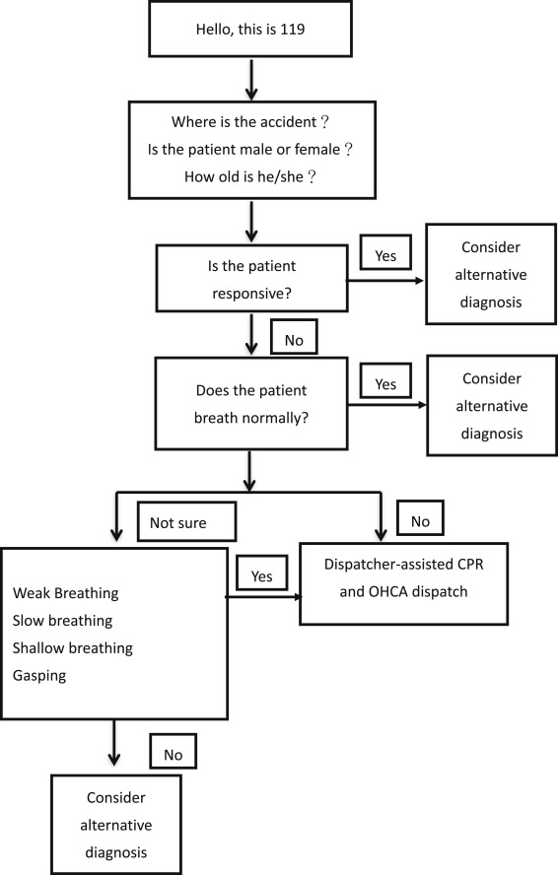

Notes:
Specificity key at each step because it informs the algoriythm…the quicker they get through the algorithm the sooner the help gets sent.

Slide 75
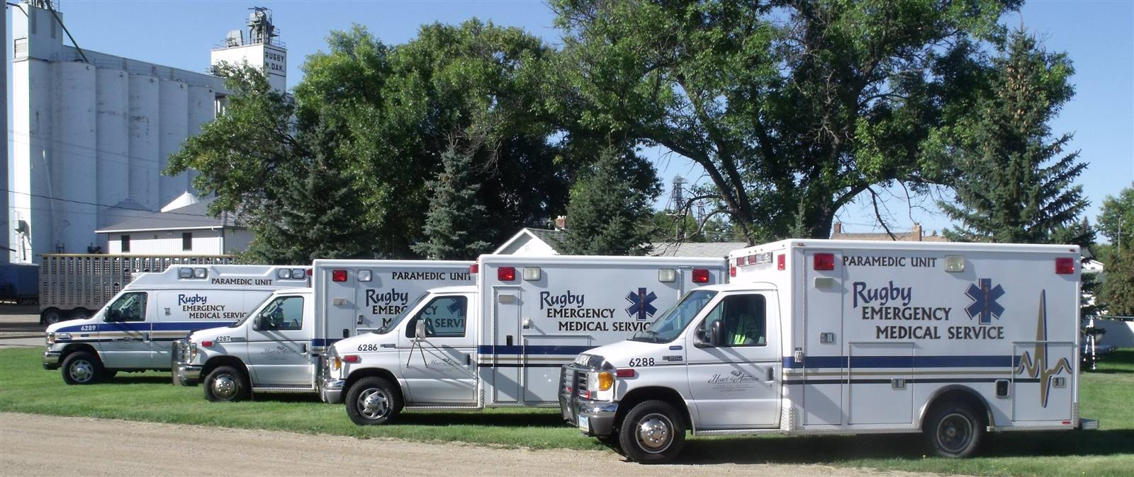
The consequence

Slide 76
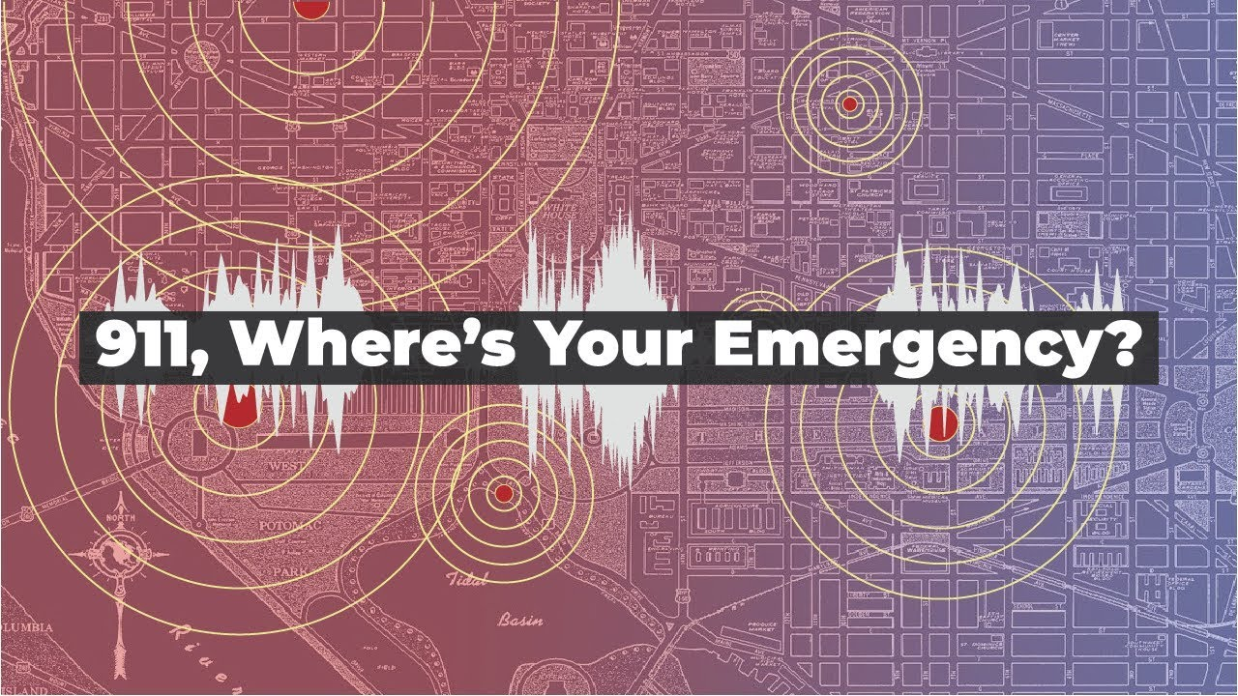
Notes:
Specificity key at each step because it informs the algoriythm…the quicker they get through the algorithm the sooner the help gets sent.

Slide 77
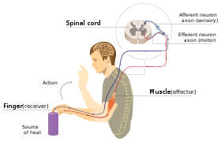
Reflex Arc
In practice: where can we create bypasses to increase operational efficiency?

Slide 78


Reflex Arcs

Slide 79
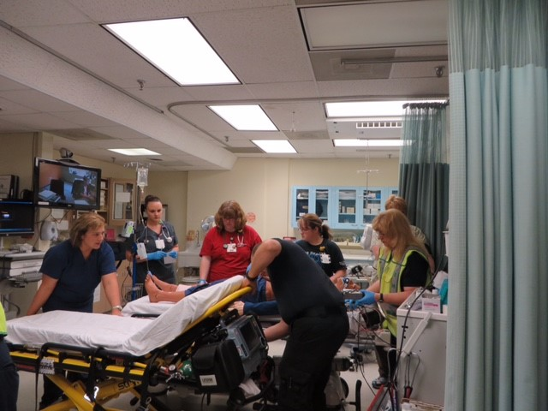

Consequences
Notes:
Not deemed as credible there is no action in the ER to receive the patient. Should look like panel A, but looks like panel B

Slide 80
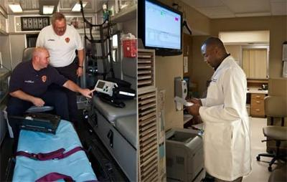
Solution: create a bypass
Notes:
Show this and then problem was closing the loop!

Slide 81
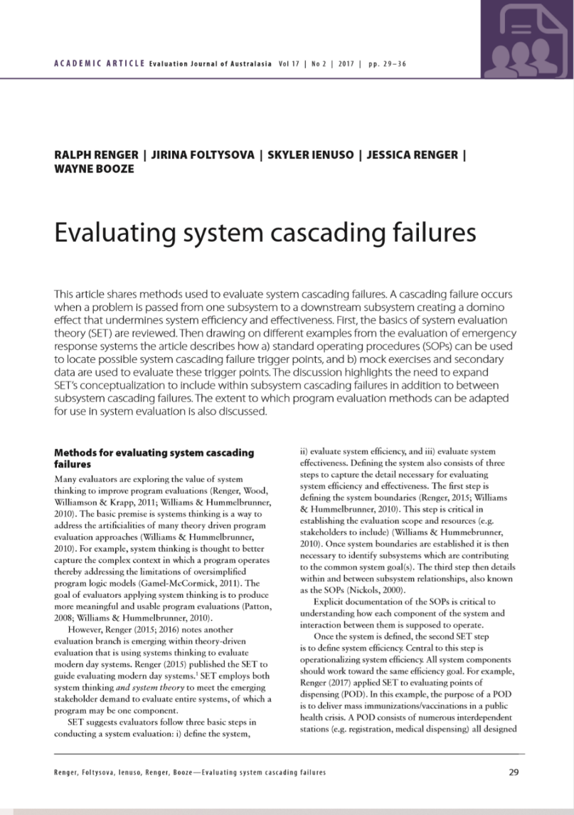
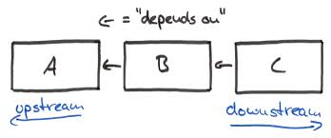
Cascading Failures

Slide 82







Looking upstream for solutions
Cascading Failures
Volunteer Emergency Medical Services
Emergency Dispatch
EMS with Paramedic
Heart Hospital
(definitive care)
Critical Access Hospital

Slide 83


Recommendation

Slide 84
Breakout Room Discussion Questions – 10 minutes
What system concepts have you tried, or might you find useful in evaluating interdependencies?
How does SET step 2 differ from other QA QI approaches?
Do you need to follow SET to be able to start applying system concepts to your evaluation?
Notes:
Can just use feedback loops ot start gaining confidence and convince leaders of the value of applying systems thinking to evaluation.

Slide 85
Applying SET – Step 3

Slide 86
Bystander CPR
Original Emergency Dispatch
Paramedic 911 dispatch
Intercept
LUCAS device
EMS with Paramedic
Volunteer Emergency Medical Services
Kitimat Critical Access Hospital
Prince Rupert Hospital

Slide 87

Bystander CPR
Original Emergency Dispatch
Paramedic 911 dispatch
Intercept
LUCAS device
EMS with Paramedic
Volunteer Emergency Medical Services
Kitimat Critical Access Hospital
Prince Rupert Hospital

Slide 88
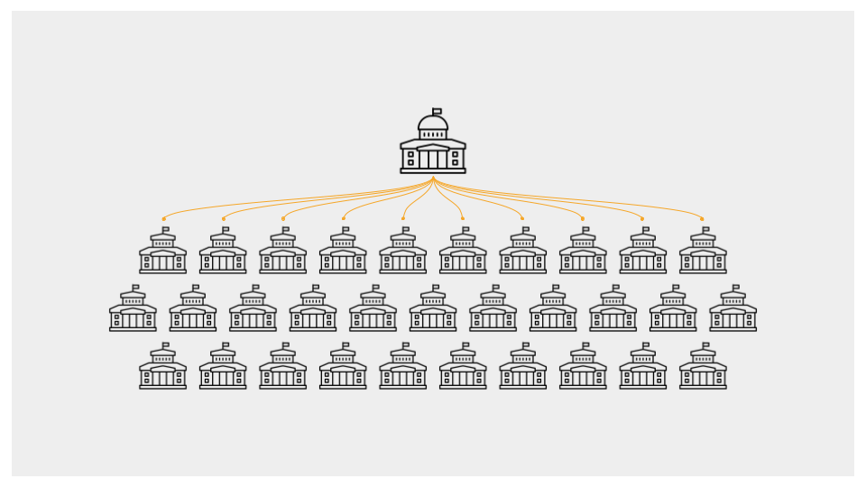
Who should be responsible for collecting emergent outcome data?
  Not individual parts of the complex intervention.
  Those overseeing complex intervention.
  Friedman (RBA): community level indicators.
Notes:
Results based accountability

Slide 89
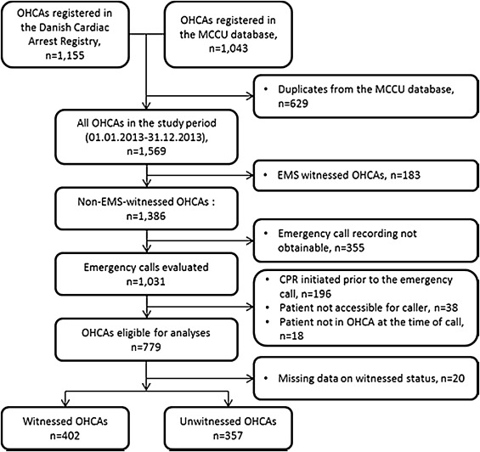
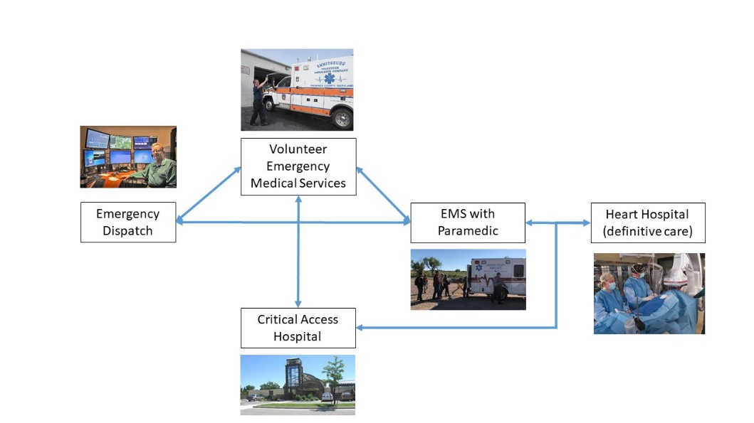
Cardiac Care System
Survival rate data compiled at the state level.

Slide 90
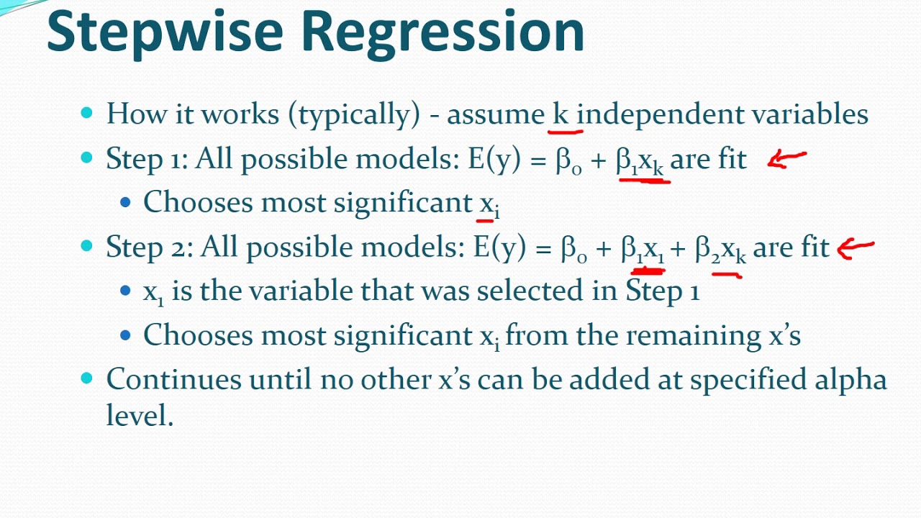
A pitfall of evaluating emergence
It does not make sense to evaluate the effectiveness of individual system parts because they are “interdependent”.
The emergent property is a “product” of the interaction of parts. (Ackoff). It’s not summative!

Slide 91
Breakout Room Discussion Questions – 10 minutes
How does an emergent outcome differ from a long-term outcome, like that found in a logic model?
In the cardiac care response intervention, the emergent property is saving lives. It may be more challenging to define in other settings. What might be the emergent outcome for:
  Homelessness interventions?
  Tax policies/codes?
  Transportation systems?
  Theme parks?
Notes:
Homelessness interventions: its stability or quality of life
Tax policies/codes: fairness.
Transportation systems: rider safety and reliability.
Customer experience.

Slide 92
Time permitting
Cover 94-97 or skip to 98

Slide 93
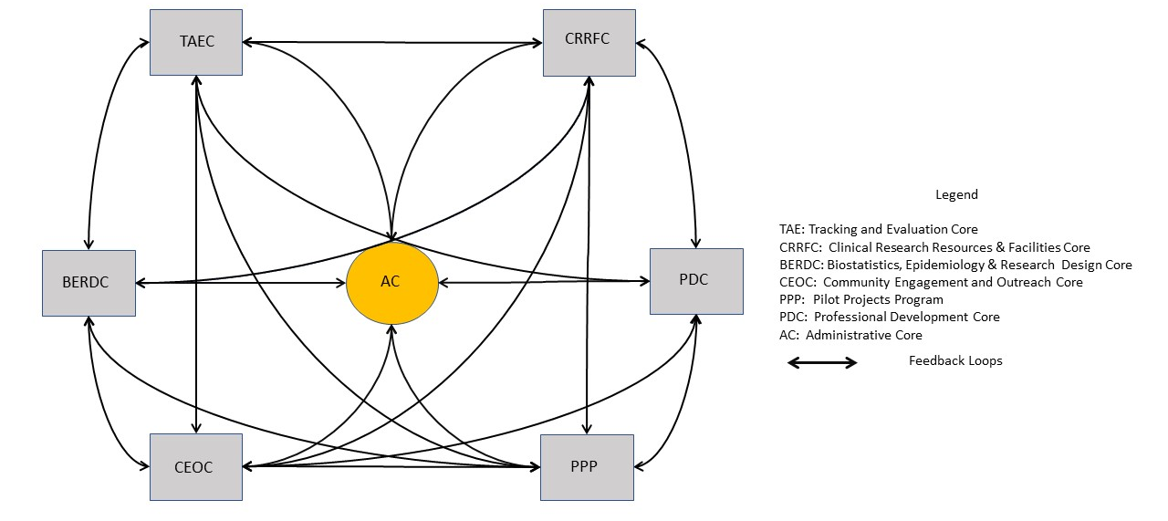
Illustrating the power of SET

Slide 94
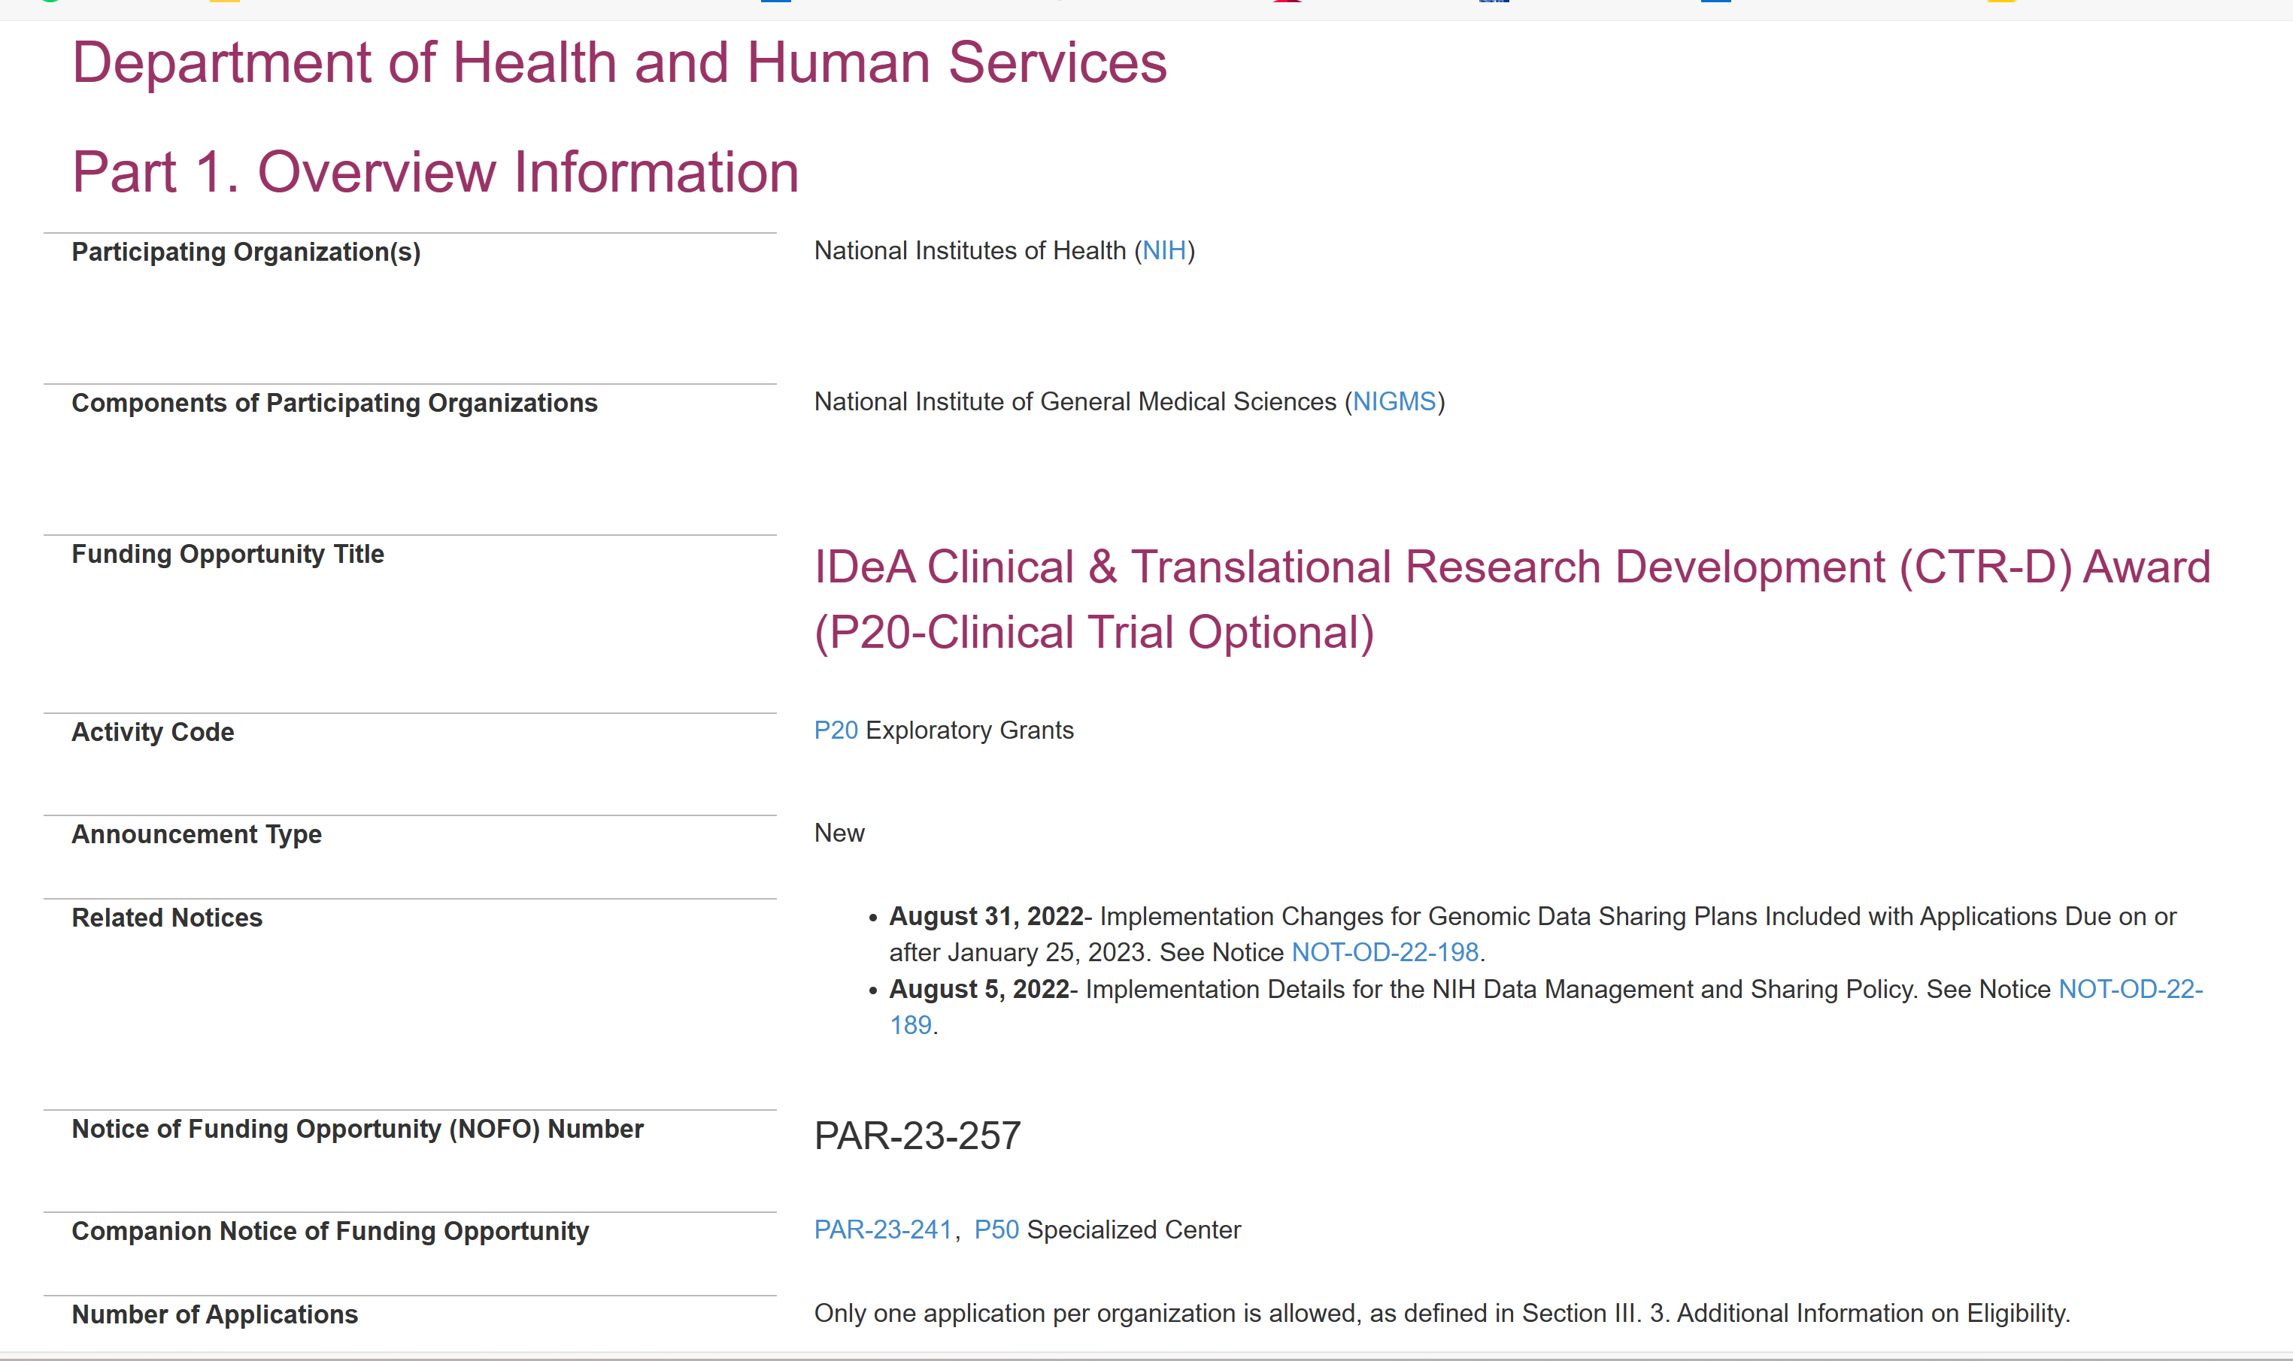
What the NOFO says…
24 references to interdependence
  “Collaborate between cores”
  “Partner with other organizations”
  “Promote multi-directional engagement”
Even reference to emergence
  “synergize with existing strengths”

Slide 95
But the “mandated” evaluation falls short!
NIH Required
Systems Approach
Process evaluation
  Focus is on SOP implementation for individual cores.
Outcome evaluation
  Logic Models for each core
  Reporting only outputs (publications, funding)
Process evaluation
  Focus on core interdependencies
  LOCS, stakeholder interviews
  Prerequisite for emergence
Outcome evaluation
  Researcher self-efficacy

Slide 96

Evaluation Utility Metrics (EUMs)

Slide 97
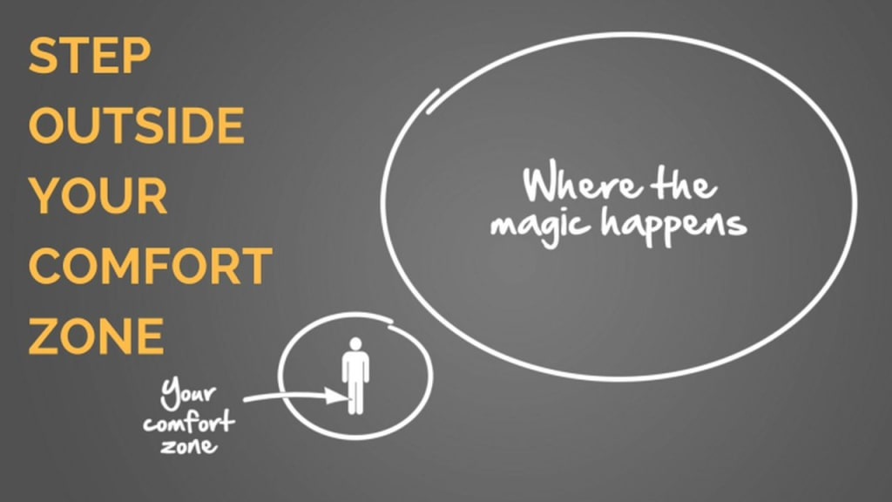

Slide 98
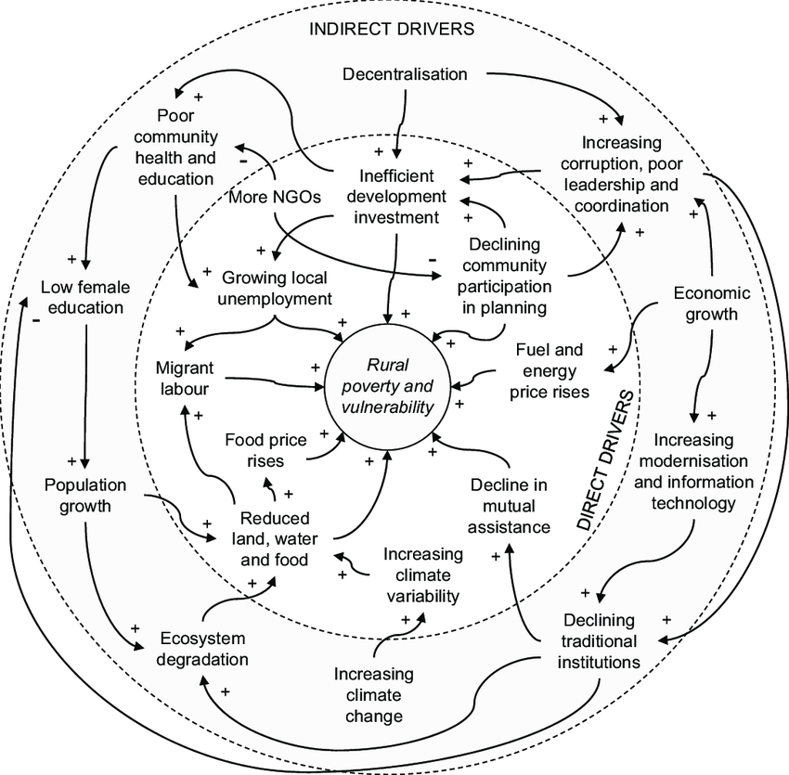
Ignore the Wicked Problem BS
Don’t be dissuaded by evaluators who only care about marketing.
Stay focused on evaluating the intervention!
  Evaluation boundary vs problem boundary.

Slide 99
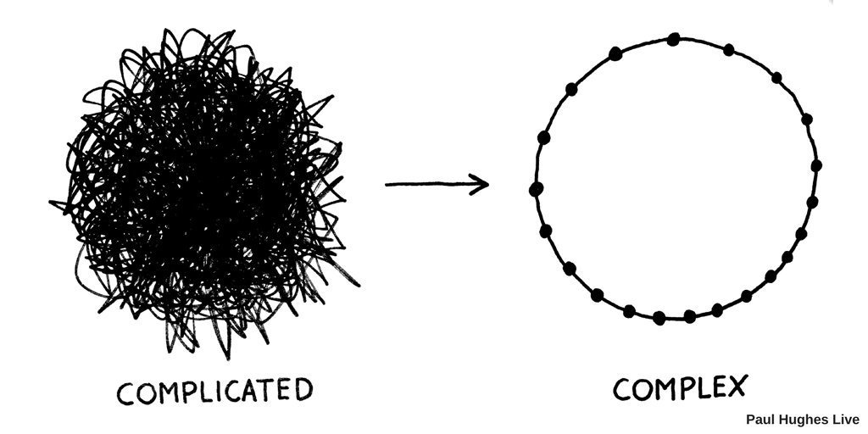
Don’t be deterred by academics and theoretical arguments.
Evaluating complex interventions, will take more resources but it is not complicated, its not difficult.

Slide 100


Contact Information:
  email ralph@justevaluation.com
  Website: justevaluation.com
  Cell: 520-203-1038
IAP || Book || System Evaluation Theory (infoagepub.com)

