Slide 1
Welcome
AEA 2022
Systems Evaluation Workshop
Bolden 5

Slide 2
We respectfully acknowledge that our conference is being held on the original lands of the Chitimacha.

Slide 3
Housekeeping
Breaks:
10:30 am - 10:45 am
Lunch: 12:00 noon - 1:00 pm
Afternoon – 2:30pm - 2:45pm but…..we are heading to the Pythian Market
Contact Information:
email ralph@justevaluation.com
Website: justevaluation.com
Cell: 520-203-1038

Slide 4
What is your name?
Where do you work?
What brought you to the workshop?

Slide 5
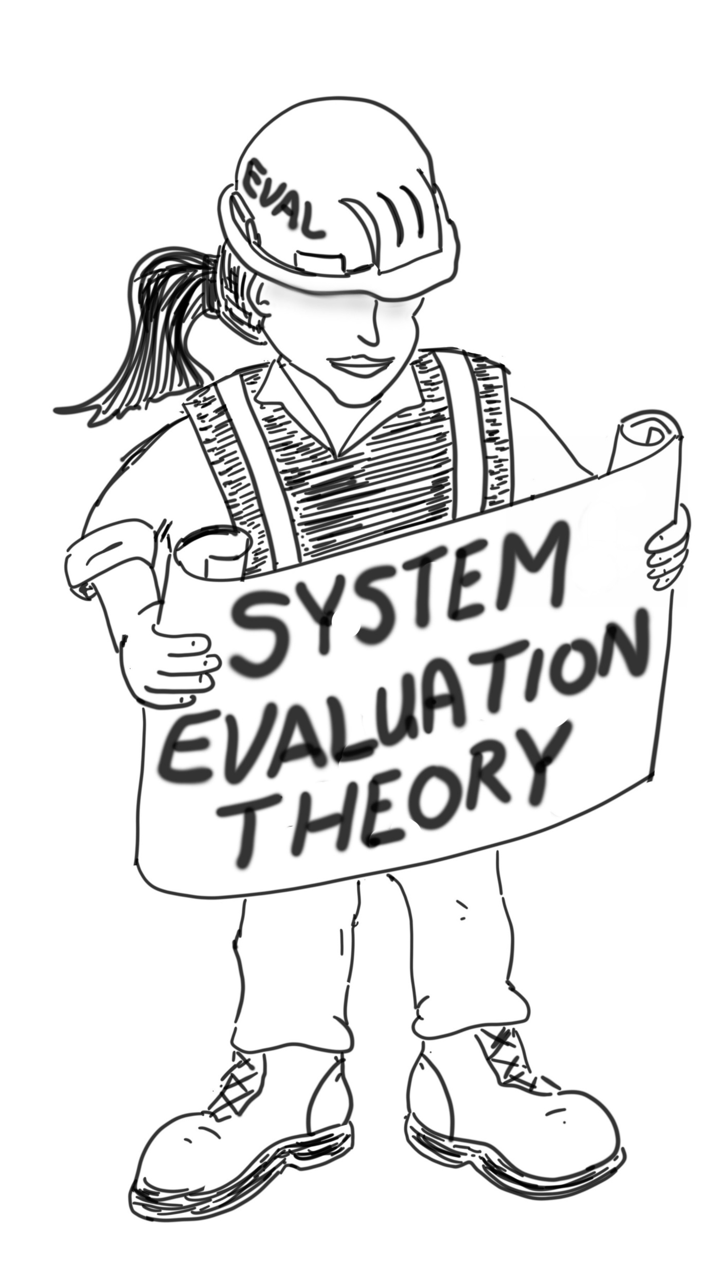
Workshop Objectives
Objective 1: To understand the challenges in evaluating complex interventions.
Objective 2: To understand why an approach grounded in systems is a path forward for evaluating complex interventions.
Objective 3: To learn how to use Systems Evaluation Theory (SET) to define and evaluate complex interventions operating and functioning as a system.
Objective 4: To reinforce an understanding of systems properties and principles by going on a field trip.

Slide 6
What characterizes a simple intervention?
“ a simple linear pathway linking the intervention and its outcome” (Petticrew, 2011).

Slide 7
A simple intervention
Notes:
a “I would add that the intervention can be expected to produce change in the immediate-intermediate-long term outcomes

Slide 8
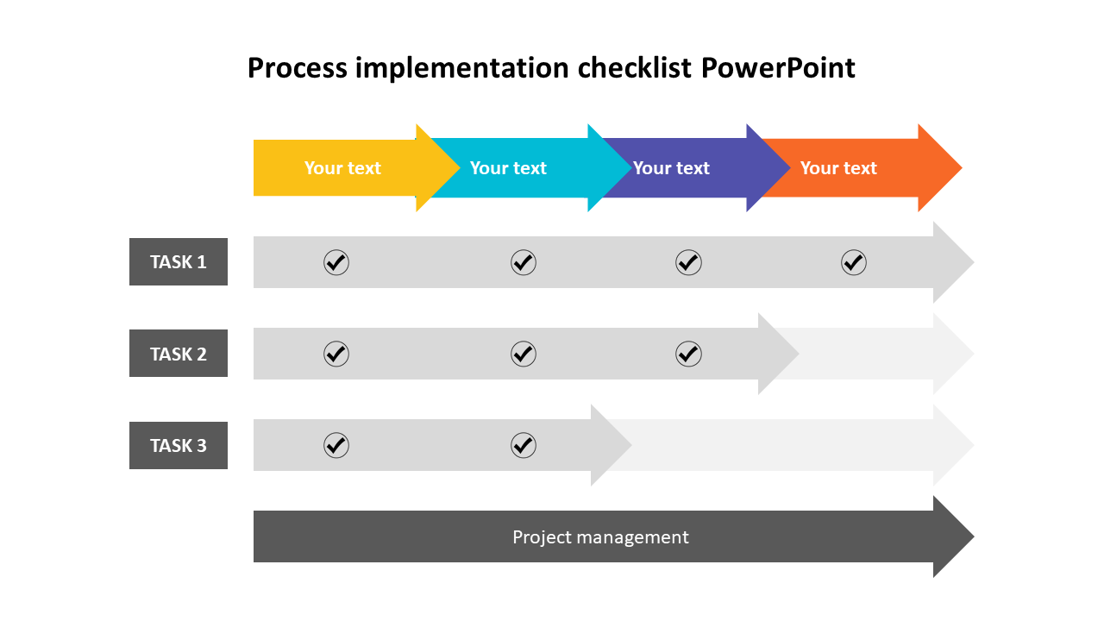
What might be some of the process evaluation questions for this simple intervention?
Was all the course content covered?
Did students complete all the assignments?

Slide 9
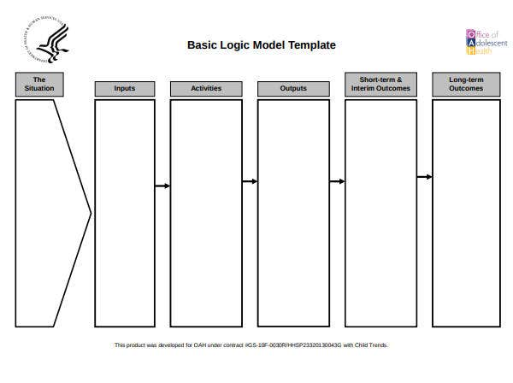
What might be some of the outcomes for this simple intervention?
# of enrollees
Courses developed
Obtain High School Diploma
Teachers
Classrooms
IT
Progression in courses
High schoolers dropout
GED Classes
Notes:
What do you have direct and immediate control to change?
Discussion needed about long term outcome: is it juts a crazy gola to get $$$ or is it that they are part of something bigger…in which case we need a different appraoch?

Slide 10
What are characteristics of a complex intervention?
A complex intervention “involves at minimum multiple components and a complex pathway…” (Guise et al., 2017).
Many components working together nonlinearly.

Slide 11
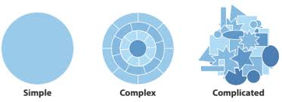
What is the difference between complex and complicated?
Our field is very inconsistent and careless in using the terms complex and complicated.
We will use the term complex to mean many parts working together.
We will use the term complicated to mean difficult.
Notes:
No right or wrong answer.
We are trying to evaluate complexity…Williams, rogers, etc.

Slide 12
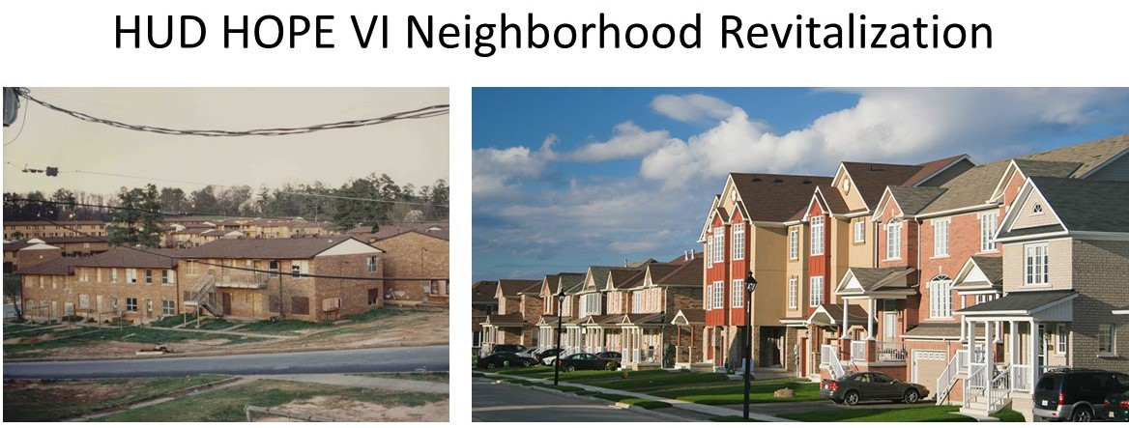
Housing Density
Job Skills
Safe Parks
Neighborhood
Businesses
Tax Incentives
Childcare
Education

Slide 13
Housing Density
Job Skills
Safe Parks
Neighborhood
Businesses
Tax Incentive
Tax incentive
Finish High School
Childcare

Slide 14
is a complex intervention
Notes:
A complex intervention “involves at minimum multiple components and a complex pathway…” (Guise et al., 2017).

Slide 16
Safe Parks
Job Skills
Neighborhood
Businesses
Housing Density
Tax Incentive
Education
Childcare

Slide 17
Safe Parks
Job Skills
Neighborhood
Businesses
Housing Density
Tax Incentive
Residents Remaining in Neighborhood
Retrained and employed
New locally owned businesses
Park Utilization
Reduced Housing
Density
Spouses at Work
High School Diploma
Education
Childcare

Slide 18
What does this strategy miss from an outcomes evaluation perspective?

Slide 19
Housing Density
Job Skills
Safe Parks
Neighborhood
Businesses
Tax Incentive
Childcare
Finish High School

Slide 20
What does this strategy miss from a process evaluation perspective?

Slide 21
Housing Density
Job Skills
Safe Parks
Neighborhood
Businesses
Tax Incentive
Tax incentive
Finish High School
Childcare

Slide 22
Safe Parks
Job Skills
Neighborhood
Businesses
Housing Density
Tax Incentive
Finish High School
Childcare

Slide 23
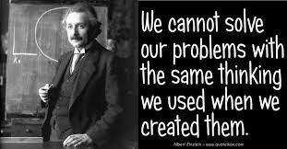
If more logic models are not the solution, then…
Notes:
It’s not the logic model fault
Doing more of the thing that created the problem in the first place.

Slide 24
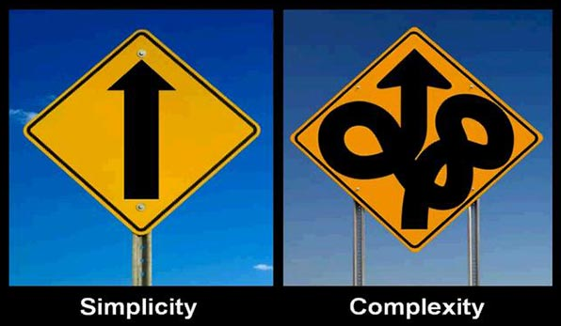
…..what is the solution?

Slide 26
How would you define a system?
An integrated whole whose essential properties emerge from the interdependence between its parts (Ison, 2008).
Notes:
First step is to define a system; to define = must understand its properties; an evaluation approach must be aligned to evaluating its properties.

Slide 27
System thinking and theory is a good fit for evaluating complex interventions because….
Systems, by definition, have many moving parts that must work together to achieve something they cannot do independently.

Slide 28
What do we mean by system parts?
System parts include a set of plans, resources, authorities, agencies, and their associated human resources (Jackson, Faith, & Willis, 2012).
Basically any component of a complex intervention.
Notes:
Poll Answer: F, all of the above

Slide 29
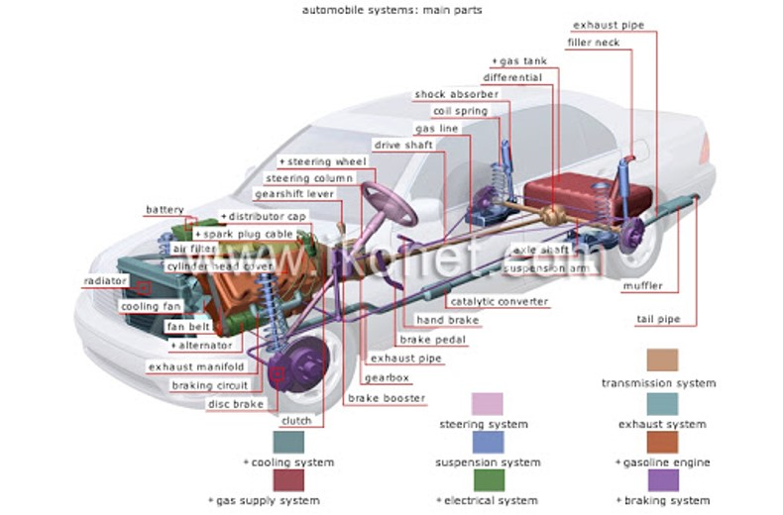
Illustrating parts, interdependence and emergence

Slide 30
Meet the system test?
All parts are needed for the essential system property (i.e., moving you from point A to point B) to emerge.
If a single part is missing, then the car won’t run as well or at all, so the essential system property may not emerge.

Slide 31
Notes:
Us example of sports

Slide 32
What are the system parts?
Players, coaches.
Equipment manager?
Family?

Slide 33
What is the emergent system property?
Team chemistry?
Love of teammates?
Respect?
We will be discussing how to evaluate the emergent property and who should be responsible for data collection.

Slide 34
Meet the system test?
All the system parts (players, coaches, training staff) are needed for team chemistry to emerge.
No single player can create team chemistry but missing a player or having the wrong player can destroy team chemistry.

Slide 35
Housing Density
Job Skills
Safe Parks
Neighborhood
Businesses
Tax Incentive
Tax incentive
Finish High School
Childcare

Slide 36
Meet the system test?
All the HUD HOPE VI components are needed for improved quality of life to emerge.
No single component can achieve quality of life on its own but missing just one part likely means the intervention will not lead to improvements in quality of life.

Slide 37
So what is the value added of applying an understanding of system properties in evaluating complex interventions?
Status quo = panic and no direction.
Wicked problem.
Treating complexity as “a bunch of stuff” (Meadows).
There are no standards to evaluate a bunch of stuff.
Property of interdependence gives the “bunch of stuff” (i.e., complexity) an operational purpose that can now be evaluated.
Property of emergence gives the “bunch of stuff” (i.e., complexity) a functional purpose that can now be evaluated.

Slide 38
Break

Slide 39
Let’s be honest
Many interventions are not designed with the complexity necessary to match the problem they are intended to solve.
This explains why most interventions fail (GAO2021; Suchman, 1967; Friedman, 2009)
Even though the logic model isn’t fit for purpose (evaluating complexity), even a perfect evaluation can’t make up for a poor program design.
Notes:
It is true that often our evaluations do not fit the problem at hand, however if the design is flawed then even an evaluation fit for purpose will conclude the program failed.

Slide 40
However, for complex interventions that are well designed…
Need an evaluation approach tailored to evaluate complexity.
An approach grounded in systems provides a possible way forward for evaluating complex interventions.
Notes:
When evaluations show the program isn’t working we tend to blame the tool.

Slide 41
System Evaluation Theory (SET)
A blueprint for how to do apply an understanding of systems to evaluate complex interventions.
Step 1. Define the system.
Step 2: Evaluate interdependencies.
Step 3: Evaluate emergence.
Notes:
SET takes this systems thinking lens and creates a meaningful and manageable path forward to conduct a systems evaluation
Notes based on munch conversation: you can still evaluate individual parts to see whether they are meeting their goal, say using logic models.

Slide 42
Rationale of System Evaluation Theory (SET)
Cascading events
Parts
Reworks
Step 1: Define the System
Levels
Step 2: Evaluate System Efficiency
Interdependencies
Reflex Arcs
Scale
Evaluate interdependencies
Feedback loops
Boundaries
Others
Emergence
Step 3: Evaluate System Effectiveness
Note: System refers to the complex intervention that is acting as a system.
Evaluate emergence
Holism

Slide 43
The Challenge

Slide 44
The LUCAS device evaluated as a simple intervention
Positive Intrathoracic pressure.
Reduced variability in CPR.
No fatigue.
High Quality CPR difficult to sustain
Increased blood flow to the brain
$
Researchers
Multiple trials
Prototypes
LUCAS
LUCAS 2
LUCAS 3

Slide 45
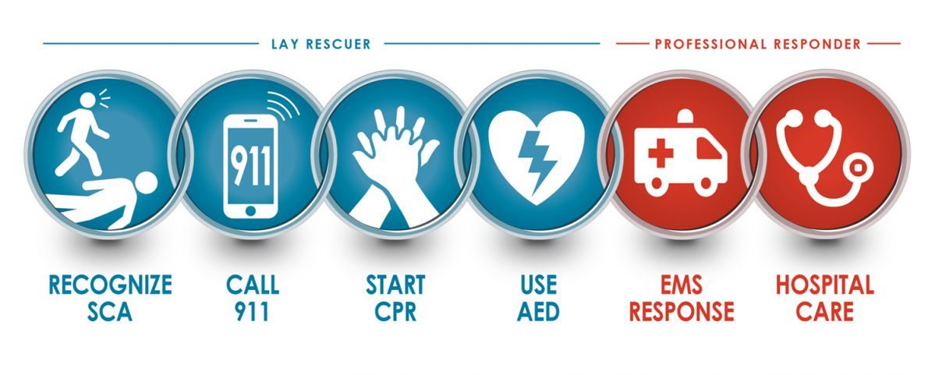
But the reality is…

Slide 46
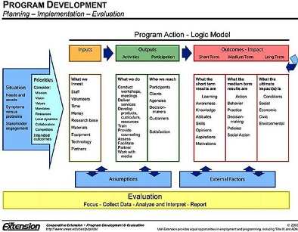
Could try multiple logic models.

Slide 47
What does “coupling” miss as it relates to the process evaluation?

Slide 48
What does “coupling” miss as it relates to the outcome evaluation?

Slide 49
The LUCAS device is one of many interdependent components.

Slide 50
The LUCAS device by itself cannot save a life.

Slide 51
We are evaluating a complex intervention operating and functioning as a system.
The LUCAS device is one interdependent component of the cardiac system of care.

Slide 52
Applying System Evaluation Theory (SET)
Cascading events
Parts
Reworks
Step 1: Define the System
Levels
Step 2: Evaluate System Efficiency
Interdependence
Reflex Arcs
Scale
Evaluate interdependencies
Feedback loops
Boundaries
Others
Emergence
Step 3: Evaluate System Effectiveness
Note: System refers to the complex intervention that is acting as a system.
Evaluate emergence
Holism

Slide 53
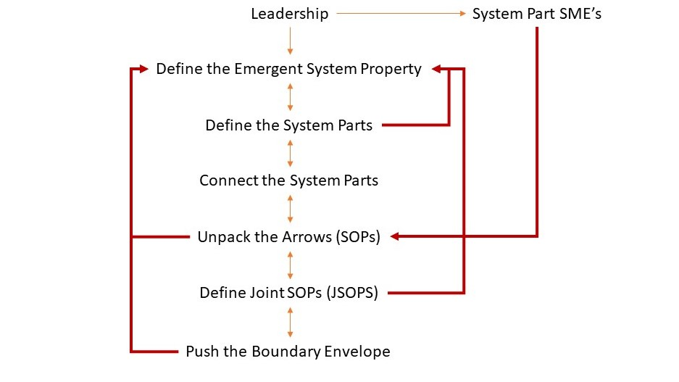
Step 1: Define the System

Slide 54
Cardiac System of Care Case Study
Notes:
Sticking with a simple example yuou can undertsnad the basics. Nut know this has been applied to evaluating COVID, CTRs, etc.

Slide 55
Notes:
Lewe’s reference to the law

Slide 56
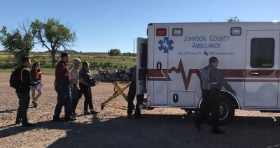
Emergency Dispatch
Volunteer Emergency Medical Services
EMS with Paramedic
Heart Hospital
(definitive care)
Critical Access Hospital
Notes:
Used leaders to do this. Storyboarding technique
Chronological or time bound boundary

Slide 57
Volunteer Emergency Medical Services
Emergency Dispatch
EMS with Paramedic
Heart Hospital
(definitive care)
Critical Access Hospital
Notes:
Used leaders to do this. Storyboarding technique
Chronological or time bound boundary

Slide 58
Volunteer Emergency Medical Services
Emergency Dispatch
EMS with Paramedic
Heart Hospital
(definitive care)
Critical Access Hospital
Notes:
Used leaders to do this. Storyboarding technique
Chronological or time bound boundary

Slide 59
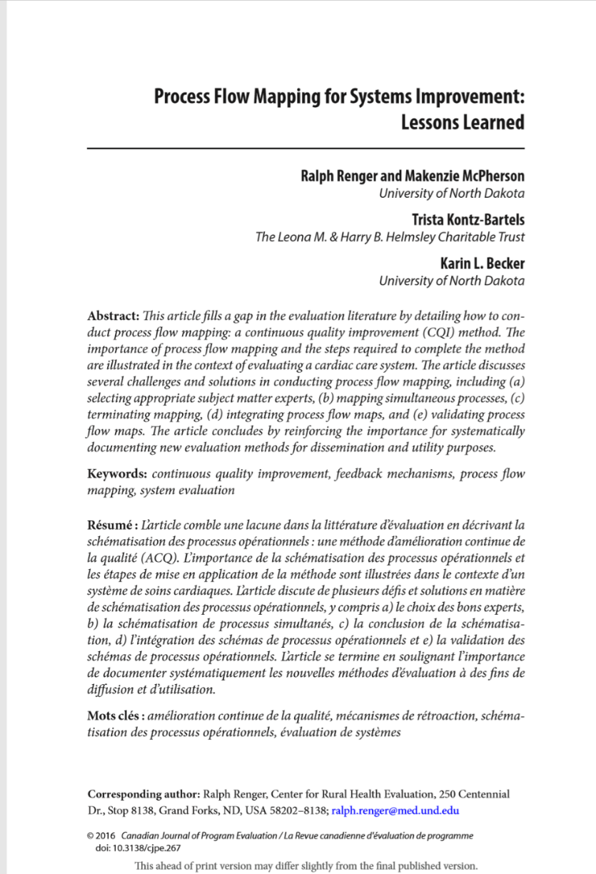
Using Process Flow Mapping to “unpack” the arrows

Slide 60
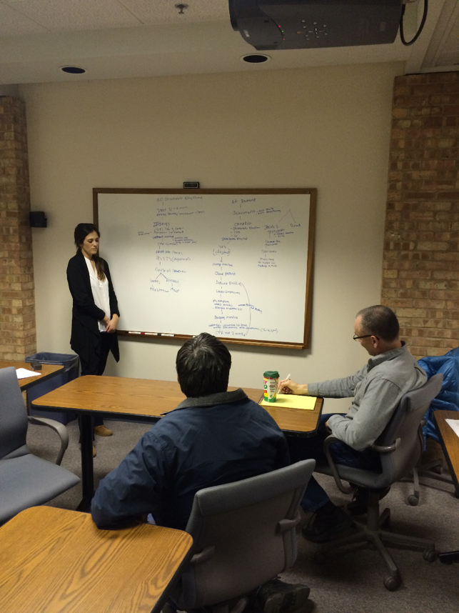
Notes:
Process flow mapping

Slide 61
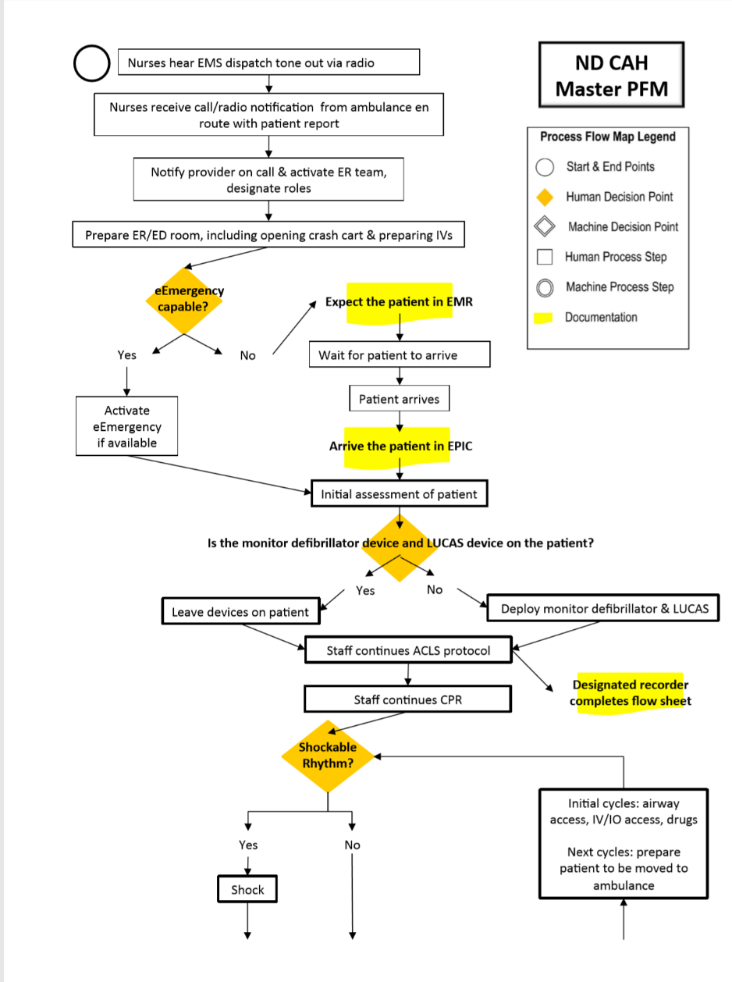
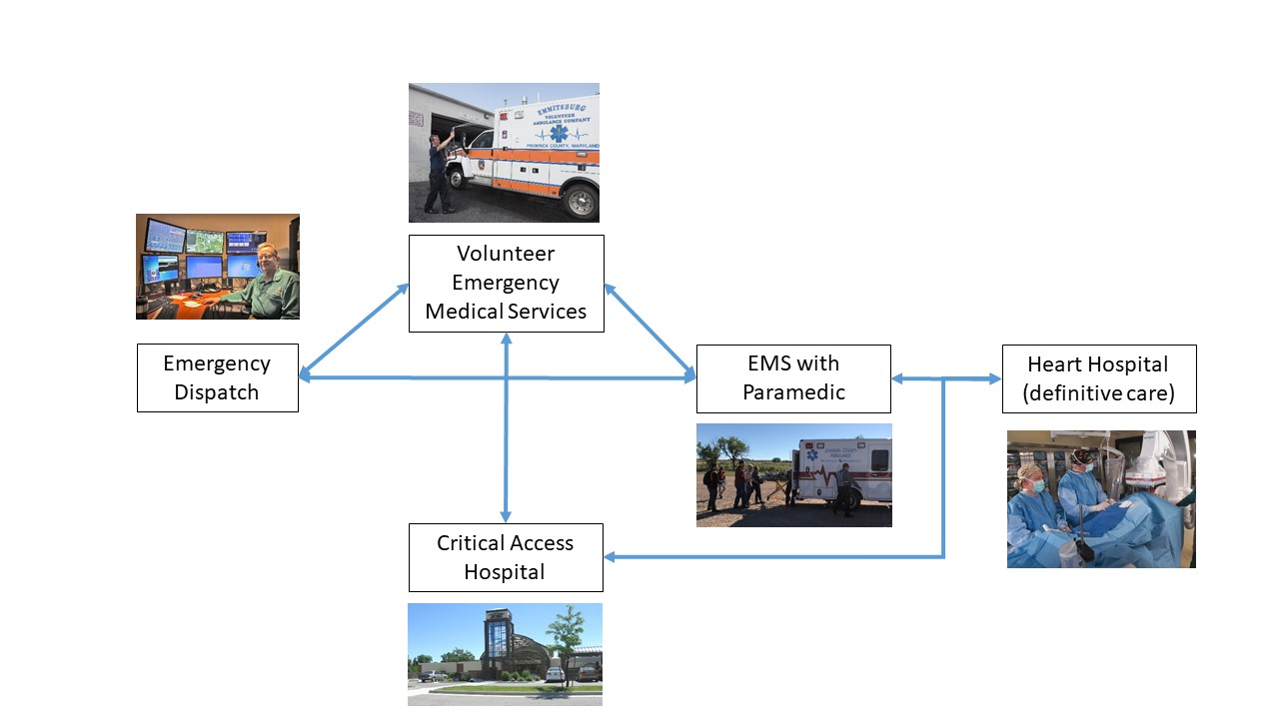
Notes:
Process flow mapping

Slide 62
How do SOPs help with the evaluation?
The SOPs are the standard of acceptability against which we make evaluative judgements!

Slide 63
Notes:
Bring two system parts together at a time.

Slide 65
The parts included in our system form an initial system boundary

Slide 66
A system boundary separates the created system from its environment (Wolski, 2020).
Notes:
Answer
Answer: g, all of the above

Slide 68
Long Term Care
(Rehabilitation)
Bystander CPR

Slide 69
Long Term Care
(Rehabilitation)
Bystander CPR

Slide 70
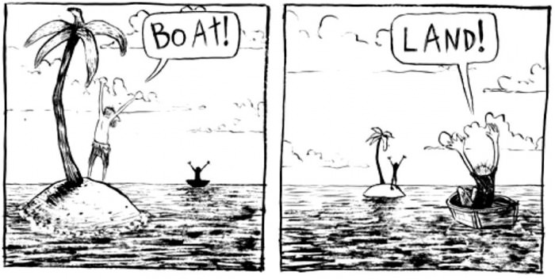
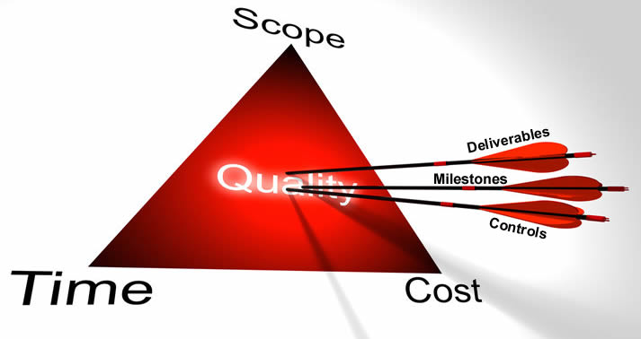
Why is knowing the system boundary important?
Helps you understand which perspectives are needed.
Gives you an idea of the scope and therefore cost of the evaluation.

Slide 71
Summary: Defining the System

Slide 72
Step 1 Workarounds
When you don’t have time and/or money to work through all the steps.
“Everything around you is on fire” (Tania Buck)
IGEM Mark Beevers
Used source documentation
Law
Workflows

Slide 73
What are some benefits of step 1 beyond evaluation?
Yarbrough et. al = we want our evaluation products and processes to be useful.
Products.
Defined SOPs = helps with standardizing training.
Processes.
Builds culture of cooperation; improved SOPs by just talking through; cheaper alternative.

Slide 75
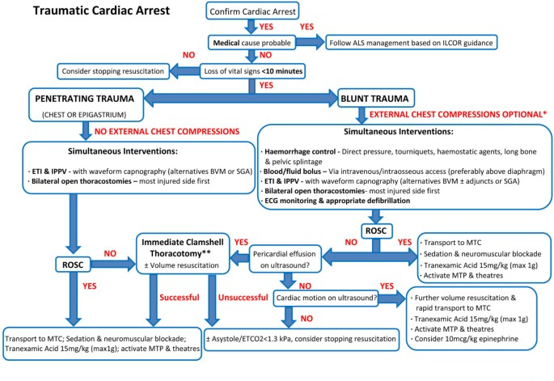
What is the product of step 1?
Now what?

Slide 76
Rationale of System Evaluation Theory (SET)
Cascading events
Parts
Step 1: Define the Intervention Operating as a System
Reworks
Levels
Step 2: Evaluate System Efficiency
Interdependence
Reflex Arcs
Scale
Evaluate interdependencies
Feedback loops
Boundaries
Others
Emergence
Step 3: Evaluate System Effectiveness
Note: System refers to the complex intervention that is acting as a system.
Evaluate emergence
Holism
Notes:
Moved Mentimeter question (why is it important to evaluate system efficiency before effectiveness?) to this slide.

Slide 77
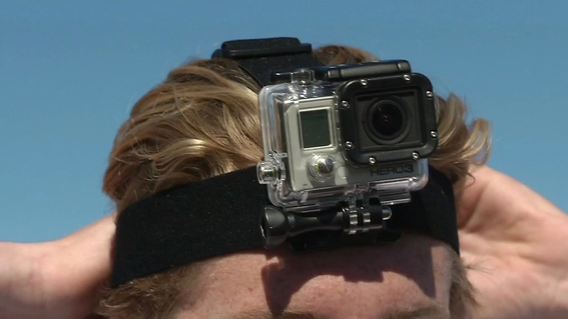
What might be some methods for evaluating JSOPs (interdependencies)?
Notes:
The types of questions asked are informed by the system principles.
Questions will pertain to feedback loops, cascading events, reflex arcs, etc
Analyses of source documents (e.g. themes) informed by systems principles.
Where you focus your observation is informed by systems principles.

Slide 78
Evaluating the Cardiac Care System JSOPs using direct observation
Volunteer Emergency Medical Services
Emergency Dispatch
EMS with Paramedic
Heart Hospital
(definitive care)
Critical Access Hospital

Slide 79
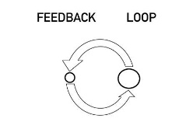
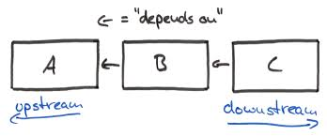
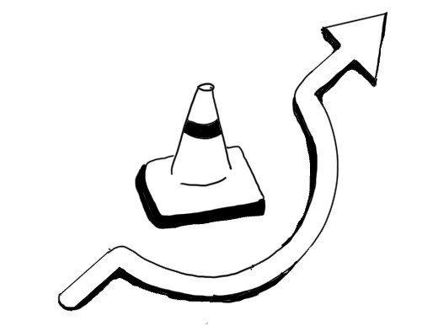
Applying system principles to evaluate interdependencies.
Feedback loops
Cascading events
Reflex arcs

Slide 80
Feedback Loops
The return of information about the status of a process.
Notes:
Add close the loop

Slide 81
Locating feedback loops

Slide 82
Feedback Loops: Wherever and whenever information is exchanged.
Volunteer Emergency Medical Services
Emergency Dispatch
EMS with Paramedic
Heart Hospital
(definitive care)
Critical Access Hospital

Slide 83
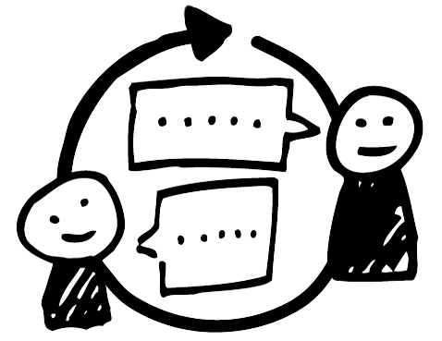
First evaluation decision point: Is the feedback loop being closed?
Notes:
Examples: ending transmission; acknowledgment of fax, signature

Slide 84
Second evaluation decision point: Quality of the feedback?
Notes:
Add close the loop

Slide 85
Feedback loop frequency
Patient and run report data collected by EMS
Hospital adds data on patient outcome
State EMS combines run data and hospital data.
Notes:
Cardiac arrest data entered into a system by EMTs after every run
Information wasn’t being provided back to EMTs to improve their performance: EMTs stopped filling out reports

Slide 86
Feedback loop frequency
Patient and run report data collected by EMS
Annually
Hospital adds data on patient outcome
State EMS combines run data and hospital data.
Notes:
Cardiac arrest data entered into a system by EMTs after every run
Information wasn’t being provided back to EMTs to improve their performance: EMTs stopped filling out reports

Slide 87
Consequences

Slide 88
Recommendation: Increase feedback loop frequency
Patient and run report data collected by EMS
Annually
Hospital adds data on patient outcome
State EMS combines run data and hospital data.
Notes:
Cardiac arrest data entered into a system by EMTs after every run
Information wasn’t being provided back to EMTs to improve their performance: EMTs stopped filling out reports

Slide 89
Recommendation: Increase feedback loop frequency
Patient and run report data collected by EMS
Monthly
Hospital adds data on patient outcome
State EMS combines run data and hospital data.
Notes:
Cardiac arrest data entered into a system by EMTs after every run
Information wasn’t being provided back to EMTs to improve their performance: EMTs stopped filling out reports

Slide 90
Feedback Specificity
Caller
911 Dispatch Center

Slide 91
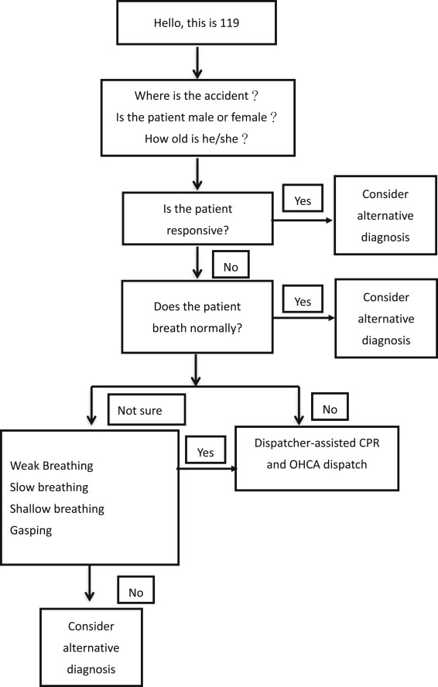
Locate the feedback loops
Notes:
specificty

Slide 92
Specificity critical at each feedback loop
Goal is to get to this part of the algorithm as quickly as possible.
Notes:
Specificity key at each step because it informs the algoriythm…the quicker they get through the algorithm the sooner the help gets sent.
Recommendation to change from “what is your emergency” to where is your emergency first question.

Slide 93
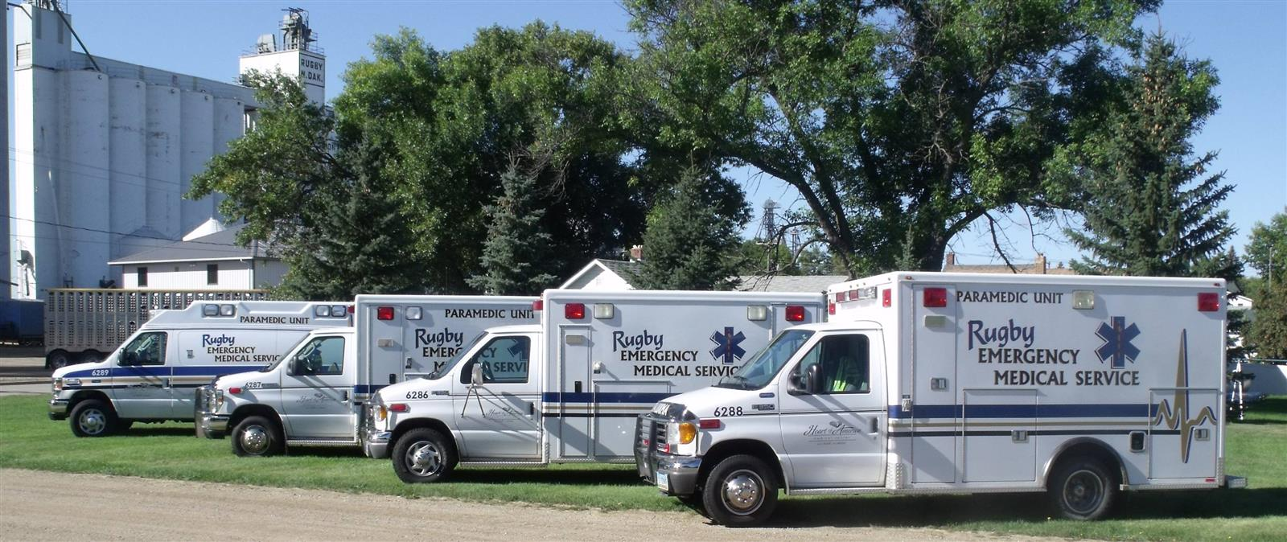
The consequence

Slide 94
“What is your emergency?”
A cascading event caused by a failed feedback loop
Goal is to get to this part of the algorithm as quickly as possible.
Notes:
Specificity key at each step because it informs the algoriythm…the quicker they get through the algorithm the sooner the help gets sent.
Recommendation to change from “what is your emergency” to where is your emergency first question.

Slide 95
Additional specificity problem
Notes:
Specificity key at each step because it informs the algoriythm…the quicker they get through the algorithm the sooner the help gets sent.

Slide 96
Recommendation

Slide 97
Feedback Credibility
Notes:
Don’t trust volunteers in this critical situations because many volunteers have not experienced them alot

Slide 98
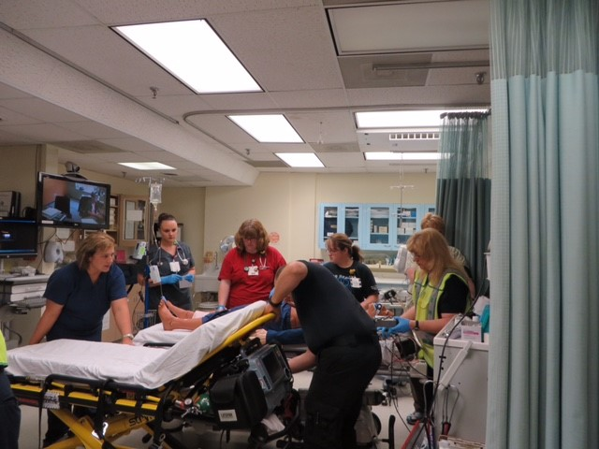
Consequences
Notes:
Not deemed as credible there is no action in the ER to receive the patient. Should look like panel A, but looks like panel B

Slide 99
Helmsley Charitable Trust solution: create a bypass
Notes:
Show this and then problem was closing the loop!

Slide 100
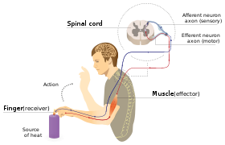
Reflex Arc
In practice: To what extent can processes be handled at the lowest operational level as opposed to being passed up the system for processing; which causes delays.

Slide 101
Reflex Arcs

Slide 102
Reflex Arcs

Slide 103
Cascading Failures

Slide 104
Looking upstream for solutions
Cascading Failures
Volunteer Emergency Medical Services
Emergency Dispatch
EMS with Paramedic
Heart Hospital
(definitive care)
Critical Access Hospital

Slide 105
Recommendation

Slide 106
Rationale of System Evaluation Theory (SET)
Cascading events
Parts
Step 1: Define the Intervention Operating as a System
Reworks
Levels
Step 2: Evaluate System Efficiency
Interdependence
Reflex Arcs
Scale
Evaluate interdependencies
Feedback loops
Boundaries
Others
Emergence
Step 3: Evaluate System Effectiveness
Note: System refers to the complex intervention that is acting as a system.
Evaluate emergence
Holism
Notes:
Moved Mentimeter question (why is it important to evaluate system efficiency before effectiveness?) to this slide.

Slide 107
Step 3: Evaluating System Emergence (i.e., effectiveness)
To evaluate a system’s effectiveness is to ask whether the interdependent parts were successful in allowing the essential system property to emerge.

Slide 108
Volunteer Emergency Medical Services
Heart Hospital
(definitive care)
Cardiac Care System
Emergency Dispatch
Critical Access Hospital
EMS with Paramedic
Notes:
Used leaders to do this. Storyboarding technique
Chronological or time bound boundary

Slide 109
Volunteer Emergency Medical Services
Heart Hospital
(definitive care)
Emergency Dispatch
Critical Access Hospital
EMS with Paramedic
Notes:
Used leaders to do this. Storyboarding technique
Chronological or time bound boundary

Slide 110
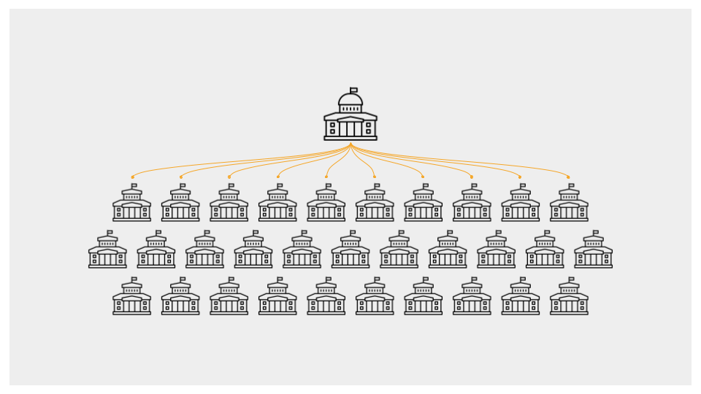
Who is responsible for collecting data on the emergent property?
Those overseeing the system (complex intervention).
Friedman (RBA): community level indicators.
Not individual system parts.
Notes:
Results based accountability

Slide 111
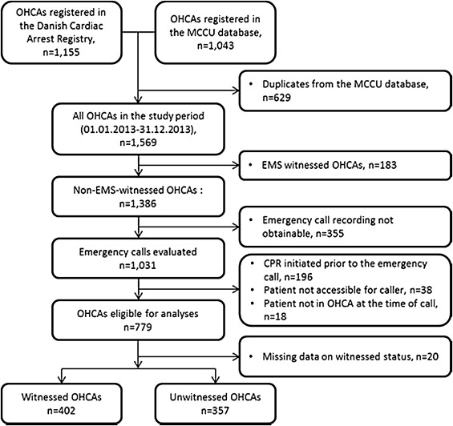
Cardiac Care System
Survival rate data compiled at the state level.

Slide 112
HUD HOPE VI
Survey of all participants by external evaluator.

Slide 113
A pitfall of evaluating emergence
If you are evaluating emergence then it not make sense to evaluate the effectiveness of individual system parts because they are “interdependent”.
But assuming interdependence is good if property isn’t emerging then you might need to:
look at whether the system parts are indeed correct…that is, is it what a system part contributing necessary and correct or are we missing a part??
Or whether you have the correct emergent property
The emergent property is a “product” of the interaction of parts. (Ackoff). It’s not summative!
Notes:
Evaluating single parts is okay for its own long term outcome (in its control). If we have interdependence but no emergence, then 1. wrong emergent property. 2. a system part may be failing….how do we know if a system part is failing? This comes out in step 2….they aren’t interacting…..so you go back.
If you detect a system problem either emergence or interdependence. I’m hoping before evaluating meregence that I’ve detected a probble with a system part through the evaluation of interdependence. BUT….if not emergent, then one part isn’t holding up its end of the bargain…

Slide 114
You know what to evaluate, but the how may be challenging
The emergent property is often multidimensional.
Mental component.
Physical component.
Financial component.
Could also borrow from other professions, like Psychology.
Psychologists have methods for developing tools to evaluate multidimensional constructs.
Indicators could be useful.
Tenure
work position (stability).
Businesses.
Purchasing a home.
Notes:
Surveys…go to…often not practical

Slide 115
Field trip to the Pythian Market

Slide 117
Worksheet

Slide 118
Field Trip Observations
Evaluating the emergent property
All levels operate as a system.
The emergent property remains the same at all levels!
Evaluating interdependencies
The nature of the evaluation question change because the parts at each level are different.
Single restaurant: Was the customer’s order being correctly relayed from the greeter, to toppings, to cashier? Was the cooking and cooling equipment required to ensure quality sandwiches regularly inspected and functional?
Food court: Are all restaurants in the food court abide by the Hazard Analysis Critical Control Point (HACCP) principles (FDA, 2017). What is the timing of the opening/closing of these three clusters of businesses that optimizes customer satisfaction? Are all the different dietary requirments covered?
Highest level: Is there a way to get people from the venue to venue safely? Parking access? Do the attractions cater to different age groups/interests?

Slide 119
Observations from a single restaurant
Feedback loops?
Cascading events?
Reflex arcs?

Slide 120
Contact Information:
email ralph@justevaluation.com
Website: justevaluation.com
Cell: 520-203-1038
IAP || Book || System Evaluation Theory (infoagepub.com)

